Slide 1

Machine Learning Guided Synthesis of Materials with Specific Structures and Properties
Romain GAUTIER
Institut des Matériaux de Nantes Jean Rouxel (IMN)
GDR MEETICC
Nantes, December 5th, 2023
Chemist interested in ML.
L’objecif, ici, n’est pas vraiment de rentrer dans les détails technique du ML mais de voir comment le ML peut être utilisé pour la science des matériaux.

Slide 2
What is Artificial Intelligence?
Symbolic AI
Connectionist AI
Hypothetical-deductive machine
Inductive machine
First use of the term “Artificial Intelligence”
Machine Learning belongs to this category
Cardon D.; Cointet, J.P..; Mazières, A. “Neurons spike back”, Réseaux, (2018) 211(5)
Notes:
2
2

Slide 3
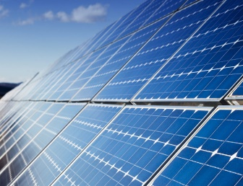
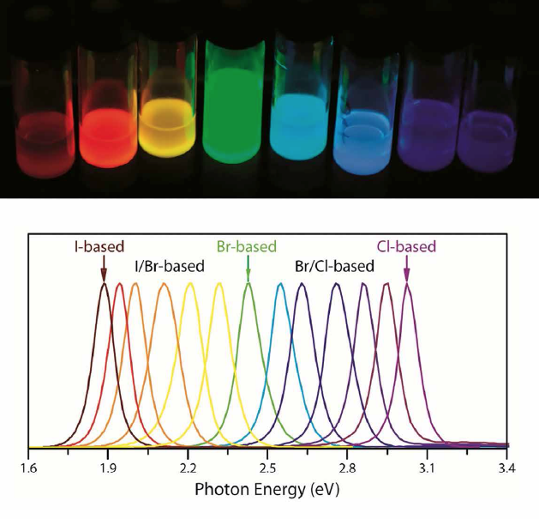
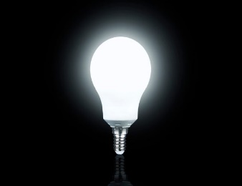
Applications of hybrid perovskites
Optoelectronic applications:
Solar cells
LEDs
Solid State Lighting
Hybrid perovskite ABX₃
A = Ammonium ion
B = Metal ion
X = Halide ion
Notes:
3
3

Slide 4
Low dimensional hybrid perovskite
Lead halide Perovskite
Perovskite-type compounds are built from only corner sharing PbX₆ octahedra
d_{Pb-Pb} ≈ 6 Å
Massuyeau, F.; Broux, T.; Coulet, F.; Demessence, A.; Mesbah, A.; Gautier, R. Advanced Materials, (2022) 34(41)
Notes:
4
4

Slide 5
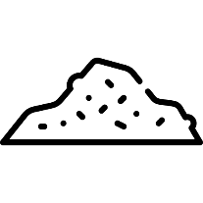

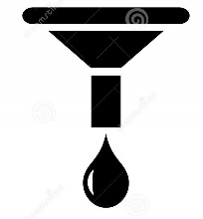

The discovery of functional hybrid perovskite
PbX₂
+ HX acid
+ amine
Synthesis
Heating 20-100°C
Filtration
Structural determination
XRD
Optical Characterizations
Notes:
5
5

Slide 6
The discovery of functional hybrid perovskite
PbX₂
+ HX acid
+ amine
Synthesis
Heating 20-100°C
Filtration
Structural determination
XRD
Optical Characterizations
Notes:
6
6

Slide 7
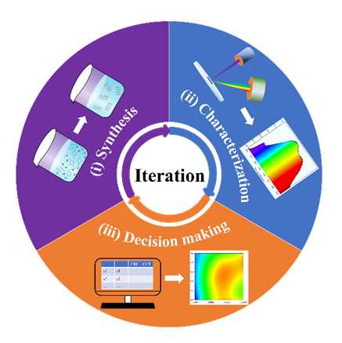
Optimization of a white phosphor
Machine learning guided discovery of phosphors
Experimental validation
CCT
6924 K
6503 K
5705 K
4040 K
3156 K
CRI
92
94
96
97
94
A 70-fold reduction in the number of experiments relative to a grid-based search
Yuan, H. ; Qi, L.; Paris, M. ; Chen, F.; Shen, Q.; Faulques, E.; Massuyeau, F.; Gautier, R. Advanced Science (2021) 8(19), 2101407
Notes:
7
7

Slide 8
The discovery of functional hybrid perovskite
PbX₂
+ HX acid
+ amine
Synthesis
Heating 20-100°C
Filtration
Structural determination
XRD
Optical Characterizations
Notes:
8
8

Slide 9
X-ray diffraction patterns of new hybrid metal halides
Perovskite or not perovskite ?
1
2
Intensity (a.u.)
Intensity (a.u.)
2θ (°)
2θ (°)
3
4
Intensity (a.u.)
Intensity (a.u.)
2θ (°)
2θ (°)
Massuyeau, F.; Broux, T.; Coulet, F.; Demessence, A.; Mesbah, A.; Gautier, R. Advanced Materials, (2022) 34(41)
Notes:
9
9
Dans l’ordre 24, 25, 26, 1

Slide 10
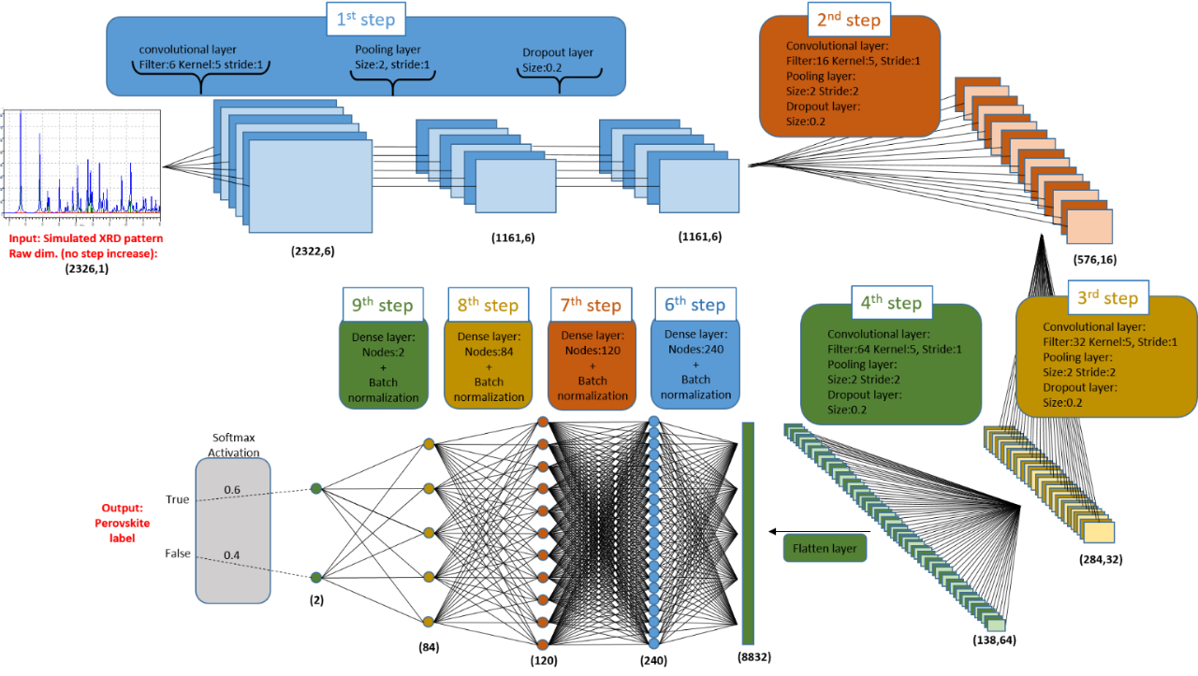
A convolutional neural network
to identify perovskites
Dataset
998 crystal structures from the Cambridge Structural Database
Identification of the structure type for each structure:
Perovskite / Non-perovskite
Simulation of the powder XRD patterns
80% for training
20% for validation
Accuracy of 92% at discriminating perovskites vs. non perovskites
Massuyeau, F.; Broux, T.; Coulet, F.; Demessence, A.; Mesbah, A.; Gautier, R. Advanced Materials, (2022) 34(41)
CNN => Manière de traiter les DRX peut paraitre aberrante car on a jamais appris à faire comme cela
Notes:
10
10

Slide 11
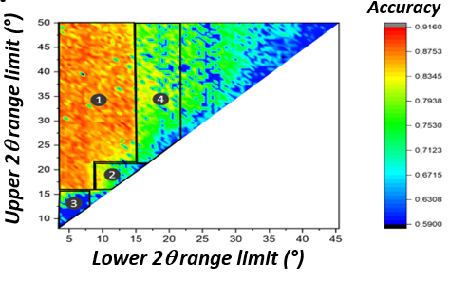
How the neural network
can identify perovskites?
PROBLEM
SOLUTION
How to identify the important features for the neural network in the XRD patterns?
Hide some parts of the XRD patterns and calculate the accuracy
Intensity (a.u.)
2θ (°)
A 8° to 10° (2θ) / 9 to 11 Å
B 12.5° to 17.5° (2θ) / 5 to 7 Å
C 17.5° to 29.5° (2θ) / 3 to 5 Å
Massuyeau, F.; Broux, T.; Coulet, F.; Demessence, A.; Mesbah, A.; Gautier, R. Advanced Materials, (2022) 34(41)
Notes:
11
11

Slide 12
How the neural network
can identify perovskites?
Three identified features
Sums of XRD patterns
A
8° to 10° (2θ) / 9 to 11 Å
B
12.5° to 17.5° (2θ) / 5 to 7 Å
C
17.5° to 29.5° (2θ) / 3 to 5 Å
Massuyeau, F.; Broux, T.; Coulet, F.; Demessence, A.; Mesbah, A.; Gautier, R. Advanced Materials, (2022) 34(41)
Notes:
12
12

Slide 13
How the neural network
can identify perovskites?
Three identified features
Sums of XRD patterns
A
8° to 10° (2θ) / 9 to 11 Å
B
12.5° to 17.5° (2θ) / 5 to 7 Å
C
17.5° to 29.5° (2θ) / 3 to 5 Å
What are these features ?
Massuyeau, F.; Broux, T.; Coulet, F.; Demessence, A.; Mesbah, A.; Gautier, R. Advanced Materials, (2022) 34(41)
Notes:
13
13

Slide 14
How the neural network
can identify perovskites?
Three identified features
Sums of XRD patterns
A
8° to 10° (2θ) / 9 to 11 Å
B
12.5° to 17.5° (2θ) / 5 to 7 Å
C
17.5° to 29.5° (2θ) / 3 to 5 Å
What are these features ?
Massuyeau, F.; Broux, T.; Coulet, F.; Demessence, A.; Mesbah, A.; Gautier, R. Advanced Materials, (2022) 34(41)
Notes:
14
14

Slide 15
How the neural network
can identify perovskites?
Three identified features
Sums of XRD patterns
A
8° to 10° (2θ) / 9 to 11 Å
B
12.5° to 17.5° (2θ) / 5 to 7 Å
C
17.5° to 29.5° (2θ) / 3 to 5 Å
d ≈ 6 Å
What are these features ?
Massuyeau, F.; Broux, T.; Coulet, F.; Demessence, A.; Mesbah, A.; Gautier, R. Advanced Materials, (2022) 34(41)
Notes:
15
15

Slide 16
Our augmented ability to identify perovskites
Perovskite or not perovskite ?
1
2
Intensity (a.u.)
Intensity (a.u.)
2θ (°)
2θ (°)
3
4
Intensity (a.u.)
Intensity (a.u.)
2θ (°)
2θ (°)
Massuyeau, F.; Broux, T.; Coulet, F.; Demessence, A.; Mesbah, A.; Gautier, R. Advanced Materials, (2022) 34(41)
Notes:
16
16
Dans l’ordre 24, 25, 26, 1

Slide 17
Our augmented ability to identify perovskites
Perovskite or not perovskite ?
A = Non Perovskite
B = Perovskite
A
B
1
2
Intensity (a.u.)
Intensity (a.u.)
2θ (°)
2θ (°)
3
4
Intensity (a.u.)
Intensity (a.u.)
2θ (°)
2θ (°)
Massuyeau, F.; Broux, T.; Coulet, F.; Demessence, A.; Mesbah, A.; Gautier, R. Advanced Materials, (2022) 34(41)
Notes:
17
17
Dans l’ordre 24, 25, 26, 1
8 à 10 pour non perov
12.5 à 17.5 pour perov

Slide 18
Our augmented ability to identify perovskites
Perovskite or not perovskite ?
A = Non Perovskite
B = Perovskite
A
B
1
2
Non Perovskite
Intensity (a.u.)
Intensity (a.u.)
2θ (°)
2θ (°)
3
4
Intensity (a.u.)
Intensity (a.u.)
2θ (°)
2θ (°)
Massuyeau, F.; Broux, T.; Coulet, F.; Demessence, A.; Mesbah, A.; Gautier, R. Advanced Materials, (2022) 34(41)
Notes:
18
18
Dans l’ordre 24, 25, 26, 1
8 à 10 pour non perov
12.5 à 17.5 pour perov

Slide 19
Our augmented ability to identify perovskites
Perovskite or not perovskite ?
A = Non Perovskite
B = Perovskite
A
B
A
B
1
2
Non Perovskite
Intensity (a.u.)
Intensity (a.u.)
2θ (°)
2θ (°)
3
4
Intensity (a.u.)
Intensity (a.u.)
2θ (°)
2θ (°)
Massuyeau, F.; Broux, T.; Coulet, F.; Demessence, A.; Mesbah, A.; Gautier, R. Advanced Materials, (2022) 34(41)
Notes:
19
19
Dans l’ordre 24, 25, 26, 1
8 à 10 pour non perov
12.5 à 17.5 pour perov

Slide 20
Our augmented ability to identify perovskites
Perovskite or not perovskite ?
A = Non Perovskite
B = Perovskite
A
B
A
B
1
2
Non Perovskite
Non Perovskite
Intensity (a.u.)
Intensity (a.u.)
2θ (°)
2θ (°)
3
4
Intensity (a.u.)
Intensity (a.u.)
2θ (°)
2θ (°)
Massuyeau, F.; Broux, T.; Coulet, F.; Demessence, A.; Mesbah, A.; Gautier, R. Advanced Materials, (2022) 34(41)
Notes:
20
20
Dans l’ordre 24, 25, 26, 1
8 à 10 pour non perov
12.5 à 17.5 pour perov

Slide 21
Our augmented ability to identify perovskites
Perovskite or not perovskite ?
A = Non Perovskite
B = Perovskite
A
B
A
B
1
2
Non Perovskite
Non Perovskite
Intensity (a.u.)
Intensity (a.u.)
2θ (°)
2θ (°)
A
B
3
4
Intensity (a.u.)
Intensity (a.u.)
2θ (°)
2θ (°)
Massuyeau, F.; Broux, T.; Coulet, F.; Demessence, A.; Mesbah, A.; Gautier, R. Advanced Materials, (2022) 34(41)
Notes:
21
21
Dans l’ordre 24, 25, 26, 1
8 à 10 pour non perov
12.5 à 17.5 pour perov

Slide 22
Our augmented ability to identify perovskites
Perovskite or not perovskite ?
A = Non Perovskite
B = Perovskite
A
B
A
B
1
2
Non Perovskite
Non Perovskite
Intensity (a.u.)
Intensity (a.u.)
2θ (°)
2θ (°)
A
B
3
4
Perovskite
Intensity (a.u.)
Intensity (a.u.)
2θ (°)
2θ (°)
Massuyeau, F.; Broux, T.; Coulet, F.; Demessence, A.; Mesbah, A.; Gautier, R. Advanced Materials, (2022) 34(41)
Notes:
22
22
Dans l’ordre 24, 25, 26, 1
8 à 10 pour non perov
12.5 à 17.5 pour perov

Slide 23
Our augmented ability to identify perovskites
Perovskite or not perovskite ?
A = Non Perovskite
B = Perovskite
A
B
A
B
1
2
Non Perovskite
Non Perovskite
Intensity (a.u.)
Intensity (a.u.)
2θ (°)
2θ (°)
A
B
A
B
3
4
Perovskite
Intensity (a.u.)
Intensity (a.u.)
2θ (°)
2θ (°)
Massuyeau, F.; Broux, T.; Coulet, F.; Demessence, A.; Mesbah, A.; Gautier, R. Advanced Materials, (2022) 34(41)
Notes:
23
23
Dans l’ordre 24, 25, 26, 1
8 à 10 pour non perov
12.5 à 17.5 pour perov

Slide 24
Our augmented ability to identify perovskites
Perovskite or not perovskite ?
A = Non Perovskite
B = Perovskite
A
B
A
B
1
2
Non Perovskite
Non Perovskite
Intensity (a.u.)
Intensity (a.u.)
2θ (°)
2θ (°)
A
B
A
B
3
4
Perovskite
Perovskite
Intensity (a.u.)
Intensity (a.u.)
2θ (°)
2θ (°)
Massuyeau, F.; Broux, T.; Coulet, F.; Demessence, A.; Mesbah, A.; Gautier, R. Advanced Materials, (2022) 34(41)
Notes:
24
24
Dans l’ordre 24, 25, 26, 1
8 à 10 pour non perov
12.5 à 17.5 pour perov

Slide 25
Our augmented ability to identify perovskites
Perovskite or not perovskite ?
A = Non Perovskite
B = Perovskite
A
B
A
B
1
2
Non Perovskite
Non Perovskite
Intensity (a.u.)
Intensity (a.u.)
2θ (°)
2θ (°)
A
B
A
B
3
4
Perovskite
Perovskite
Intensity (a.u.)
Intensity (a.u.)
2θ (°)
2θ (°)
Massuyeau, F.; Broux, T.; Coulet, F.; Demessence, A.; Mesbah, A.; Gautier, R. Advanced Materials, (2022) 34(41)
Notes:
25
25
Dans l’ordre 24, 25, 26, 1
8 à 10 pour non perov
12.5 à 17.5 pour perov

Slide 26
The discovery of functional hybrid perovskite
PbX₂
+ HX acid
+ amine
Synthesis
Heating 20-100°C
Filtration
Structural determination
XRD
Optical Characterizations
Notes:
26
26

Slide 27
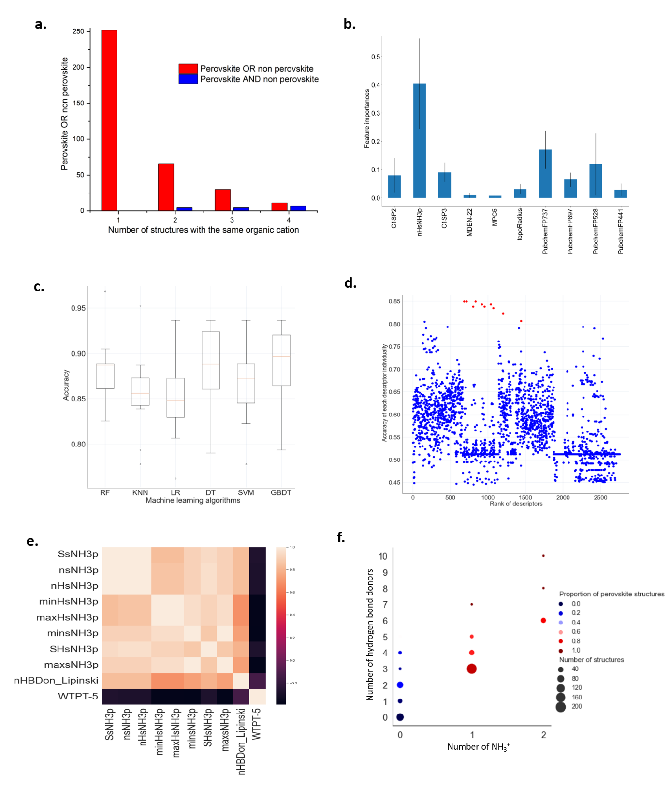
Can we predict before the synthesis?
Can we accurately predict the synthesis of hybrid perovskites before the synthesis?
Is the organic amine the determining factor ?
Dataset
385 different organic amines involved in 626 different crystal structures
Laref, R.; Massuyeau, F.; Gautier, R. Small, (2023) Accepted
Notes:
27
27
Dans l’ordre 24, 25, 26, 1
8 à 10 pour non perov
12.5 à 17.5 pour perov

Slide 28
Can we predict before the synthesis?
Extracting organic cations as SMILES using CSD API
Organic molecules represented as SMILES
2756 descriptors and fingerprints for each structure
(input matrix X)
Prediction
Machine Learning algorithms
Perovskite
627
CIFs collected from CSD
Non
Perovskite
Structure type for each structure
(output y)
SMILES = Simplified Molecular Input Line Entry Specification
Laref, R.; Massuyeau, F.; Gautier, R. Small, (2023) Accepted
Notes:
28
28
Dans l’ordre 24, 25, 26, 1
8 à 10 pour non perov
12.5 à 17.5 pour perov

Slide 29
Can we predict before the synthesis?
The best algorithm (GBDT) with the best combination of 10 descriptors allows to reach an accuracy of 88.65 %
The number of –NH₃⁺ can determine the structure type with an accuracy of 84.99%
Laref, R.; Massuyeau, F.; Gautier, R. Small, (2023) Accepted
Notes:
29
29
Dans l’ordre 24, 25, 26, 1
8 à 10 pour non perov
12.5 à 17.5 pour perov

Slide 30
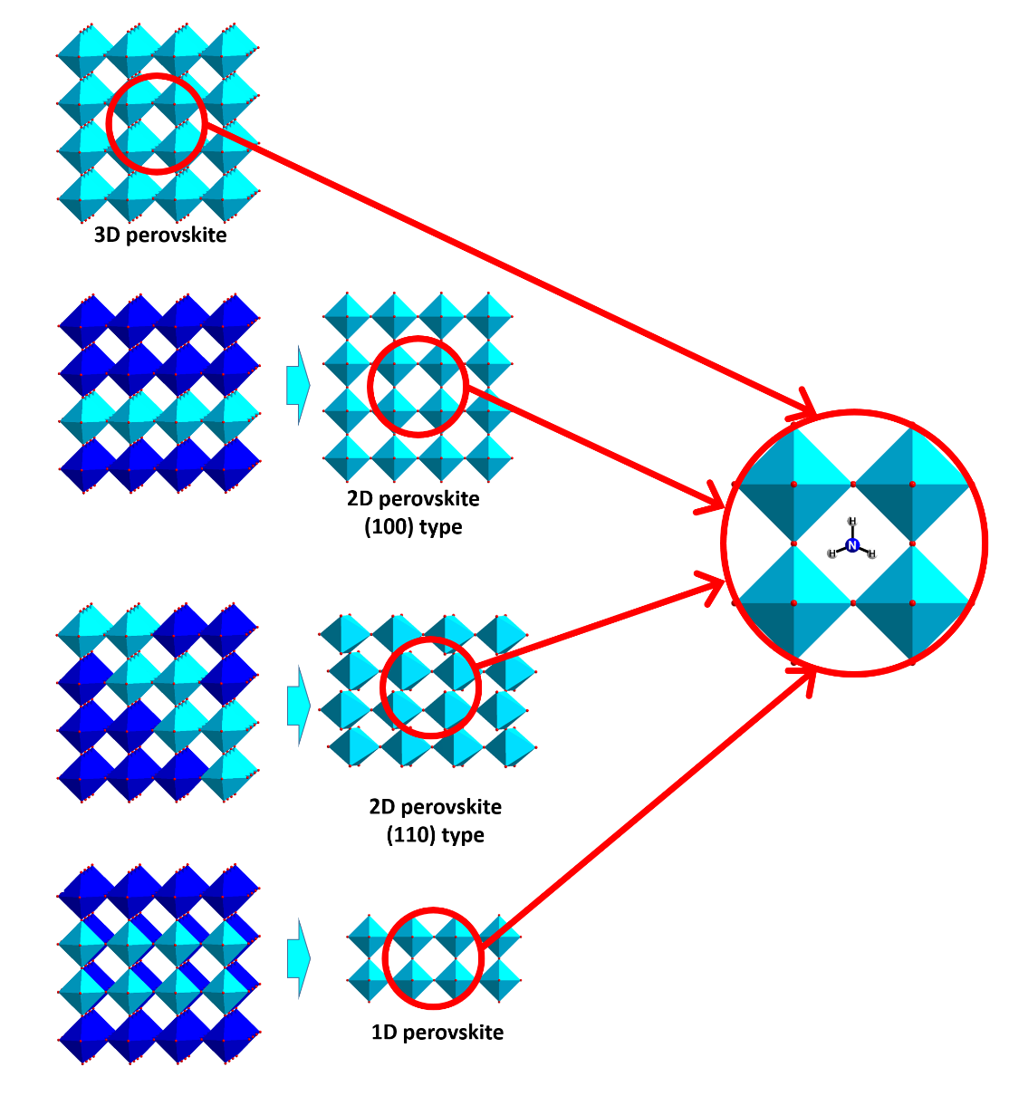
Can we predict before the synthesis?
Why the presence of –NH₃⁺ is so important to crystallize perovskite type structures?
Strong nucleophilic site between four [PbX₆]²⁻ corner-sharing octahedra of the perovskite structural type.
–NH₃⁺ localizes in these sites and creates a dense hydrogen network with X⁻ halide ions.
Laref, R.; Massuyeau, F.; Gautier, R. Small, (2023) Accepted
Notes:
30
30
Dans l’ordre 24, 25, 26, 1
8 à 10 pour non perov
12.5 à 17.5 pour perov

Slide 31
Conclusion
Perovskite vs. Non Perovskite
from the powder XRD patterns
Perovskite vs. Non Perovskite
from the use of molecular descriptors
Identify the important features to better understand the mechanisms.
Notes:
31
31

Slide 32



Acknowledgment
Collaborators:
Florian Massuyeau
Rachid Laref
Fundings:
THANK YOU FOR
YOUR ATTENTION

