Slide 1
Ultrafast Structural Dynamics and Control of Phase Transitions
Herve Cailleau
Institute of Physics of Rennes
International Research Laboratory DYNACOM Tokyo
M. Lorenc, E. Janod, C. Mariette, S. Iwai, …

Slide 2
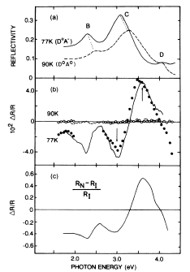
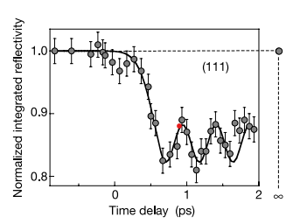
From pioneering works
Neutral-Ionic PIPT Coherent phonon
S. Koshihara K. Sokolowski-Tinten
PRB 1990 Nature 2003

Slide 3
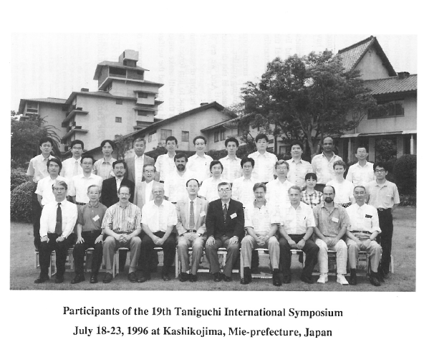
Relaxations of Excited States
and Photo-Induced Phase Transitions

Slide 4
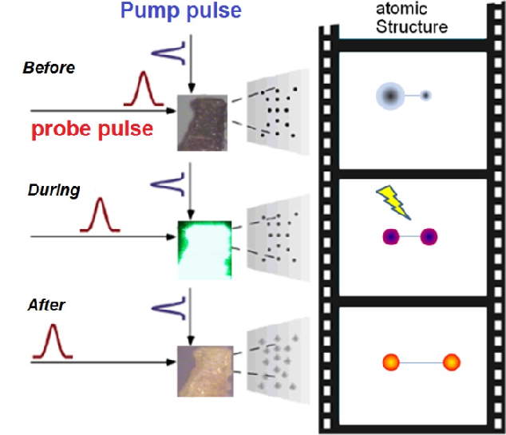
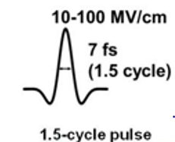
Ultrafast Techniques
as fast as atomic motions
Pump-probe method
Optical (IR-UV)
Thz and mid-IR
X-ray and
electron diffraction
XANES
- ARPES
…
Currently 10-100 fs
N_{phot} ~ few percent
E ~ 1-100 MV/cm (10⁻²-1 V/Ǻ)

Slide 5
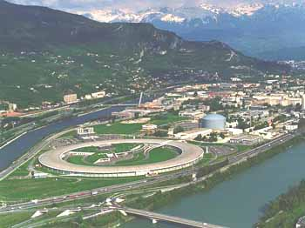
Ultra-fast X-ray science
around large facilities:
synchrotron 100 ps
X-FEL 10-100 fs

Slide 6
Ultra-fast X-ray science
around large facilities:
synchrotron 100 ps
X-FEL 10-100 fs
coupled to very sentive transient
optical reflectivity measurents

Slide 7
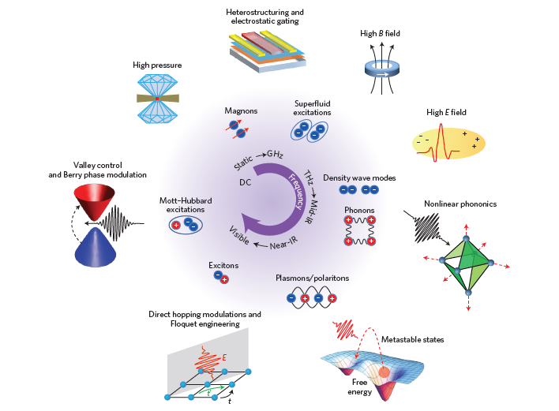
To « towards properties on demand in quantum materials »
« New eyes give rise
to new ideas »
Not only seeing
but also acting
Review
Basov, Averitt,
Hsieh
Nature Materials
September 2017
Thermal PT/PIPT

Slide 8
Outline
1 – Isosymetric and/or Symmetry Breaking Phase Transitions
2 – Ultrafast Structural Dynamics and Control of Phase transitions

Slide 9
Outline
1 – Isosymetric and/or Symmetry Breaking Phase Transitions
2 – Ultrafast Structural Dynamics and Control of Phase transitions

Slide 10
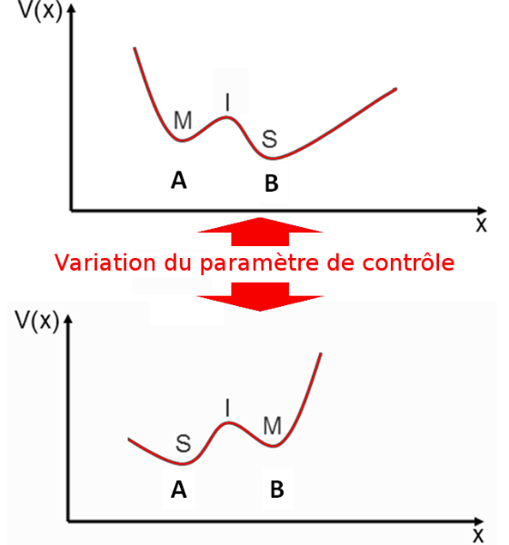
Phase transitions: a long story since Van der Waals
More one century was necessary to establish the universality of phase transitions at thermal equilibrium, despite the diversity in the nature of constituents, interactions and properties
.

Slide 11
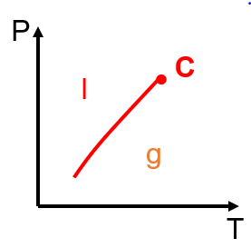
Phase transitions: a long story since Van der Waals
More one century was necessary to establish the universality of phase transitions at thermal equilibrium, despite the diversity in the nature of constituents, interactions and properties
The familiar example is the liquid-gas phase transition
with T and P as external control parameter.
Phase diagram exhibits a first order phase transition
located on a coexistence line P₀(T) ending at a
critical point C, below the supercritical crossover
regime.
No change of symmetry
A thermodynamic rule:
T increase favours the phase of high-entropy S
P increase favours the phase of low-volume V
dP/dT = ΔS/ΔV
.

Slide 12
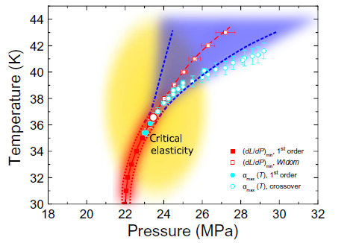
Phase transitions: a long story since Van der Waals
A quantum material
Metal – Insulator Mott
transition
Lang et al.
Science Advances 2016
Κ-(BEDT-TTF)₂Cu[N(CN)₂]Cl

Slide 13
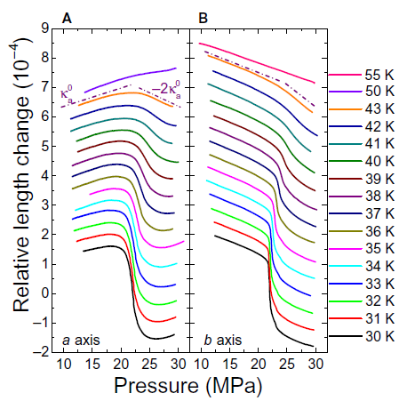
Phase transitions: a long story since Van der Waals

Slide 14
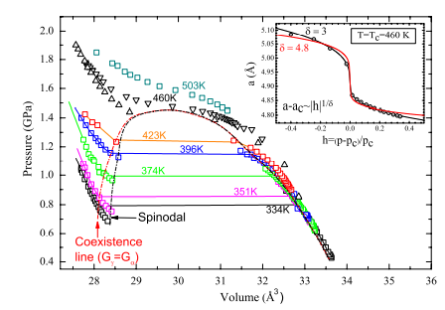
Phase transitions: a long story since Van der Waals
Not unique
A quantum material
Cerium
Decremps et al.
PRL 2011
Analogy with Van der Waals
equation of state
Very large change of volume

Slide 15
Universality with the phase transition of a ferromagnetic material
For the para-ferromagnetic phase transition in a magnetic fluid the control parameters are T and H.
The situation is very similar but now in the phase diagram the coexistence line
is now located on the horizontal axis H = 0.
H
M>0
M<0
C
•
T_{c} T

Slide 16
Universality with the phase transition of a ferromagnetic material
For the para-ferromagnetic phase transition in a magnetic fluid the control parameters are T and H.
The situation is very similar but now in the phase diagram the coexistence line
is now located on the horizontal axis H = 0.
What we call boils down to follow the horizontal
axis at H = 0 and it is associated with the
establishement of a spontaneous magnetic order
below T_{C}.
Kinetics after thermal quench: formation of
domains
H
M>0
M<0
C
•
T_{c} T

Slide 17
Universality with the phase transition of a ferromagnetic material
For the para-ferromagnetic phase transition in a magnetic fluid the control parameters are T and H.
The situation is very similar but now in the phase diagram the coexistence line
is now located on the horizontal axis H = 0.
Crossing the 1st order transition line at H = 0
discontinuity of M for T < T_{c} (magnetic hysteresis),
but not of S : ΔM ≠ 0 and ΔS = 0 → dH/dT = 0
Kinetics : nucleation-growth from one phase M < 0
to another one M > 0
H
M>0
M<0
C
•
T_{c} T

Slide 18
Universality with the phase transition of a ferromagnetic material
For the para-ferromagnetic phase transition in a magnetic fluid the control parameters are T and H.
The situation is very similar but now in the phase diagram the coexistence line
is now located on the horizontal axis H = 0.
Crossing the 1st order transition line at H = 0
discontinuity of M for T < T_{c} (magnetic hysteresis),
but not of S : ΔM ≠ 0 and ΔS = 0 → dH/dT = 0
Kinetics : nucleation-growth from one phase M < 0
to another one M > 0
H
M>0
M<0
C
•
T_{c} T

Slide 19
Universality with the phase transition of a ferromagnetic material
For the para-ferromagnetic phase transition in a magnetic fluid the control parameters are T and H.
The situation is very similar but now in the phase diagram the coexistence line
is now located on the horizontal axis H = 0.
Crossing the 1st order transition line at H = 0
discontinuity of M for T < T_{c} (magnetic hysteresis),
but not of S : ΔM ≠ 0 and ΔS = 0 → dH/dT = 0
Kinetics : nucleation-growth from one phase M < 0
to another one M > 0
H
M>0
M<0
C
•
T_{c} T

Slide 20
Symmetry breaking / Isosymmetric phase transition
Stability, metastability
and instability
H
F
Symmetry breaking
para-ferromagnetic
Isosymmetric
gas-liquid
M
Landau free energy landscape F = Aη² + Bη⁴ - Hη

Slide 21
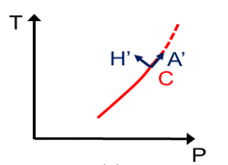
Symmetry breaking / Isosymmetric phase transition
Stability, metastability
and instability
H
F
Symmetry breaking
para-ferromagnetic
Isosymmetric
gas-liquid
M
Landau free energy landscape F = Aη² + Bη⁴ - Hη

Slide 22
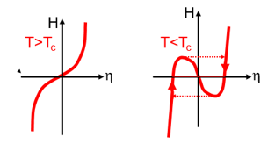
Symmetry breaking / Isosymmetric phase transition
Stability, metastability
and instability
H
F
Symmetry breaking
para-ferromagnetic
Isosymmetric
gas-liquid
M
Landau free energy landscape F = Aη² + Bη⁴ - Hη

Slide 23
Landau symmetry breaking analysis
Landau theory
Every dens,ity is expressed as ρ(r) = ρ₀(r) + Δρ(r), where ρ₀ is left invariant by all elements of the HS group G₀ and Δρ by only the elements of an irreductible representation (IR) of the initial group G₀, i.e. a group-subgroup relation G ⊂ G₀. The lost of symmetry elements (Symmetry Breaking) is desribed by an order parameter η of dimension equal to that of the IR.

Slide 24
Landau symmetry breaking analysis
Landau theory
Every dens,ity is expressed as ρ(r) = ρ₀(r) + Δρ(r), where ρ₀ is left invariant by all elements of the HS group G₀ and Δρ by only the elements of an irreductible representation (IR) of the initial group G₀, i.e. a group-subgroup relation G ⊂ G₀. The lost of symmetry elements (Symmetry Breaking) is desribed by an order parameter η of dimension equal to that of the IR.
At thermal equilibrium, different kind of degrees of freedom (electronic, structural, …) follow the evolution of this quantity measuring the degree of SB.
But in case of PIPT decoupling in time occurs?
Another fundamental feature is the formation of non-homogeneneous textured LS state, the domain structure, associated with the different equivalent phases.
What influence on PIPT?

Slide 25
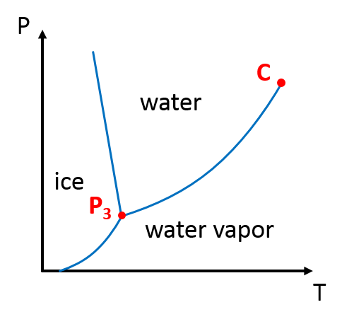
Symmetry breaking + Isosymmetric phase transitions
Stability, metastability
and instability
Symmetry breaking order parameter + Totally Symmetric order parameter

Slide 26
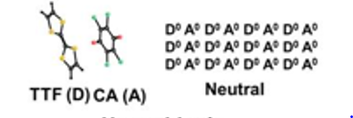
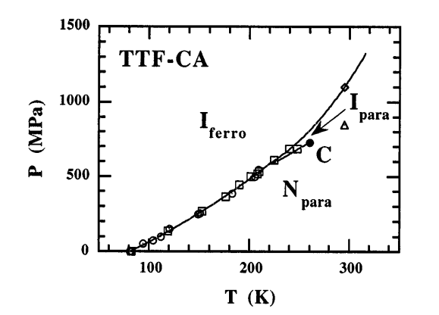
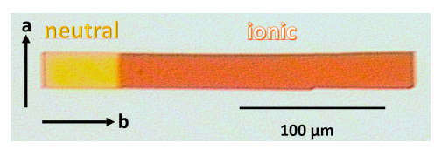
Symmetry breaking + Isosymmetric phase transitions
Stability, metastability
and instability
N- I transition in TTF-CA
From N band insulator
to I Mott insulator
Lemée-Cailleau
PRL 1997
PRL 1997
Ferroelecric symmetry breaking + Totally symmetric ionicity

Slide 27
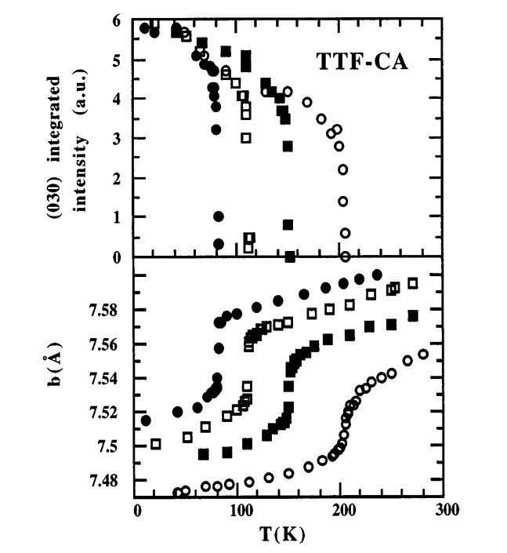
Symmetry breaking + Isosymmetric phase transitions
Stability, metastability
and instability
N- I transition in TTF-CA
Lemée-Cailleau
PRL 1997
Ferroelecric symmetry breaking + Totally symmetric ionicity

Slide 28
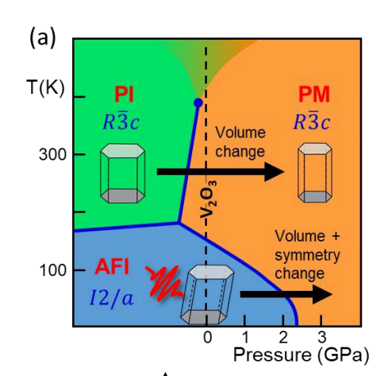
Symmetry breaking + Isosymmetric phase transitions
V2O3 prototypical Mott material
Ferroelastic symmetry breaking + Totally Symmetric I-M

Slide 29
Symmetry breaking + Isosymmetric phase transitions
V2O3 prototypical Mott material
Ferroelastic symmetry breaking + Totally Symmetric I-M

Slide 30
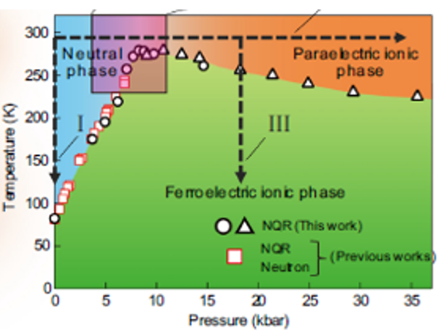
Symmetry breaking + Isosymmetric phase transitions
V2O3 prototypical Mott material
From Kanoda PRB 2018
Ferroelastic symmetry breaking + Totally Symmetric I-M

Slide 31
Beyond the Hubbard model, taking into account only electronic degrees of freedom, the coupling to lattice degrees of freedom and the long range nature of elastic interactions changes the nature of the phase transitions:
all Mott transitions couple to elastic degrees of freedom,
many possible structural symmetry breakings,
- phonon entropy dominates to stabilize the metallic phase,
from P. Littlewood ECRYS 2022
Role of structural degrees of freedom

Slide 32
Beyond the Hubbard model, taking into account only electronic degrees of freedom, the coupling to lattice degrees of freedom and the long range nature of elastic interactions changes the nature of the phase transitions:
all Mott transitions couple to elastic degrees of freedom,
many possible structural symmetry breaking,
- phonon entropy dominates to stabilize the metallic phase,
from P. Littlewood ECRYS 2022
« The only interaction known which is truly infinitely long range »
J. Friedel 1954
Role of structural degrees of freedom

Slide 33
Beyond the Hubbard model, taking into account only electronic degrees of freedom, the coupling to lattice degrees of freedom and the long range nature of elastic interactions changes the nature of the phase transitions:
all Mott transitions couple to elastic degrees of freedom,
many possible structural symmetry breaking,
- phonon entropy dominates to stabilize the metallic phase,
from P. Littlewood ECRYS 2022
« The only interaction known which is truly infinitely long range »
J. Friedel 1954
What about ultrafast photoinduced phase transitions?
Role of structural degrees of freedom

Slide 34
Outline
1 – Isosymetric and/or Symmetry Breaking Phase Transitions
2 – Ultrafast Structural Dynamics and Control of Phase transitions

Slide 35
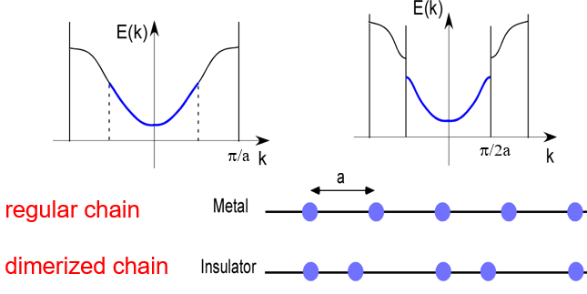
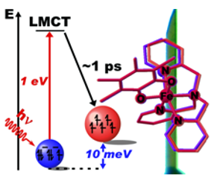
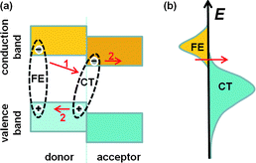
Diversity of photoexcitation processes
Delocalized (Peierls)
CT exciton
Localized (molecular switching)

Slide 36
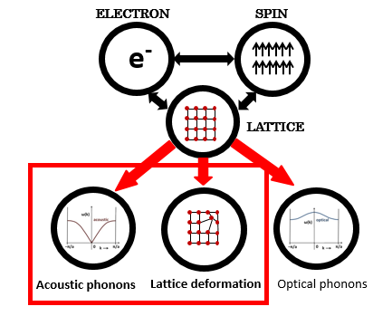
Multiscale dynamical processes in the solid state
Different time
scales
10⁻¹⁵ s
10⁻¹⁵ s
Electronic motion
10⁻¹² s
Atomic oscillation
Strain propagation
10⁻⁹ s
10⁻⁶ s
Thermal processes?
10⁻³ s
1 s
days

Slide 37
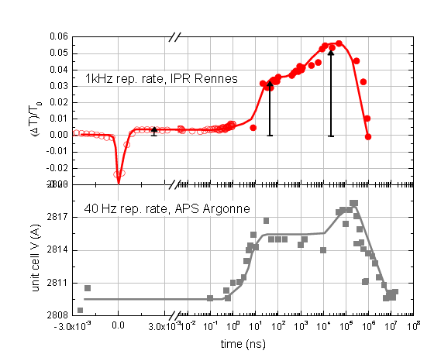
Bottlenecks during the evolution
M. Lorenc
PRL (2009)
PRB (2012)
Spin transition
From molecule to material
scale
W W
Q

Slide 38
Coherent collective dynamics of atomic motions
amplitude
time

Slide 39
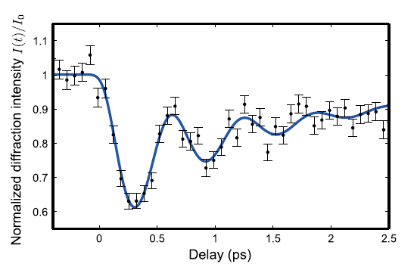
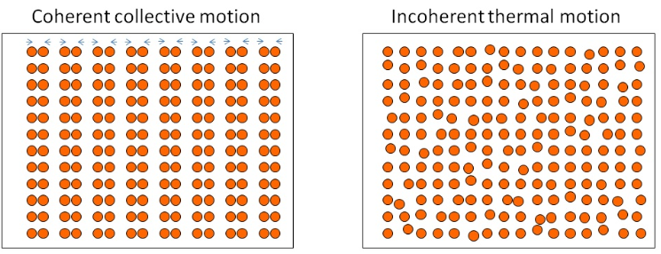
Coherent oscillating atomic motions
Driven by the quasi-instantaneous
change of the electronic state
induced by photoexcitation.
displacive force F_{q=0} ≠ 0
selective vs. democratic
Bragg peak Debye-Waller
oscillation Diffuse scattering

Slide 40
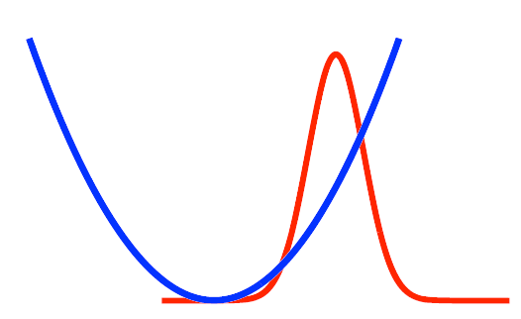
Coherent oscillating atomic motions
Driven by the quasi-instantaneous
change of the electronic state
induced by photoexcitation.
displacive force F_{q=0} ≠ 0
The dynamics of Q₀ is governed by
a displaced potential energy
Time scale:
period of
optical
mode
Bilinear coupling ~ Δn_{el}Q₀
Displaced minimum in E_{S}(Q)
From S. Johnson
Son et Lumière
Les Houches
2019

Slide 41
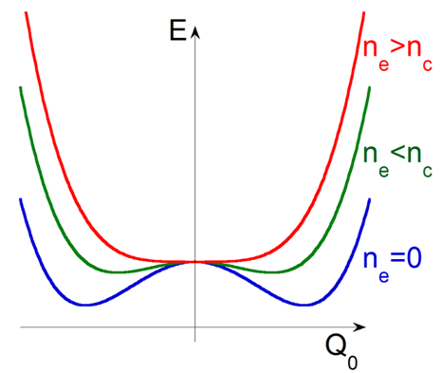
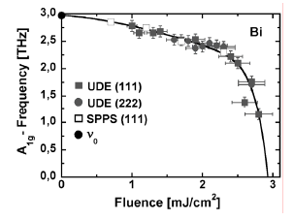
Optical mode softening
S_{e} = Cst
K. Sokolowski 2011

Slide 42
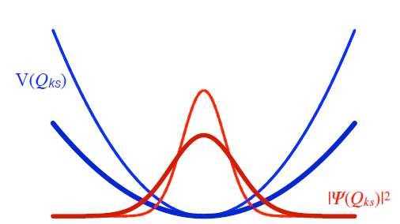
Coherent oscillating atomic motions
Driven by the quasi-instantaneous
change of the electronic state
induced by photoexcitation.
Time scale:
period of
optical
mode
Bilinear coupling ~ Δn_{el}Q₀ Linear-quadratic ~ Δn_{el}Q_{k}Q_{-k}
Displaced minimum in E_{S}(Q) Change of curvature
Q₀(t) <(ΔQ_{k})²>
From S. Jonhson
Son et Lumière
Les Houches
2019

Slide 43
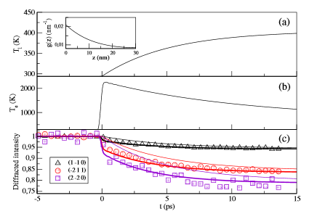
Debye-Waller and diffuse scattering effect
Bismuth
B. Arnaud PRL 2013

Slide 44
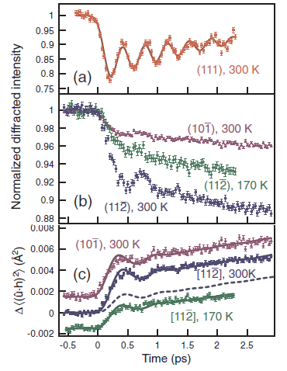
Debye-Waller and diffuse scattering effect
Bismuth
Squeezed
phonon
oscillation
B. Arnaud PRL 2013 S. L. Johnson PRL 2009

Slide 45
Photoinduced strain wave dynamics
Initially, just after photoexcitation the volume has not changed and stress energy
is stored (thermal or non-thermal). To recover mechanical equilibrium with ouside
pressure longitudinal strain wave are launched from interfaces (air/film and
film/substrate). → acoustic phonons counterpart / optical phonons.

Slide 46
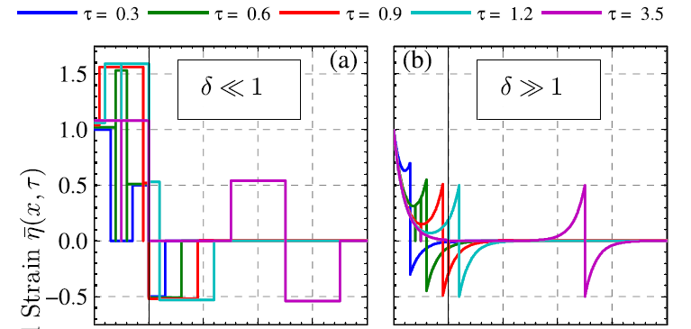
Photoinduced strain wave dynamics
Just after photoexcitation the volume has not changed and elastic stress energy
is stored (thermal or non-thermal). To recover mechanical equilibrium with ouside
pressure longitudinal strain wave are launched from interfaces.
→ acoustic phonons counterpart / optical phonons.
Acoustic time scale
t_{ac} = d/v_{s}
For t ≥ 2t_{ac}
stabilization in
new equilibrium
volume.
From M.Bargheer
Structural Dynamics
2014
Thin Substrate Thick Substrate

Slide 47
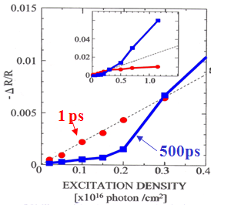
Cooperativity – Nonlinear Responsiveness - Threshold
After ultrafast photoexcitation, a
new potential energy landscape
for the equlibrium states (phases)
in the order parameter space
and the laser fluence is now the
control parameter.
S. Iwai PRL (2006)

Slide 48
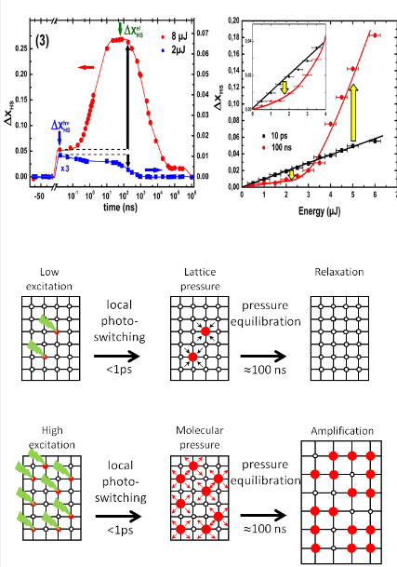
Cooperativity – Nonlinear Responsiveness - Threshold
SCO Isosymetric transition
R Bertoni et al.
Nature Materials 2016

Slide 49
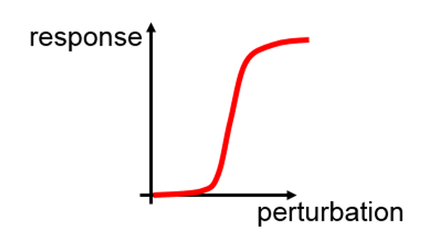
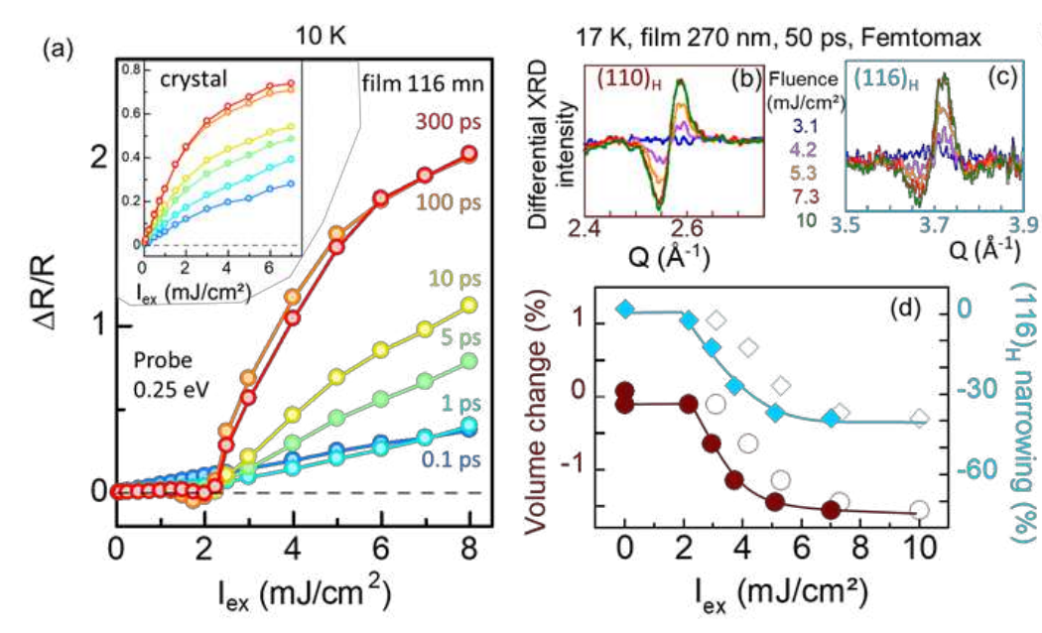
Cooperativity – Nonlinear Responsiveness - Threshold
Mott V₂O₃
I to M transition in
granular thin film
Preprint

Slide 50
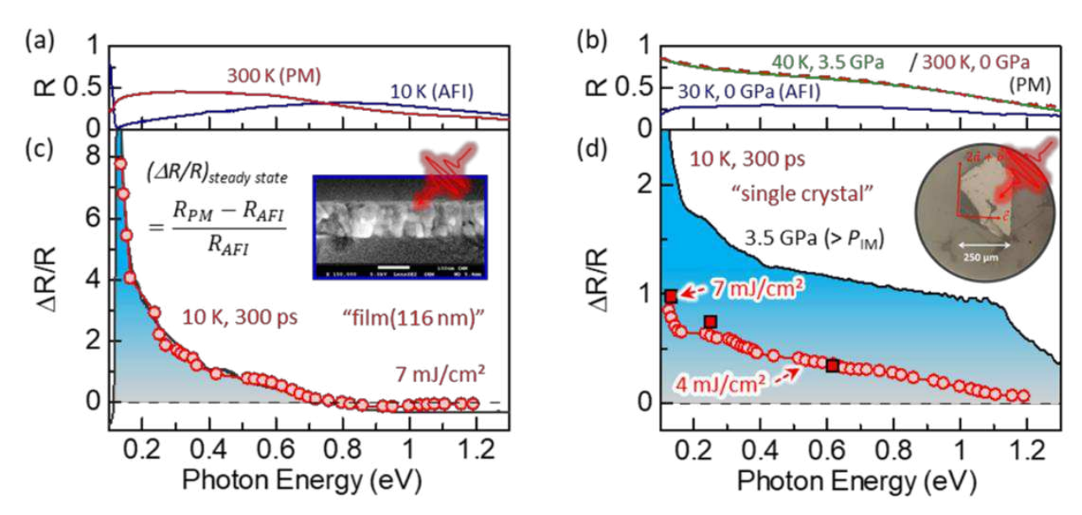
Cooperativity – Nonlinear Responsiveness - Threshold
Mott V2O3
I to M transition
Granular thin film
Preprint
Full I to M transformation

Slide 51
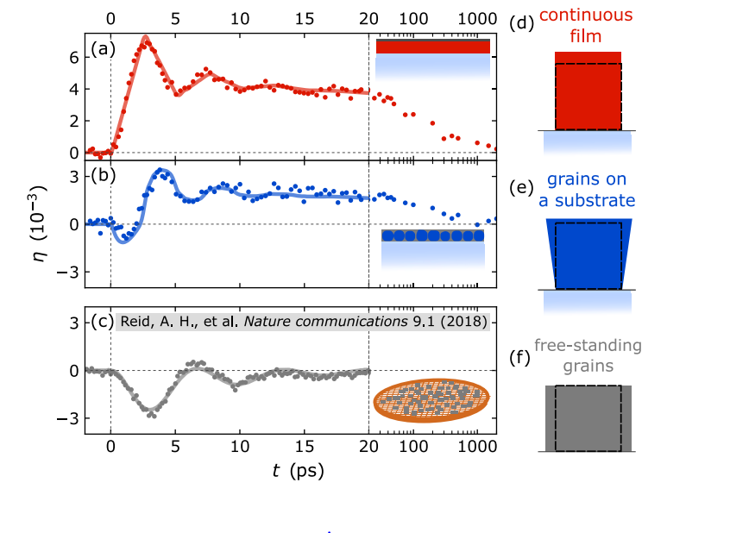
Bottlenecks: role of morphology on propagative deformations
Bargheeer Photoacoustics 2023

Slide 52
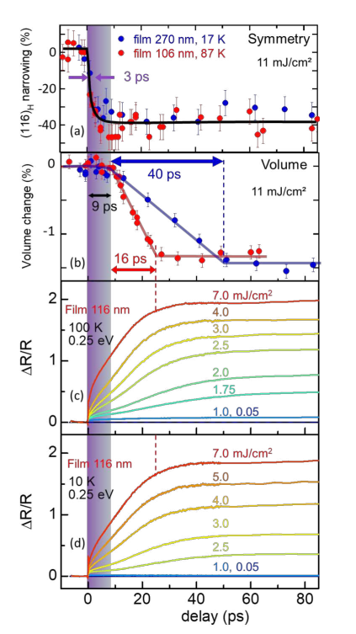
In the wake of strain waves
The volume dynamics scales with the film thickness
The shear dynamics scales with the ferroelastic domain size
The electronic dynamics (transient reflectivity)
follows the structural dynamics
Mott V₂O₃
I to M transition ingranular thin film
Preprint
c.f Poster Julio Guzman

Slide 53
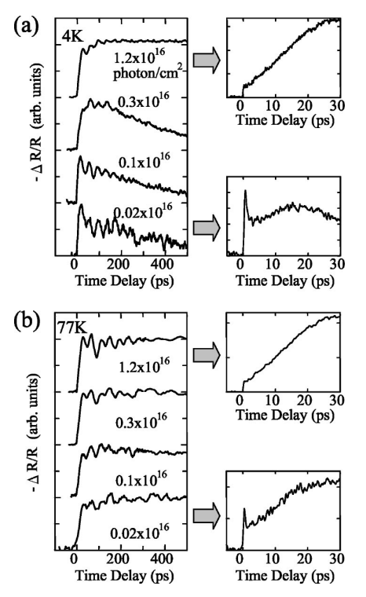
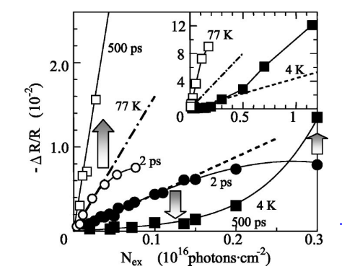
Universality of strain wave pathway
Strong similarities with the N-I transition in TTF-CA
S. Iwai PRB 2004

Slide 54
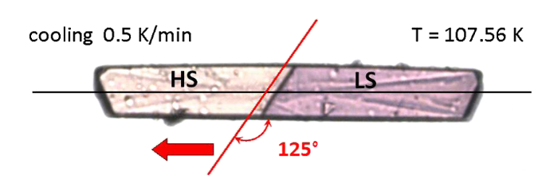
Bottlenecks: anisotropy in propagative transition
N-I transition M. Buron-Lecointe
in TTF-CA PRB 2003
~
SCO K. Boukheddaden
PRL 1995
Thermal interface motion (~ μm/s) vs. sound velocity (~ km/s)

Slide 55
Four main lessons
From kinetics to dynamics
Different isosymmetric/Symmetry breaking dynamics
Crucial role of morphology for efficiency
Central role of volume and elastic cooperativity

Slide 56
Elastic cooperativity reinforces the electronic one
Electronic cooperativity
On a two orbital model (Fabrizio PRB 2015), the excess population of ele
in upper orbital and holes in lower orbital may lead to a gap collapse above
Athreshold. The more the excess population increases, the more the effective
gap deceases.
+ Elastic cooperativity
Compressive stresses induce positive chemical pressure.When the density of
excited electrons increases, chemical pressure increases proportionality, i.e.
as an intermal mean field inducing positive feedback.

Slide 57
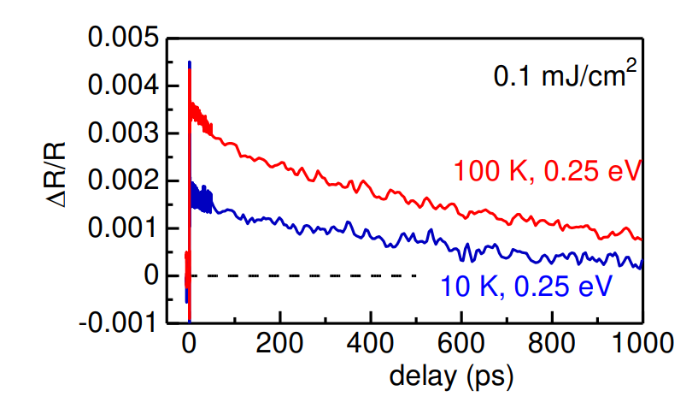
Precursor processes ?
Small polarons ?

Slide 58
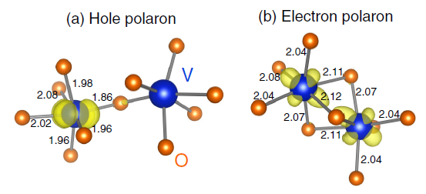
Small polaronic states
Spatial self-trapping → small polaron
V – O shorter V – V shorter
Energy gain (self-trapping) ≈ 100 meV
D. Wickramaratne PRB 99, 214103 (2019)

Slide 59
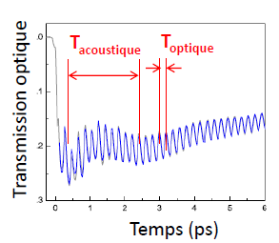
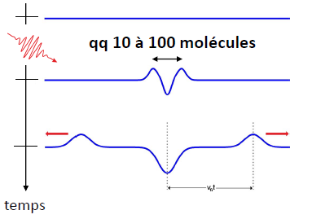
Strain wave pathway
- from local precursors at nanoscale
1-10 molecules
F. Morrissey
PRB
2010
cf. S. Nasu’s
talk

Slide 60
Strain wave pathway
- from local precursors at nanoscale
1-10 molecules
F. Morrissey
PRB
2010
cf. S. Nasu’s
talk
- to phase transition at macroscale
Phase front propagation at
sound velocity
From kinetics to dynamics
of phase transition
Generalization to shear strains (ferroelastic)

Slide 61
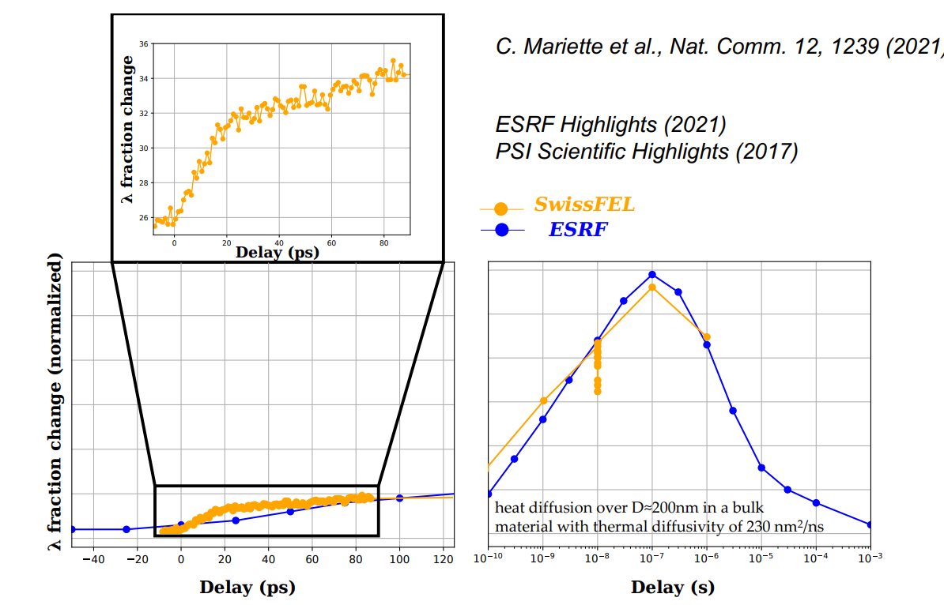
Bottlenecks: incomplete efficiency in pellet of nanocrystals of Ti₃O₅

Slide 62
Towards the AI challenge
A.M. Linderberg
Science 2021
Similarities between transient
structural changes formed under
electrical and optical excitation

Slide 63
From band insulator to Mott insulator – Electronic ferroelectricity
A band insulator is qualitively different from a Mott insulator, topologically distinct (Berry Phase jumps by π). Across the transition, the static ionic charges are quasi-continuous, while the Born charges changes sign (Resta PRL 1995). In the Mott state the anion transports a positive charge.

Slide 64
From band insulator to Mott insulator – Electronic ferroelectricity
A band insulator is qualitively different from a Mott insulator, topologically distinct (Berry Phase jumps by π). Across the transition, the static ionic charges are quasi-continuous, while the Born charges changes sign (Resta PRL 1995). In the Mott state the anion transports a positive charge.
In its modeling of N-I transition
Painelli (Crystals 2017)
observes a discontinuous
change of sign for ΔP_{e}.

Slide 65
Relaxations of Excited States
and Photo-Induced Phase Transitions
Thank you

