Slide 1







Mott insulating 1T-TaSe₂ monolayer on GaP(111)B
New challenges in quantum materials: artificial intelligence and ultrafast science
Y. Chernukha, H. Koussir, C. Sthioul, E. Haber, N. Peric, L. Biadala, P. Capiod, M. Berthe, I. Lefebvre, X. Wallart, B. Grandidier, and P. Diener

Slide 2
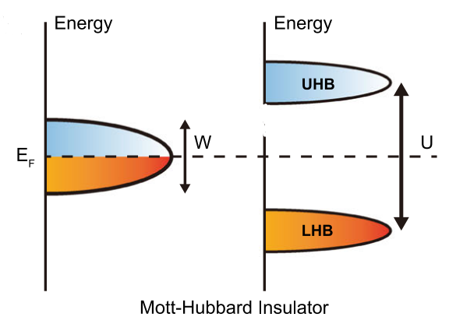
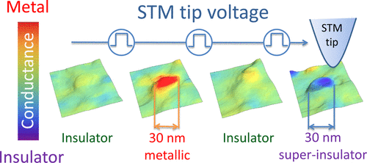
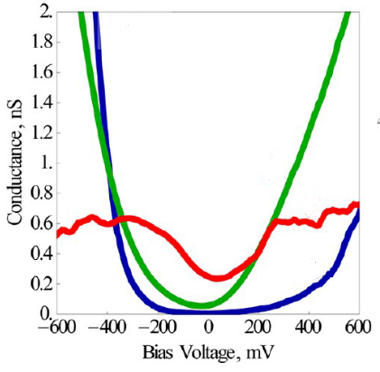

Mott insulators
Metal with half-filled band
resistive switching
Pressure
Doping
…
Electrical field
GaTa₄Se₈
Mott transition
U-W
Mott insulator
correlated metal
Dubost et al., Nano Lett. 2013, 13, 8, 3648–3653
Notes:
Mott insulators is the type of strong correlated materials where electronic configuration characterized by an add number of electrons per unit cell which result in partially field electronic band. By a conventional band theory, they should have a metallic (conductive) behavior. But in Mott insulators Columb repulsion between electrons surpass the bandwidth that leads to the electron localization and, give a rise to the band splitting into so-cold Upper Hubbard Band and Lower Hibbard band. That leads to a formation of a band gap and material become an insulator.
Mott insulators can undergo a transition to a metallic state, therefore become more conductive under different external stimuli, such as temperature, pressure or electrical field. In 2013 such resistive switching were induced due to the electrical field of the STM tip at room temperature at the local scale. What they observed was a conductive bulb created on the surface of the Mott insulating crystal thank to STM tip.

Slide 3
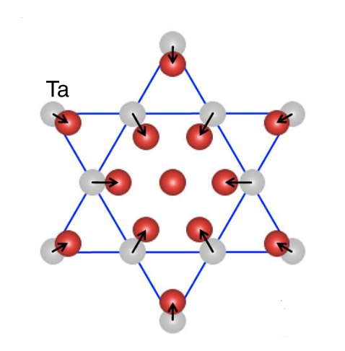
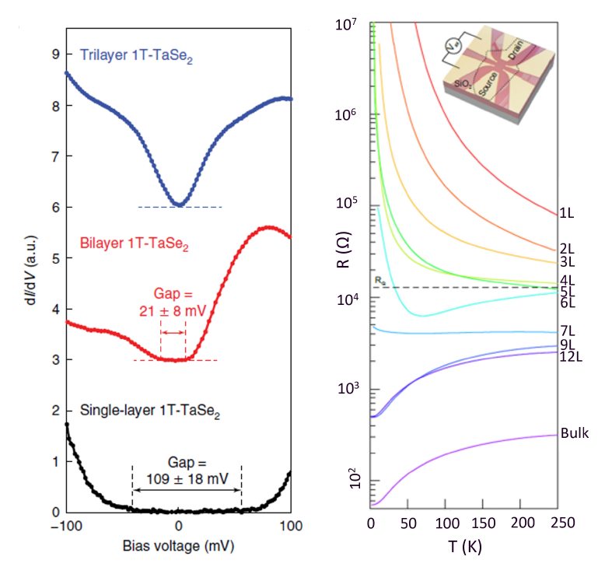
1T-TaSe₂ monolayer
TMD with “Star of David” superlattice
Mott insulating state in single layer
Se
Ta
Substrate – bilayer graphene
Yi Chen,et al., Nature Physics, 16(2):218{224, 2020.
Tian, N., et al., National Science Review, nwad144 (2023)
Notes:
Tantalum diselenide is a transition metal dichalcogenide that is a good candidate for a 2D Mott material. It has a wide Charge density wave state up to 473K that is characterized by a star of David superlattice where 12 closest atoms approaching center one. In bulk, tantalum diselenide has a metallic behavior but its exfoliation down to a single layer leads to stronger electron correlation and bandgap opening. Therefore a material become a Mott insulator where electron localization
inhibits conductivity despite the presence of free electrons that would ordinarily facilitate a metallic state.
The monolayer of 1T-TaSe2 were succefully deposited by MBE on typically metallic substrates such as graphene. Such conductive substrates are not so appropriate studing the electronic properties of the monolayer and a more insulating substrates is a need also for a possible future applications.

Slide 4
Questions?
Substrate?
Mott phase – only locally?
Resistive switching?

Slide 5
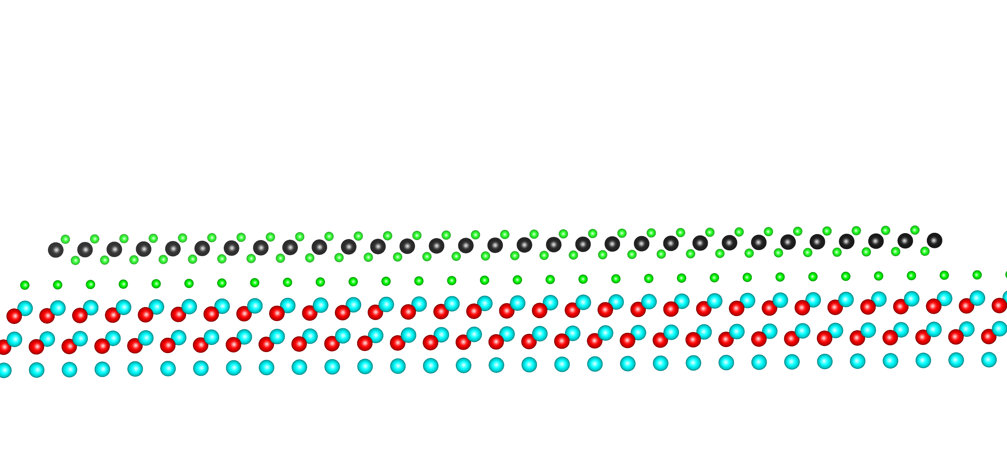
1T-TaSe₂ monolayer on GaP(111)B
Se protecting layer
TaSe₂
GaP(111)B
Deposition by MBE on Se-terminated semiconductor GaP(111)B substrate
Se
Ta
P
Ga
Notes:
In this presentation I will be talking about a monolayer of 1T-TaSe2 successfully deposited on a Se-terminated semiconductor GaP substates. Se capping layer was added to protected a monolayer during transferring sample between different experiments. First of all, the surface of the monolayer was studied by a low temperature scanning tunneling microscopy performed on the Omicron LT-STM. The Se cap was sublimated in the UHV preparation chamber and the tungsten tip was prepared outside UHV via a electrochemical etching.

Slide 6
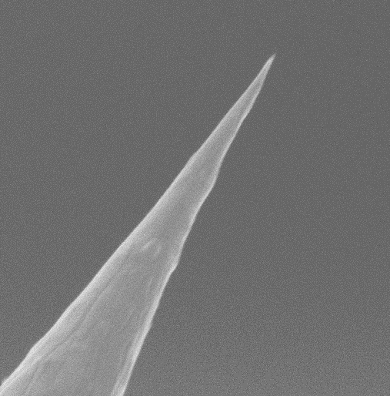
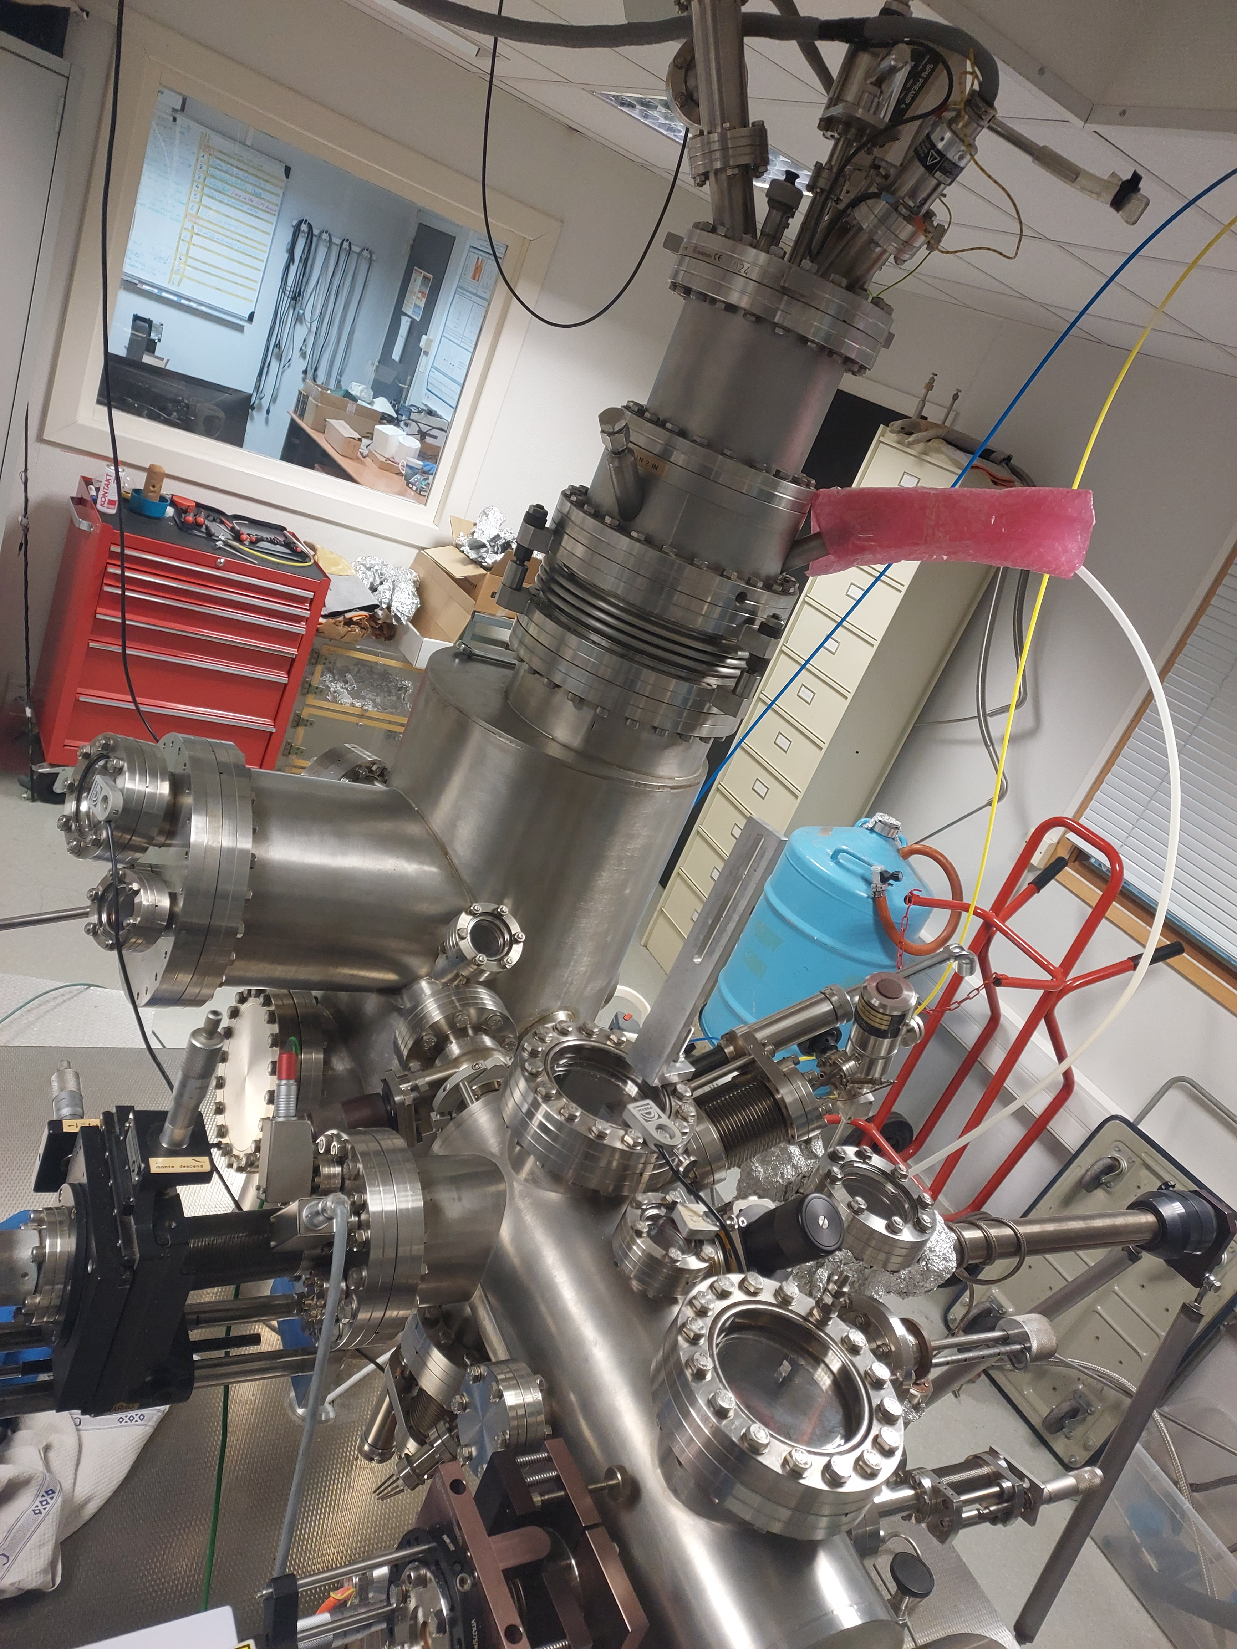

1T-TaSe₂ monolayer on GaP(111)B
LT-STM
Se protecting layer
TaSe₂
GaP(111)B
Deposition by MBE on Se-terminated semiconductor GaP(111)B substrate
Working temperature T = 77 K
Se
Ta
P
Ga
Notes:
In this presentation I will be talking about a monolayer of 1T-TaSe2 successfully deposited on a Se-terminated semiconductor GaP substates. Se capping layer was added to protected a monolayer during transferring sample between different experiments. First of all, the surface of the monolayer was studied by a low temperature scanning tunneling microscopy performed on the Omicron LT-STM. The Se cap was sublimated in the UHV preparation chamber and the tungsten tip was prepared outside UHV via a electrochemical etching.

Slide 7

1T-TaSe₂ monolayer on GaP(111)B
LT-STM
Se protecting layer
TaSe₂
GaP(111)B
Deposition by MBE on Se-terminated semiconductor GaP(111)B substrate
Working temperature T = 77 K
Se
Ta
P
Ga
Houda Koussir
PhD student
Notes:
In this presentation I will be talking about a monolayer of 1T-TaSe2 successfully deposited on a Se-terminated semiconductor GaP substates. Se capping layer was added to protected a monolayer during transferring sample between different experiments. First of all, the surface of the monolayer was studied by a low temperature scanning tunneling microscopy performed on the Omicron LT-STM. The Se cap was sublimated in the UHV preparation chamber and the tungsten tip was prepared outside UHV via a electrochemical etching.

Slide 8
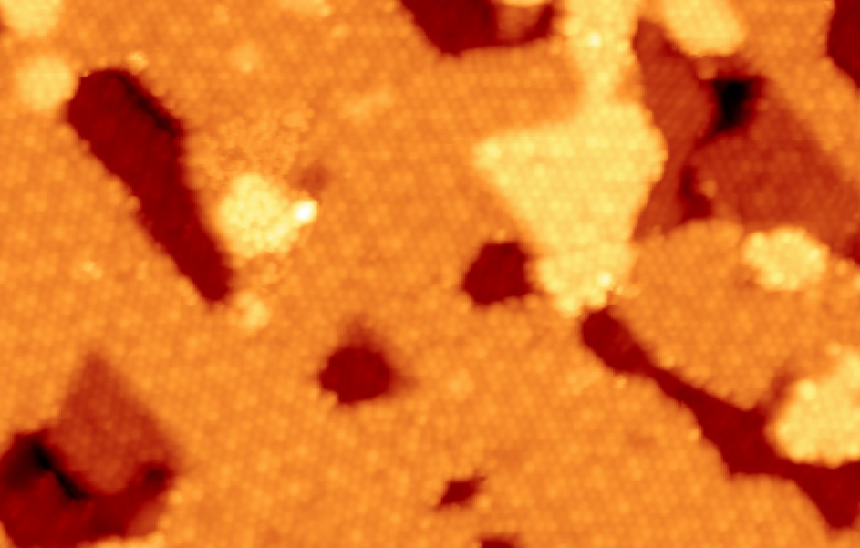
Large scale STM image
10 nm
I_{t} = 70 pA, V_{s} = -0.5V
Notes:
On a large scale STM image we can clearly see the different terraces and a repetitive pattern reproducibly observed on the whole surface, indicating full coverage of the GaP(111)B surface with TaSe2.

Slide 9
Large scale STM image
10 nm
I_{t} = 70 pA, V_{s} = -0.5V
Notes:
The heights profiles shows us the step of 3.1 angstrom between different terraces. This corresponds to the monoatomic step height between the GaP (111) planes that confirms the GaP terraces are covered with a monolayer of TaSe2.
of the observed terraces is 3.1 angstrom that conrrespons to the atomic terraces of GaP substrates and not to different layers of TaSe2 cause the thinkness the atomic layers of TaSe2 is 6 angstrom.

Slide 10
Atomic resolution
I_{t} = 70 pA, V_{s} = -0.5V
Notes:
on the high-resolution STM image we can clearly see that triangular pattern corresponds to the 6 atoms that are…
Selenium from the top layer of the TaSe2. the possible position of the Tanalum atoms that form a Star of David superlaticce are indicated in black.

Slide 11
Atomic resolution
I_{t} = 70 pA, V_{s} = -0.5V
Se
Ta
P
Ga
Triangular pattern corresponds to the top Se atoms
Notes:
Selenium from the top layer of the TaSe2. the possible position of the Tanalum atoms that form a Star of David superlaticce are indicated in black.

Slide 12
Atomic resolution
I_{t} = 70 pA, V_{s} = -0.5V
13.9°
Se
Ta
P
Ga
Triangular pattern corresponds to the top Se atoms
rotated by an angle of 13.9° from the TaSe₂ unit cell
Notes:
We also cann see that the Star of David pattern is rotated by an angle of 13,9° from the atomic unit cell.

Slide 13
Large scale STM image
10 nm
I_{t} = 70 pA, V_{s} = -0.5V
Notes:
The observed surface has two main features: a flower shaped moiré that is superimposed on a small triangular protrutions. repetitive pattern reproducibly observed on the whole surface, indicating full coverage of the GaP(111)B surface with TaSe2.

Slide 14
Flower-shaped pattern: FFT
Notes:
If we apply a fast fourrier transormation on the intermidiater resolution image we can see a two series of picks.

Slide 15
Flower-shaped pattern: FFT
FFT
1 nm⁻¹
Notes:
If we apply a fast fourrier transormation on the intermidiater resolution image we can see a two series of picks.

Slide 16
Flower-shaped pattern: FFT
FFT
1 nm⁻¹
Notes:
If we apply a fast fourrier transormation on the intermidiater resolution image we can see a two series of picks.

Slide 17


Flower-shaped pattern: FFT
FFT
Inverse FFT
1 nm⁻¹
$$38.6 Å$$
$$13.2±0.4 Å$$
Notes:
If we apply a fast fourrier transormation on the intermidiater resolution image we can see a two series of picks.

Slide 18
Flower-shaped pattern: FFT
FFT
Inverse FFT
1 nm⁻¹
-13.9°
+13.9°
$$38.6 Å$$
$$13.2±0.4 Å$$
Notes:
If we apply a fast fourrier transormation on the intermidiater resolution image we can see a two series of picks.

Slide 19
Flower-shaped pattern: FFT
FFT
Inverse FFT
1 nm⁻¹
$$38.6 Å$$
$$13.2±0.4 Å$$
Notes:
If we apply a fast fourrier transormation on the intermidiater resolution image we can see a two series of picks.

Slide 20
Superlattice
3 nm

Slide 21
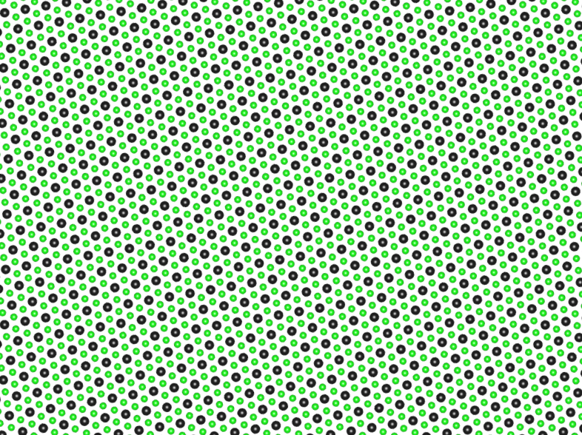
Superlattice
3 nm
Charge Density Wave
-13.9°
+13.9°
Se
Ta
Periodicity 1.32 nm
2 chiralities

Slide 22
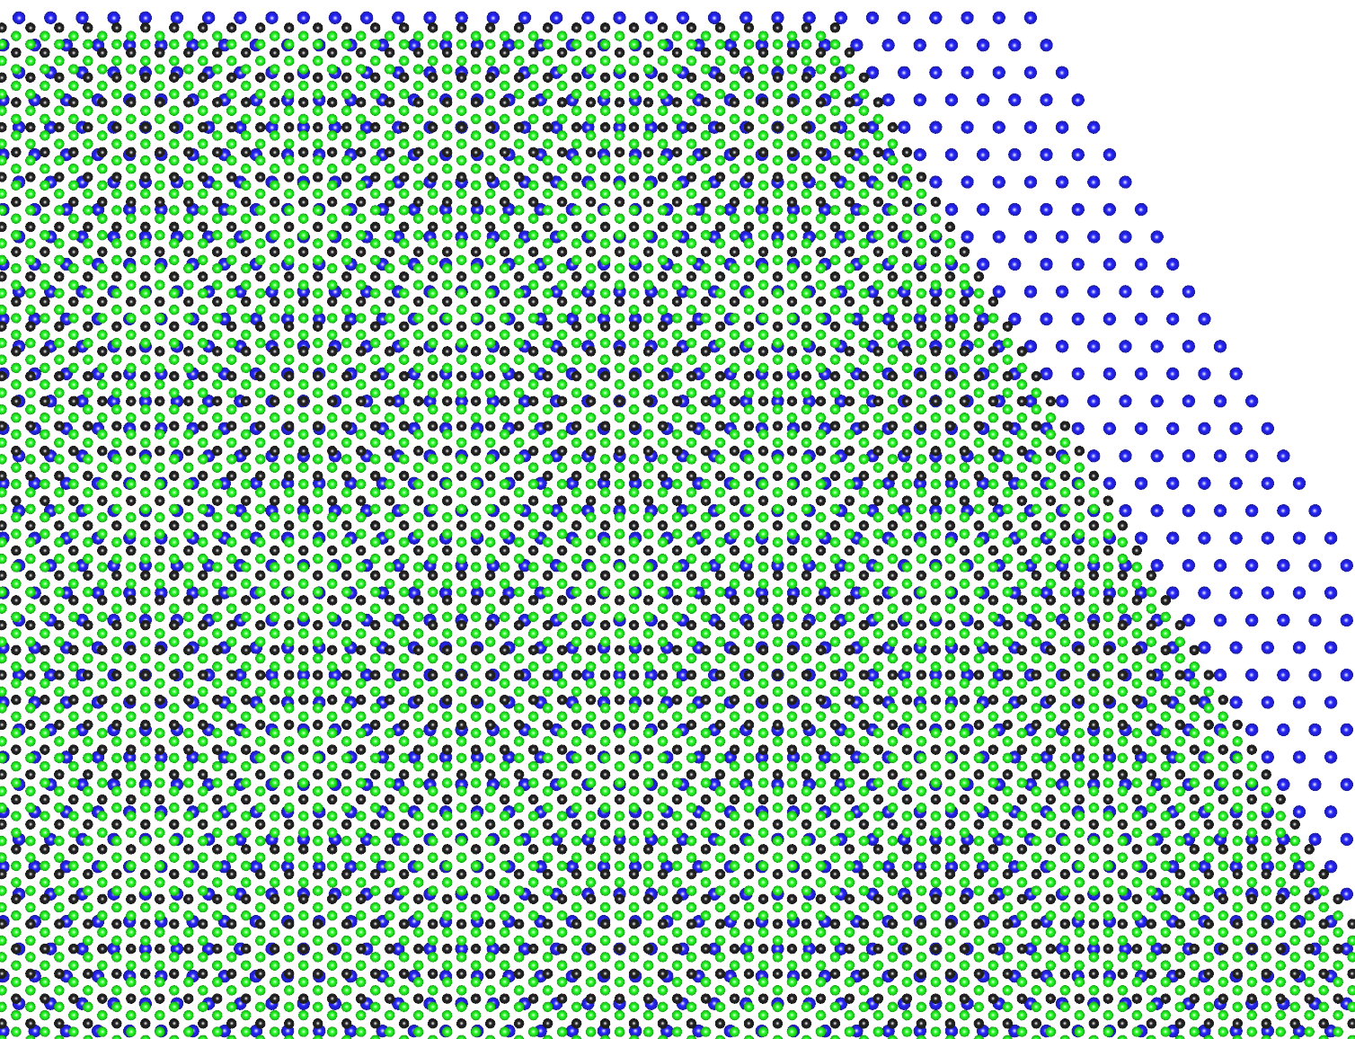
Superlattice
3 nm
Charge Density Wave
Moiré
-13.9°
substrate
+13.9°
Se
Ta
TaSe₂
Periodicity 1.32 nm
2 chiralities
Periodicity 3.8 nm
= 11 (TaSe₂)=10 (GaP)

Slide 23
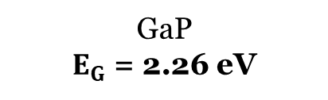
Scanning tunneling spectroscopy
Working temperature
T = 77 K
It=200pA
TaSe₂
Vs
n-doped GaP
GaP
$E_{G}$ = 2.26 eV
Notes:
For feedback conditions with a large sample bias of −2.0 V we can clearly observe zero conductance in the region of -1V and +1.3V that corresponde to the GaP bandgap. Setting up the sample bias of -0.5V we can clearly observe a zero conductance 0.13 ± 0.02 eV. The gap is surrounded by two peaks centered at −0.22 and +0.21 eV, with a Fermi energy in the middle of the gap, as expected for an undoped Mott semiconductor. The energy separation between the peaks of the LHB and UHB Hubbard bands, arising from the Coulomb repulsion in the monolayer, is 0.43 eV.
The observed gap amplitude and positions of the Hubbard peaks are very similar to those reported for 1T-TaSe2 single layers on a graphene bilayer,15,38 indicating a negligible substrate perturbation and strong electronic correlations in TaSe2.

Slide 24
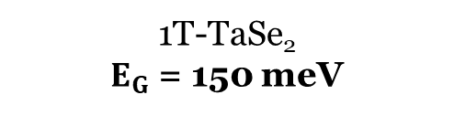
Scanning tunneling spectroscopy
Working temperature
T = 77 K
It=200pA
TaSe₂
Presence of the insulating gap in 1T-TaSe₂ in single layer limit
Vs
n-doped GaP
1T-TaSe₂
$E_{G}$ = 150 meV
GaP
$E_{G}$ = 2.26 eV
Notes:
For feedback conditions with a large sample bias of −2.0 V we can clearly observe zero conductance in the region of -1V and +1.3V that corresponde to the GaP bandgap. Setting up the sample bias of -0.5V we can clearly observe a zero conductance 0.13 ± 0.02 eV. The gap is surrounded by two peaks centered at −0.22 and +0.21 eV, with a Fermi energy in the middle of the gap, as expected for an undoped Mott semiconductor. The energy separation between the peaks of the LHB and UHB Hubbard bands, arising from the Coulomb repulsion in the monolayer, is 0.43 eV.
The observed gap amplitude and positions of the Hubbard peaks are very similar to those reported for 1T-TaSe2 single layers on a graphene bilayer,15,38 indicating a negligible substrate perturbation and strong electronic correlations in TaSe2.

Slide 25
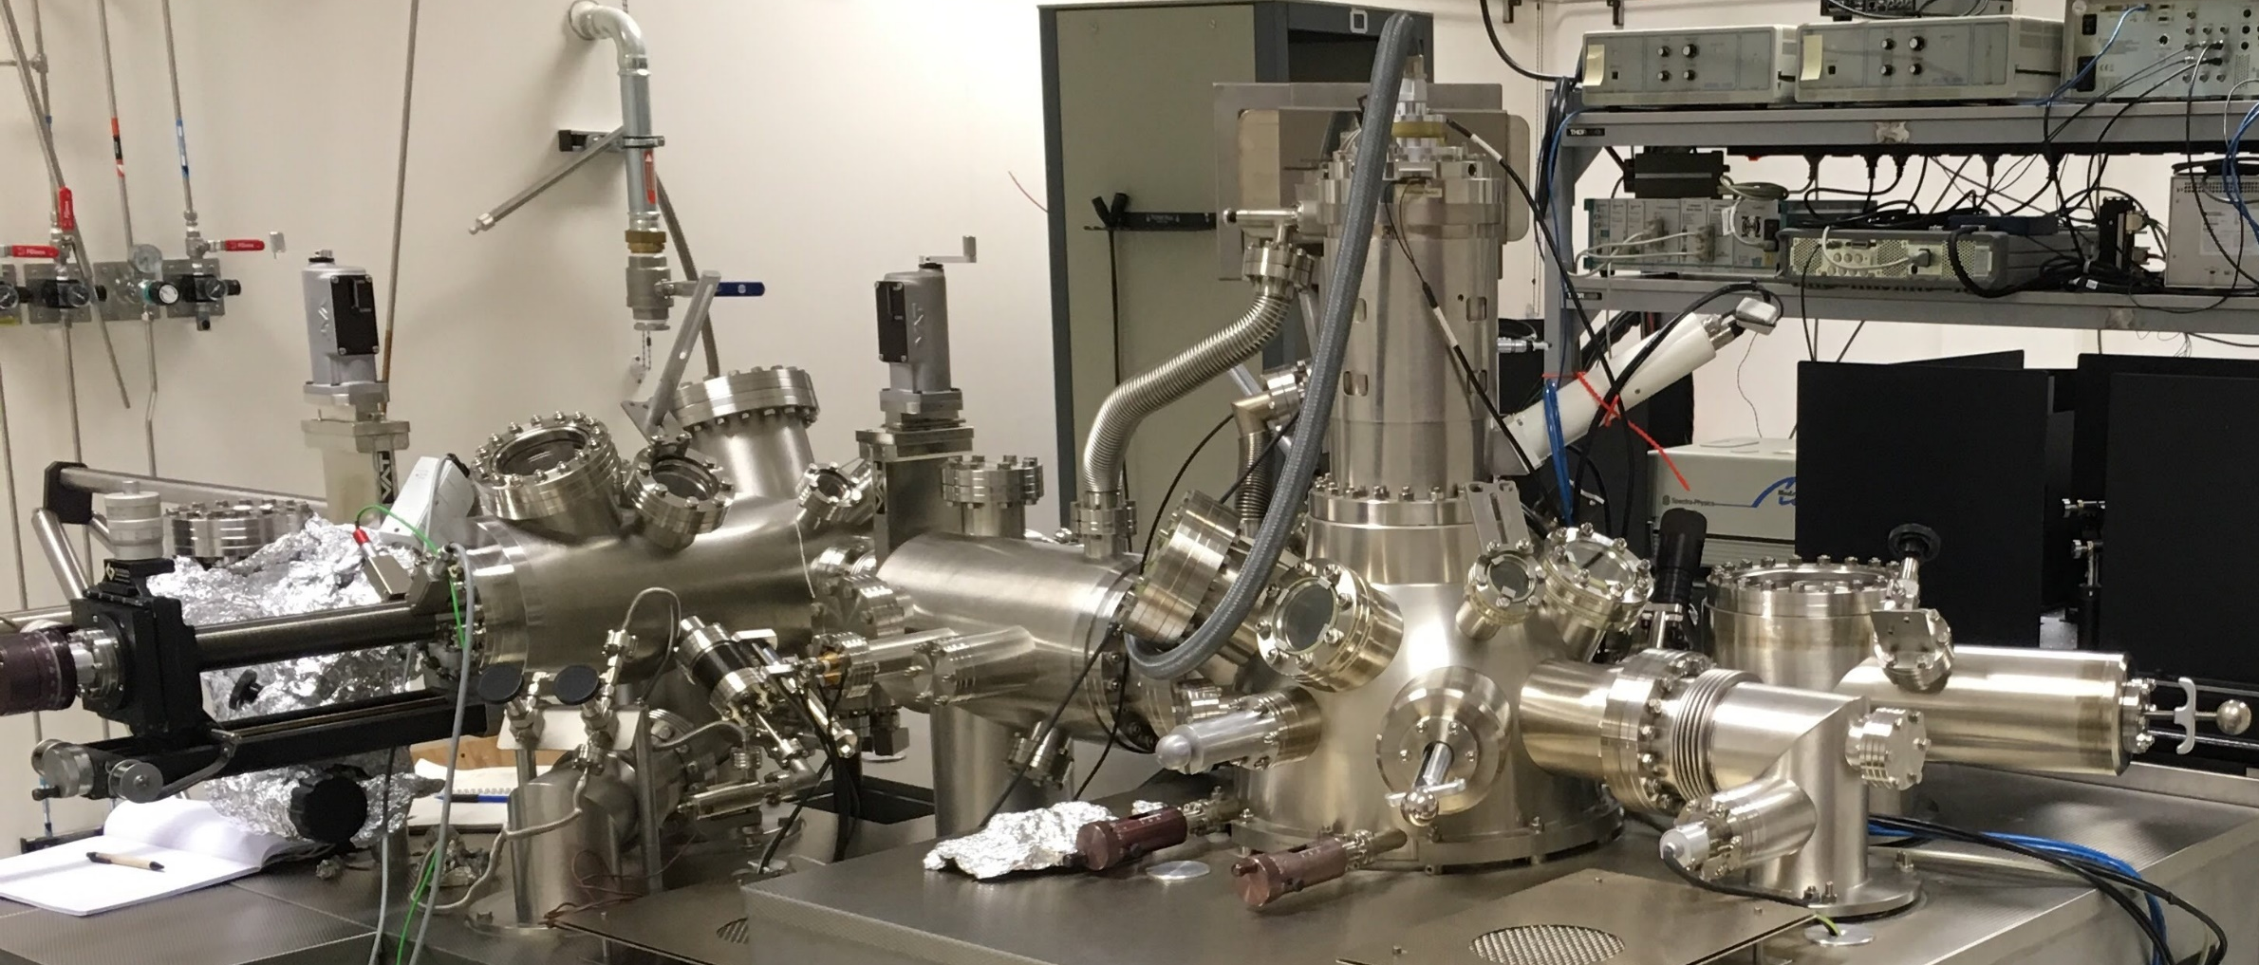
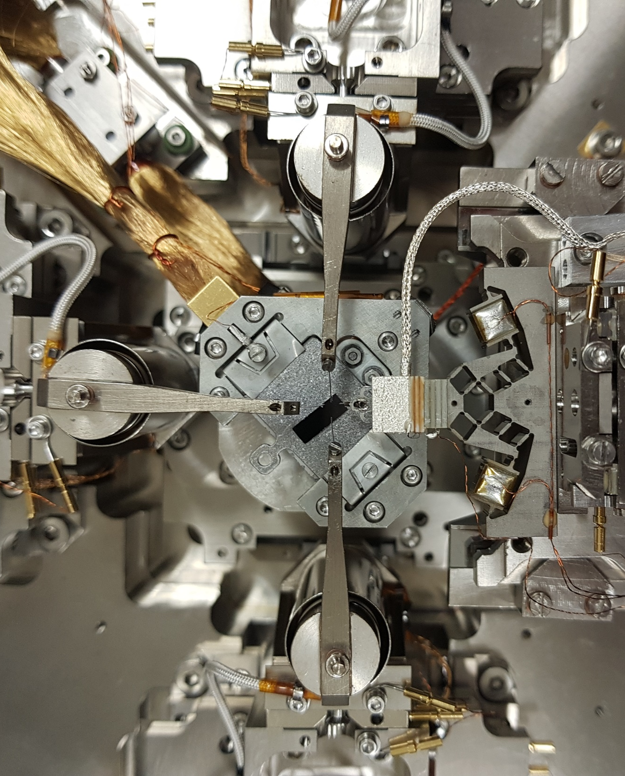
The Nanoprobe:
Four independent
STM probes
+
SEM monitoring
+
Ultra High Vacuum
Multiscale transport measurements at room temperature
Notes:
To confirm the macroscopic continuity of the TaSe2 monolayer, four-probe transport measurements were performed using a multiprobe STM called tha Nanoprobe. Chemiclly etched tungsten tips were used as a four different STm probes that can be finally positioned on the sample thanks to the installed SEM.

Slide 26
Transport measurements:
Room temperature
TaSe₂
insulating GaP
R_{s} ~ 50 kΩ/square
Notes:
The experiment was performet at the room temperature. For this measurements the monolayer of TaSe2 were deposited on the semi-insulating GaP in order to avoid an electrical conduction through the substrate..
Equidistant 4-probe measurements were performed thanks to the 4 STM tips contacted to the surface of TaSe2 after Se cap sublimmation. . Despite the roughness of the surface caused by the GaP terraces and the defects observed on each terrace, the electron conduction which is confined in the two-dimensional TaSe2 monolayer does not degrade over tens of micrometers. This property indicates a strong robustness of
transport to defects.

Slide 27
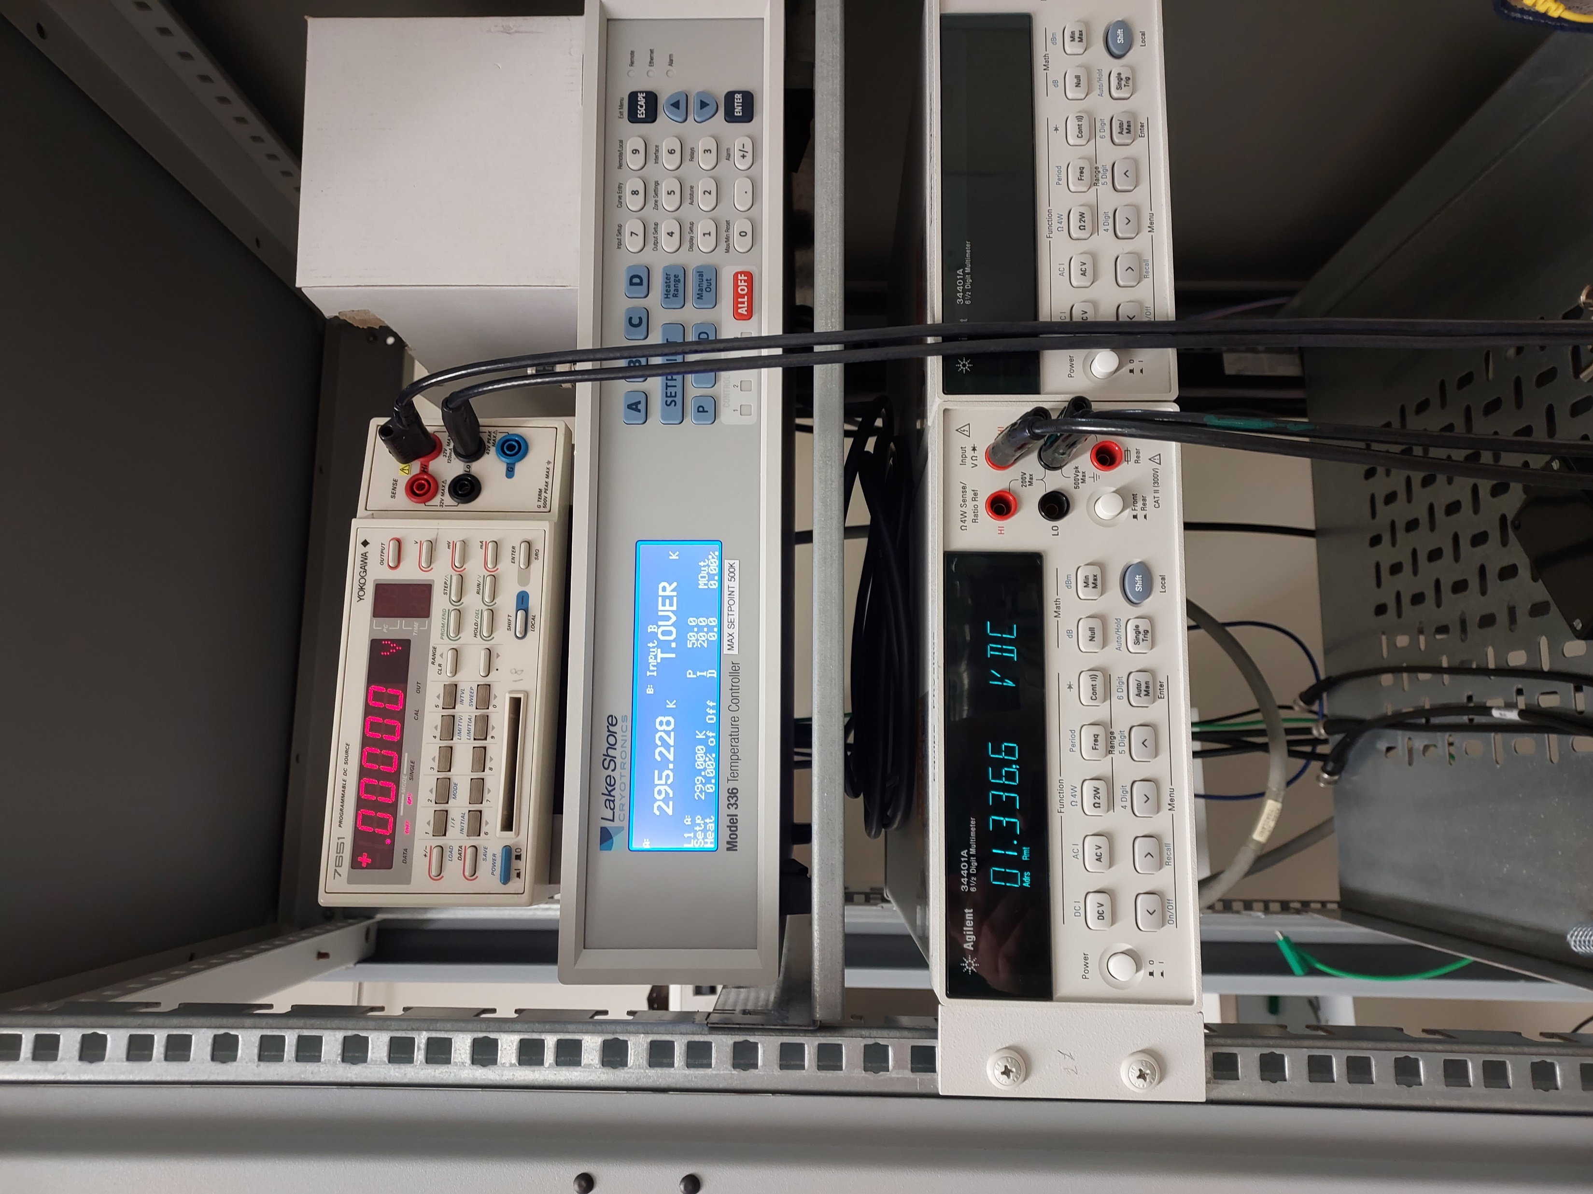
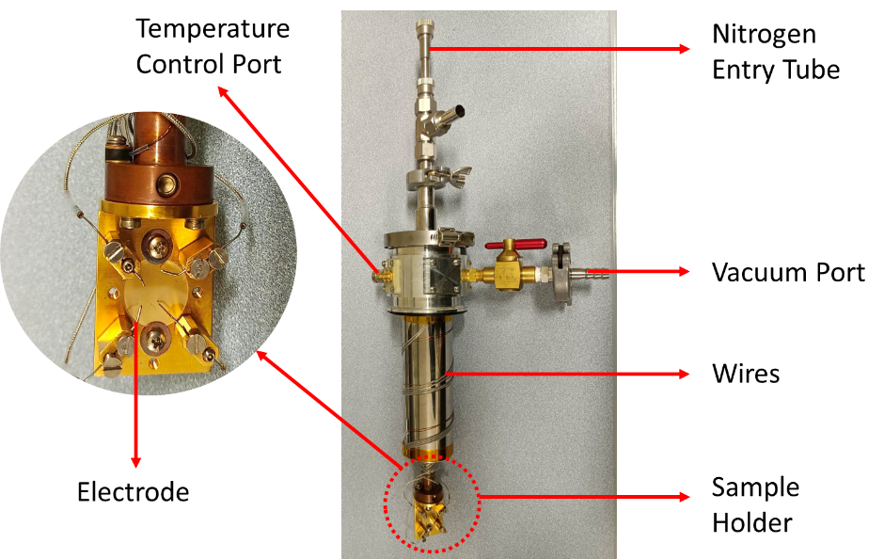
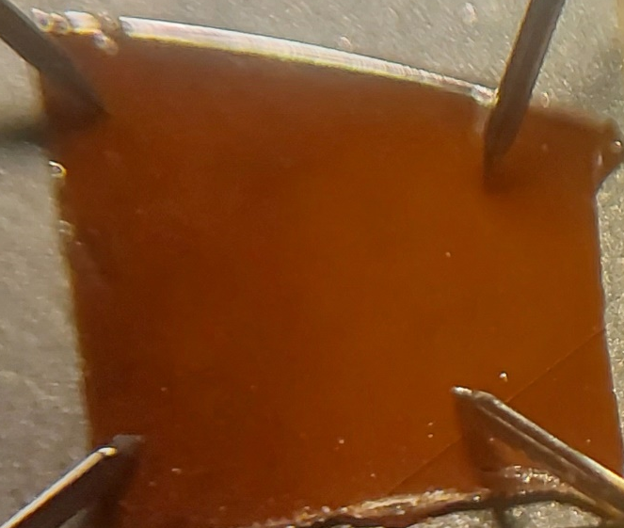
Transport measurements: temperature dependence
Janis VPF100 cryostat
DC current source
Yokogawa 7651
Temperature controller
Lake Shore 336
Voltmeter
Agilent 34401A
Temperature variation 77K÷500K
+
Macroscopic transport measurements
5 mm
Notes:
Temperature-dependent resistance measurements have also been performed on the millimetric scale. For that we used a small cryogenic setup that consist of The sample holder contains an insulating mounting surface and 4 fixed-position tungsten probes with limited
range of movements for fine scale positioning.
Pair of electrodes were connected to the DC current source and a voltmeter that allow us to perform a transport measurements. The 4 tungsten probes are connected to the sample surface but then body of the cryostat is pumped with vacuum pump in order to prevet any additional oxydation

Slide 28
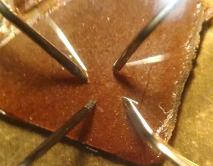
Transport measurements: temperature dependence
Se cap
TaSe₂
insulating GaP
4mm
Notes:
This measuremens were performed on the same monolayer deposited on the semi-insulating Gap with Se cap. The foru probes were put in contact and the voltage current characteristic were measured between each pair of probes to maintain the omich contact. 4 probe resistance was measured at the different temperatures and the obtaine curve shows typical semi-conducting behaviour.

Slide 29

Transport measurements: temperature dependence
Se cap
TaSe₂
insulating GaP
$R∝exp (−\frac{E_{G}}{2k_{B}T})$
$$E_{G}=135 meV$$
4mm
Notes:
This measuremens were performed on the same monolayer deposited on the semi-insulating Gap with Se cap. The foru probes were put in contact and the voltage current characteristic were measured between each pair of probes to maintain the omich contact. 4 probe resistance was measured at the different temperatures and the obtaine curve shows typical semi-conducting behaviour.

Slide 30
Transport measurements: temperature dependence
Se cap
TaSe₂
insulating GaP
$R∝exp (−\frac{E_{G}}{2k_{B}T})$
$$E_{G}=135 meV$$
4mm
Presence of the Mott insulating gap up to 400K
Notes:
Which is very close to the measured bandgap with STS that was 150meV. So we have a confirmation of the presence of the insulating bangap up to 400K. Until this, i was talking only about characterisation of the monolayer but can we manipulate with it state?

Slide 31

Resistive switching
It $↑$
TaSe₂
LHB
Vs=±0.5V
UHB
n- doped GaP
Notes:
STS réveil us the UHB and LHB. But what will happen if we increase the electrecal field? For that we will increase the setpoint current of the tips thus approache it closer to the surface…

Slide 32
Resistive switching
It $↑$
TaSe₂
LHB
Vs=±0.5V
UHB
n- doped GaP
Notes:
STS réveil us the UHB and LHB. But what will happen if we increase the electrecal field? For that we will increase the setpoint current of the tips thus approache it closer to the surface…

Slide 33

Conclusion
Flower-shaped superlattice
Electrical continuity
Mott insulating bandgap up to 400K
Resistive switching

Slide 34
OptoPulSTM

Slide 35
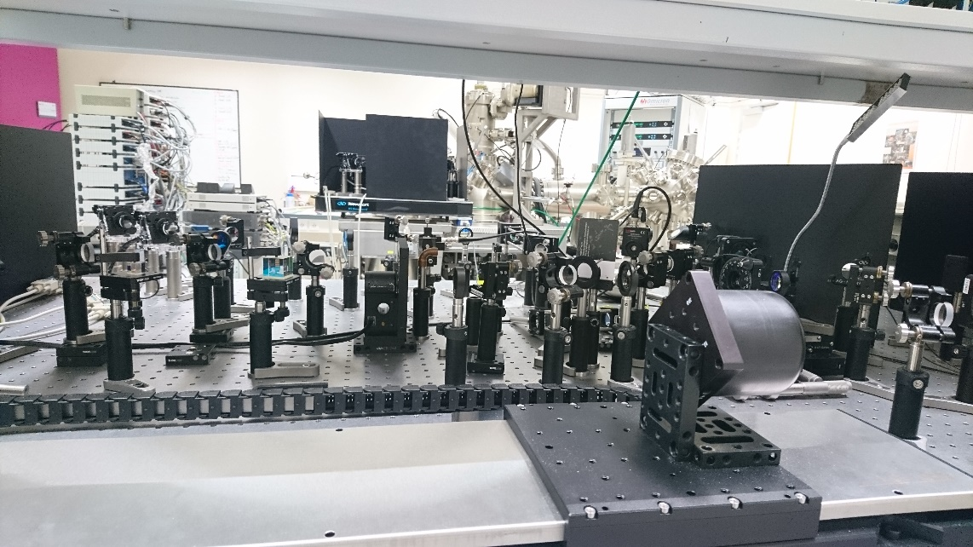
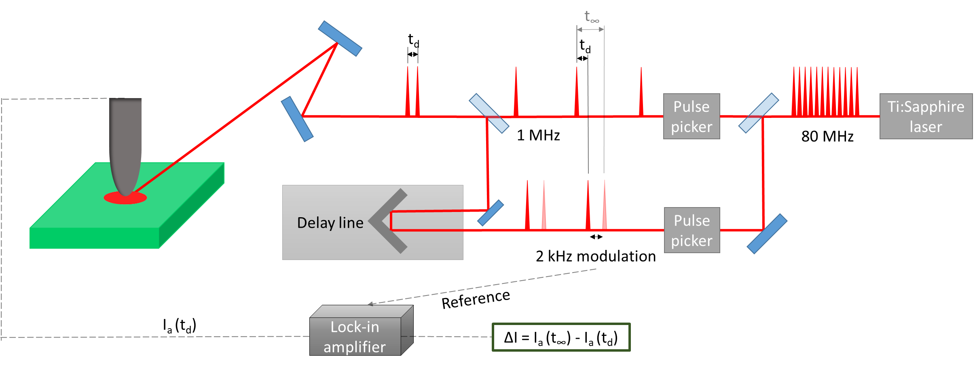
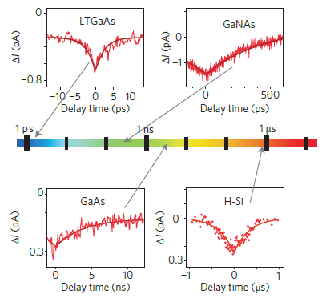
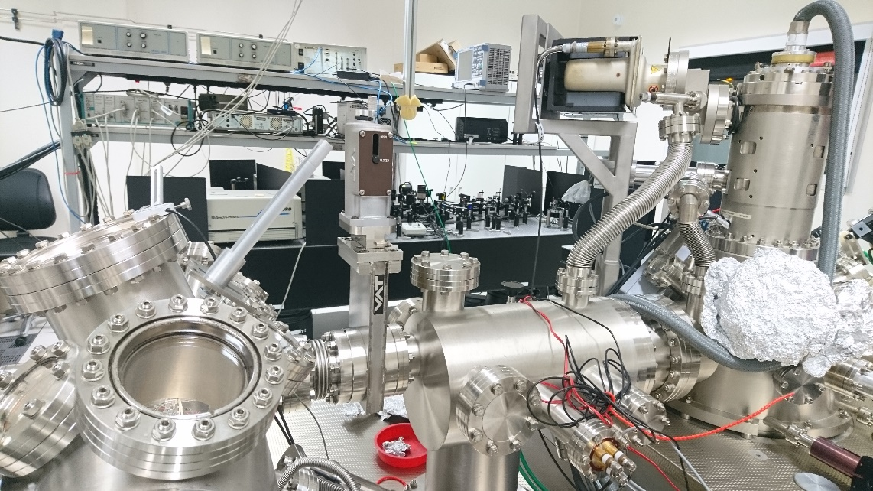
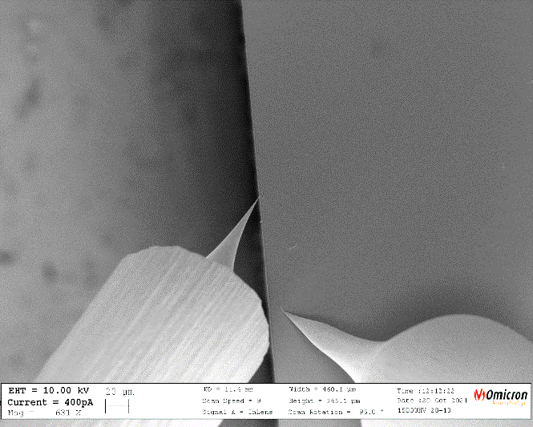
OptoPulSTM
Laser pump-probe (femtosecond time resolution )
4-probe STM (high spatial accuracy )
D=100µm
20µm
Tip 2
Tip 3
Terada, Y. et al. Nature Photon 4, 869–874 (2010)

Slide 36
OptoPulSTM
t_{d}
t∞
ΔI = I_{a} (t∞) - I_{a} (t_{d})
time
time
I*
I_{a} (t_{d})
I_{a} (t∞)
time
time
t_{d}
t_{d}
t∞
t∞
time
time
time
time
I*
I*
I_{a} (t∞)
I_{a} (t∞)
I_{a} (t_{d})
ΔI
I_{a} (t_{d})
ΔI
time
time
time
time

Slide 37
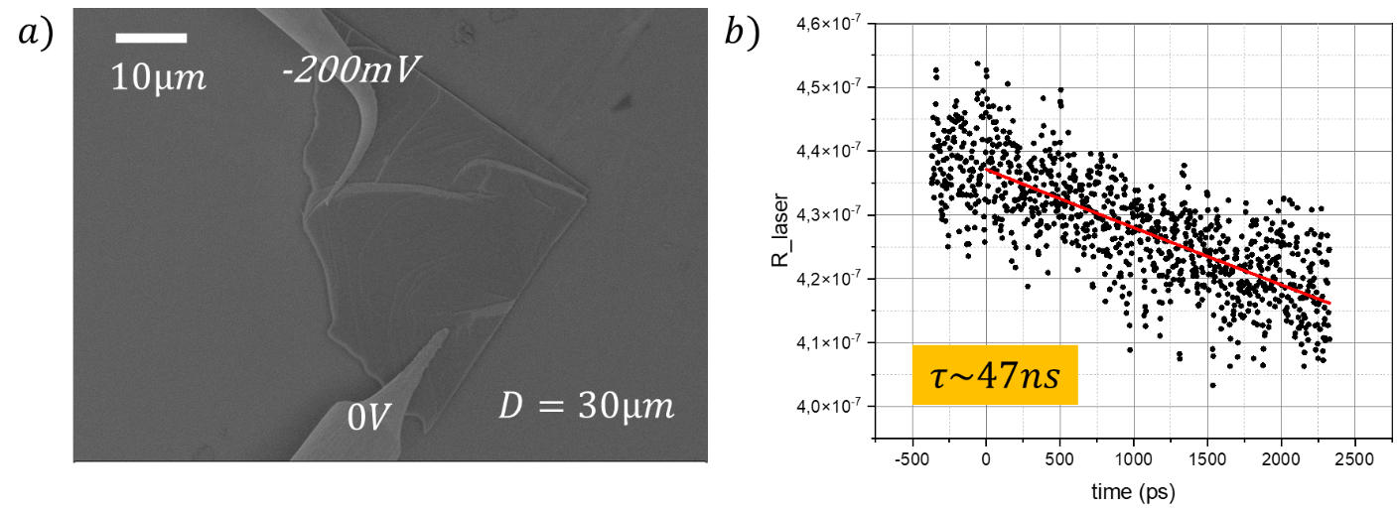
First tests
LT - GaAs
GaMo₄S₈
SEM
GaAs-BT
GaAs
1µm
GaAs
BT -GaAs
Τ=20ps

Slide 38
Thank you for your attention!

