Slide 1



The Multifaceted Impact of Memristors on Neuromorphic Systems
Damien Querlioz
Centre de Nanosciences et de Nanotechnologies
Université Paris-Saclay, CNRS, Palaiseau, France
damien.querlioz@universite-paris-saclay.fr
Joint work with the groups of Marc Bocquet and Jean-Michel Portal (Aix-Marseille Univ) and Elisa Vianello (CEA-LETI)

Slide 2
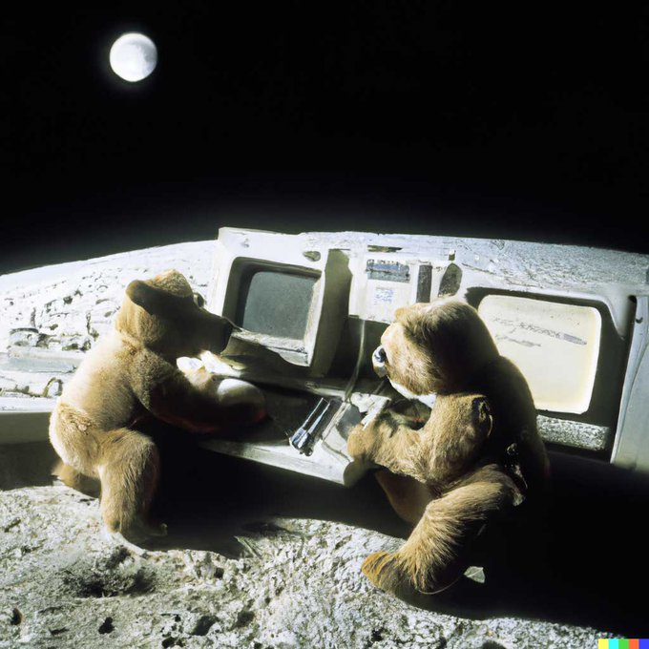
The Energy Problem of Artificial Intelligence
Operating AI is energy-intensive
Generating an image with AI or processing a medium ChatGPT request: a few W.h
Battery of a laptop ~40 W.h
“Teddy bears working on new AI research on the moon in the 1980s”
Creating an AI is EXTREMELY energy-intensive
Training the Google PALM language model (~free version of ChatGPT) required 3.5 GW.h
20,000 years of brain operation!

Slide 3
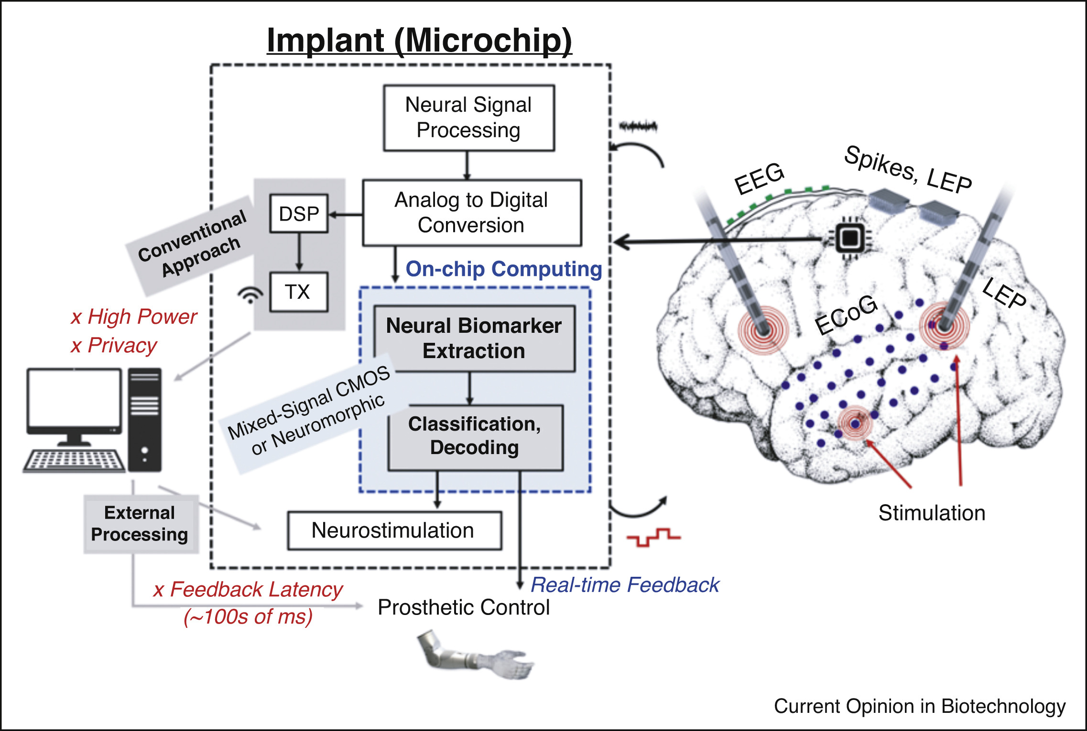
AI Energy Inefficiency Limits Its Best Applications
Yoo and Shoaran,
Current Opinion Biotechnol., 2021
Edge AI implemented in a medical implant could allow epilepsy prediction, advanced BMI…
But currently limited to elementary AI

Slide 4
The AI Energy Problem Is a Memory Problem
Neural networks differ from traditional computation:
not a lot of arithmetics, but Huge volume of parameters
In computers, memory access is extremely costly, because logic and memory are separated
Operation | Energy
Addition of data (fixed point) | 1x
Access data (onchip cache) | 60x
Access data (offchip RAM) | 3500x
Absent in the brain!
Pedram et al , IEEE D&T 2016

Slide 5
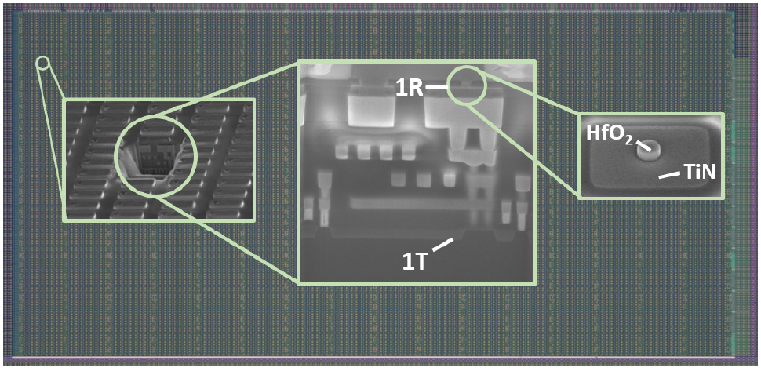
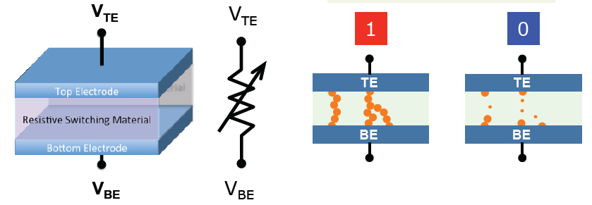
Memristor/RRAM: an Artificial Synapse!
Low resistance
High resistance
TiN/HfO_{x}/Ti/TiN stack
High voltage: move atoms to switch memristor between low/high resistance
Low voltage: allows reading the resistance

Slide 6
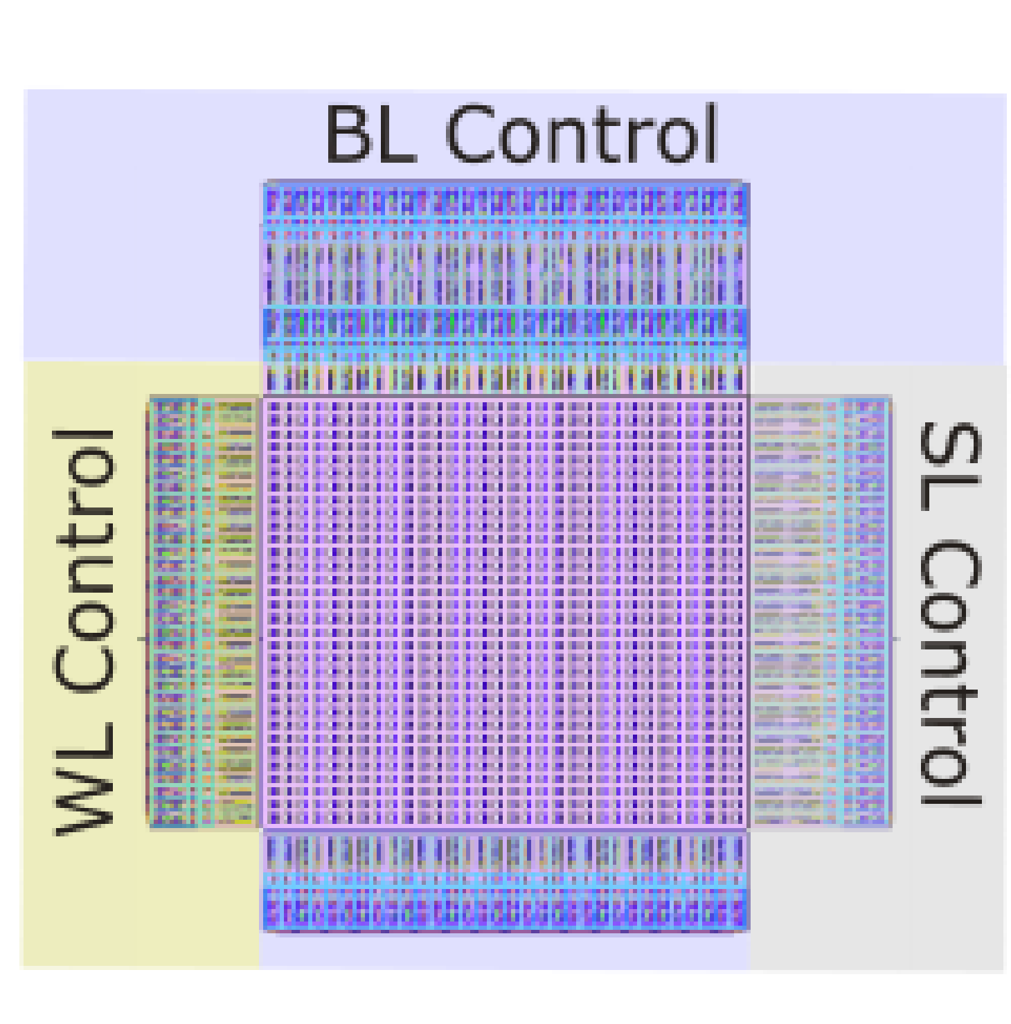
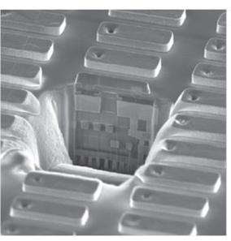
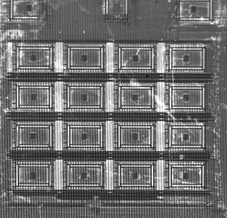
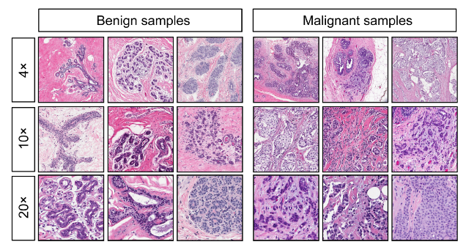
The Multifaceted Impact of Memristors on Neuromorphic Systems
Analog Memristors
  Analog Neural Networks
Binary Memristors
  The Bayesian Machine
Stochastic Memristors
  Bayesian Neural Networks
  Bayesian Learning

Slide 7
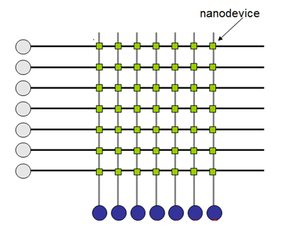
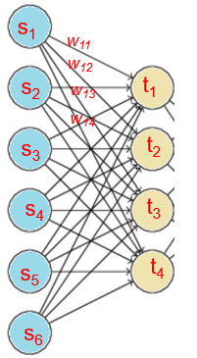
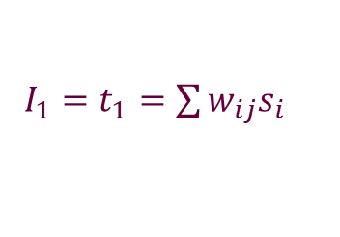
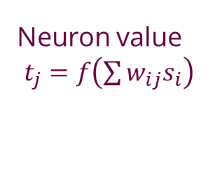
Inference Is Made Very Naturally!
A matrix of analog memristors naturally implements a layer of neural network with Kirchhoff laws!
Memristor conductance G = synaptic weight w
V=s₁
V=s₂
V=s₃
…
$I_{1}=t_{1}=\sum{w_{ij}s_{i}}$
Neuron value
$t_{j}=f\left(\sum{w_{ij}s_{i}}\right)$

Slide 8
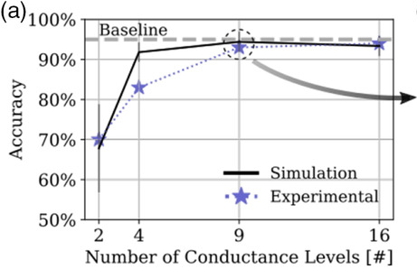
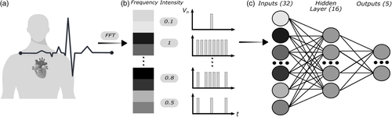
Experimental Realization with HfO_{x} Memristors
Accuracy on arrhythmia identification
Esmanhotto et al, 2200145, Advanced Intelligent Systems, 2022

Slide 9
Experimental Realization with HfO_{x} Memristors
Accuracy on arrhythmia identification
Esmanhotto et al, 2200145, Advanced Intelligent Systems, 2022

Slide 10
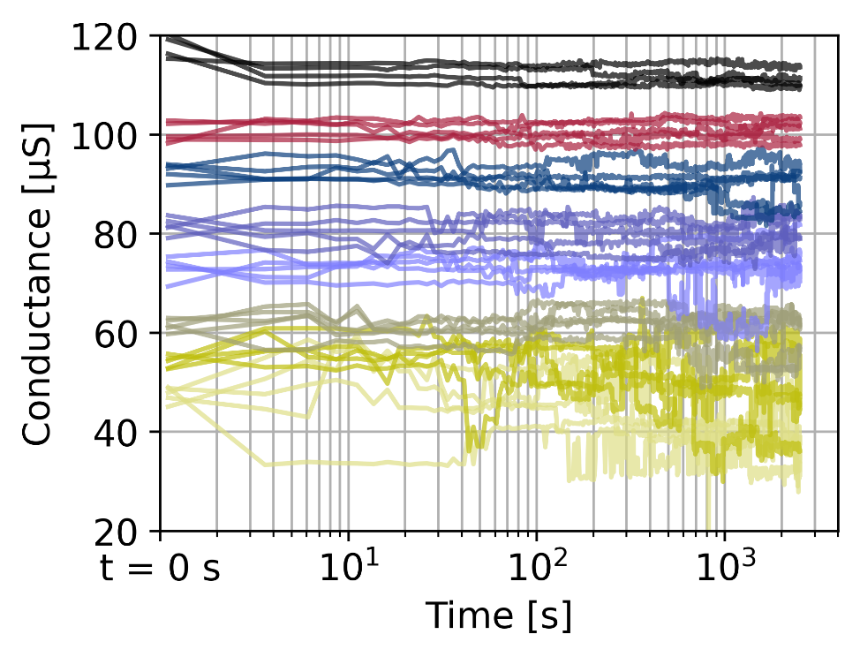
Writing Memristors Reliably
Problem
Solutions
Program Memristor
WAIT
Resistance
Still OK?
NO
YES
We’re good for months!
Esmanhotto et al, 2200145, Advanced Intelligent Systems, 2022

Slide 11
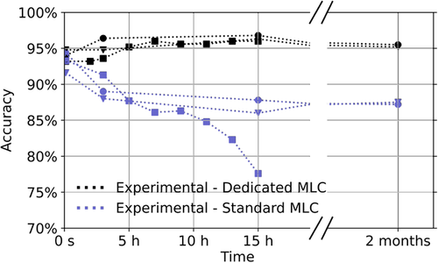
Writing Memristors Reliably
With the Wait
Esmanhotto et al, 2200145, Advanced Intelligent Systems, 2022

Slide 12
The Multifaceted Impact of Memristors on Neuromorphic Systems
Analog Memristors
  Analog Neural Networks
Binary Memristors
  The Bayesian Machine
Stochastic Memristors
  Bayesian Neural Networks
  Bayesian Learning

Slide 13

AI Is Not Only Neural Networks
Neural Networks excel at big data situations
Small data world: neural networks overfit.
Expert knowledge is important
Imagenet

Slide 14
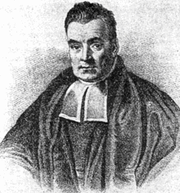
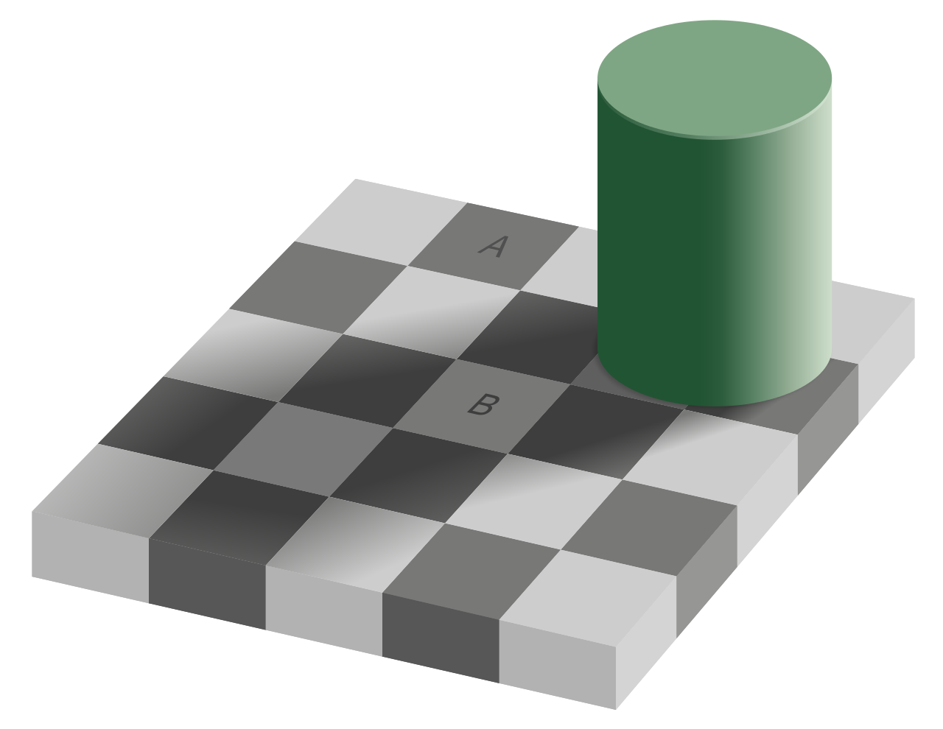
Bayesian Reasoning: Better at Small Data
Likelihoods
Prior
Thomas Bayes
$$p\left(Disease | Observations\right) ∝ p\left(Observations | Disease\right)×p(Disease)$$
Constructed with expert knowledge+Data
Hard to Compute
The Brain Might Be Using Bayesian Reasoning
Wikimedia

Slide 15


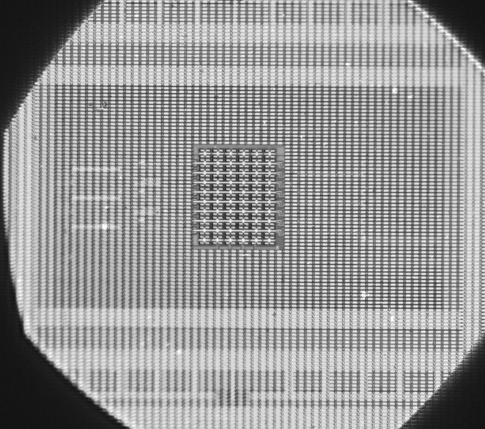
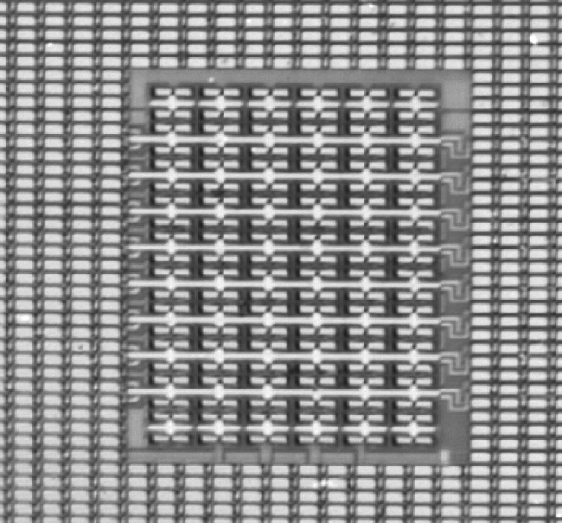
The Memristor-Based Bayesian Machine
Harabi, Hirtzlin, Turck et al, Nature Electronics 6, 53 (2023)

Slide 16
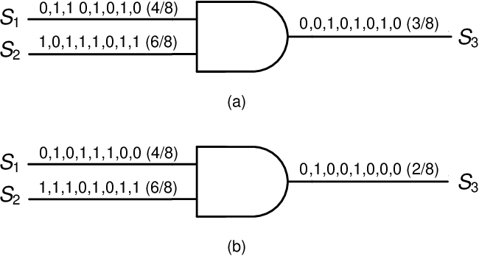
Stochastic Computing
AND
p(S₃)=p(S₁)p(S₂)
AND
A AND gate implements the multiplication of two probabilities!
Some resemblance with neurons (one wire = one real number)

Slide 17
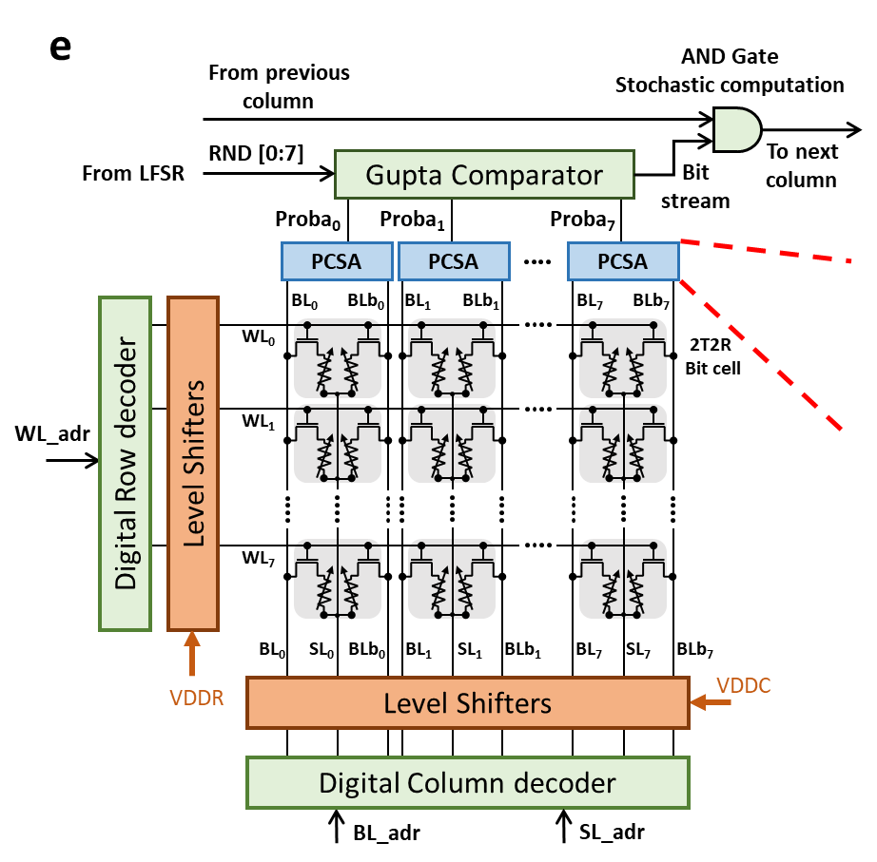
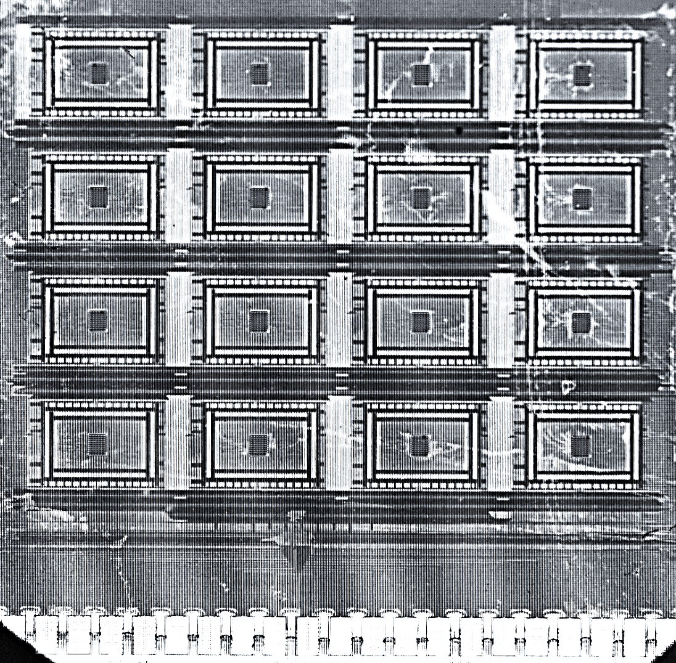




The Memristor-Based Bayesian Machine
O₁
RND₁
O₂
RND₂
O₃
RND₃
O₄
RND₄
P(O₁|Y₁)
P(O₂|Y₁)
P(O₃|Y₁)
P(O₄|Y₁)
$∝$ P(Y=1|O₁,O₂,O₃,O₄)
P(O₁|Y₂)
P(O₂|Y₂)
P(O₃|Y₂)
P(O₄|Y₂)
$∝$ P(Y=2|O₁,O₂,O₃,O₄)
P(O₁|Y₃)
P(O₂|Y₃)
P(O₃|Y₃)
P(O₄|Y₃)
$∝$ P(Y=3|O₁,O₂,O₃,O₄)
P(O₁|Y₄)
P(O₂|Y₄)
P(O₃|Y₄)
P(O₄|Y₄)
$∝$ P(Y=4|O₁,O₂,O₃,O₄)
Digital Control Unit
P(Y=4|O₁,O₂,O₃,O₄) $∝\text{P}\text{(}\text{O}\text{1}\text{|}\text{Y}\text{=4)}×…×\text{P}\text{(}\text{O}\text{4}\text{|}\text{Y}\text{=4)}$
I/O Pads
Harabi, Hirtzlin, Turck et al, Nature Electronics 6, 53 (2023)

Slide 18
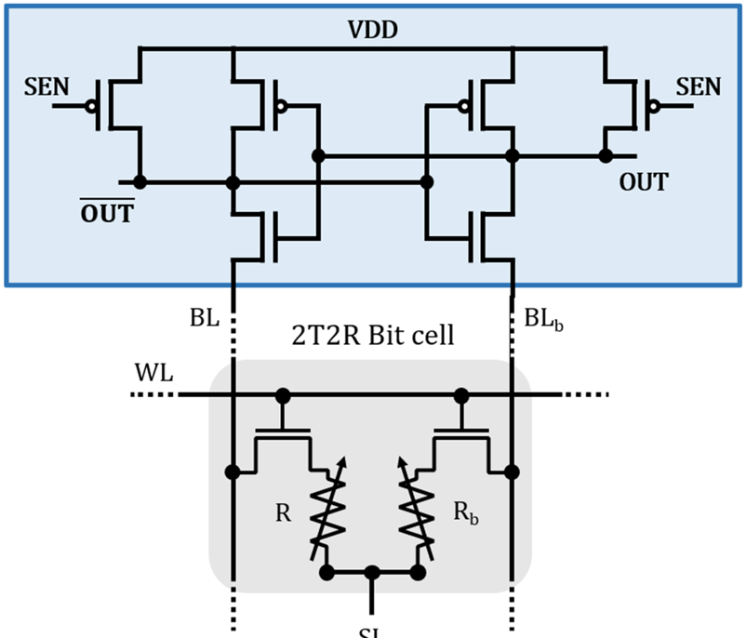
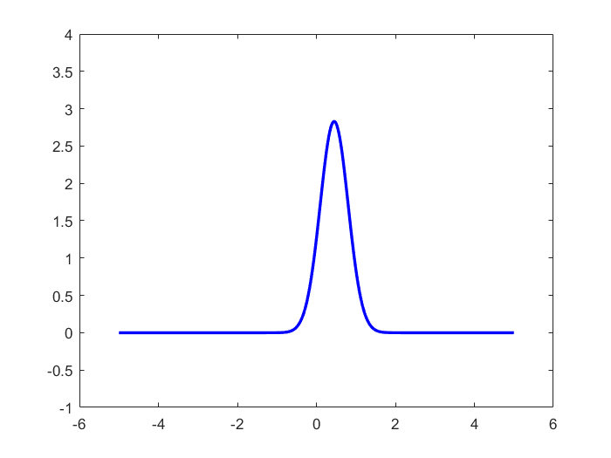
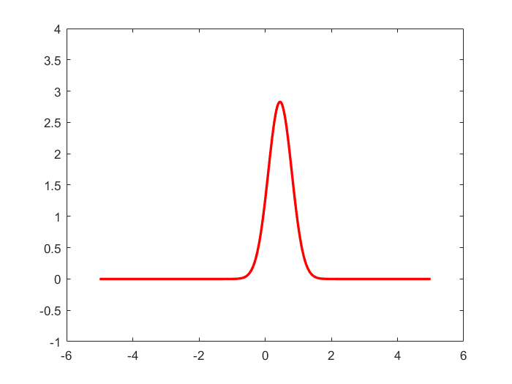
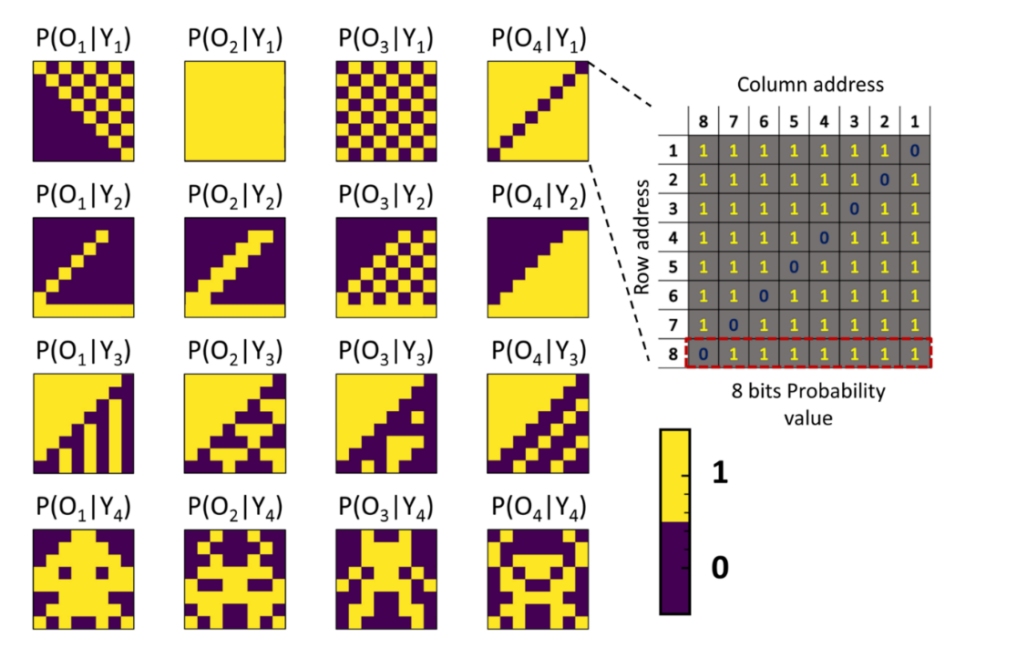
2T2R Approach to Reduce Error Rate without ECC
R
R_{b}
LRS
HRS
State 1
State 0
HRS
LRS
An error happens if
R(LRS)>R(HRS)
P(R)
Memristor Resistance R
Bocquet et al, IEEE IEDM, p. 20.6.1, 2018; Hirtzlin et al., Front. Neurosci. 13, p. 1383, 2020
No errors in the programmed likelihoods
Even 5 months after programming

Slide 19

The Memristor-Based Bayesian Machine
Randomly chosen
pseudo-RNG seeds
Best choice of
pseudo-RNG seeds
Harabi, Hirtzlin, Turck et al, Nature Electronics 6, 53 (2023)

Slide 20
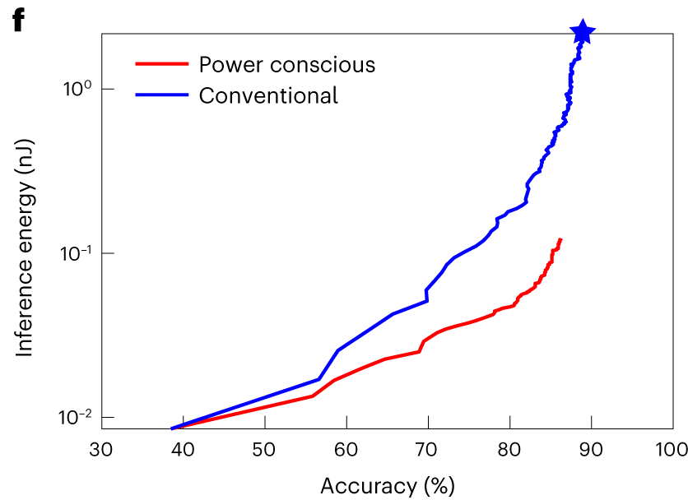

Energy Consumption
Majority of energy consumption is for RNG
Same task, STM32 MCU: 2µJ
Harabi, Hirtzlin, Turck et al, Nature Electronics 6, 53 (2023)

Slide 21
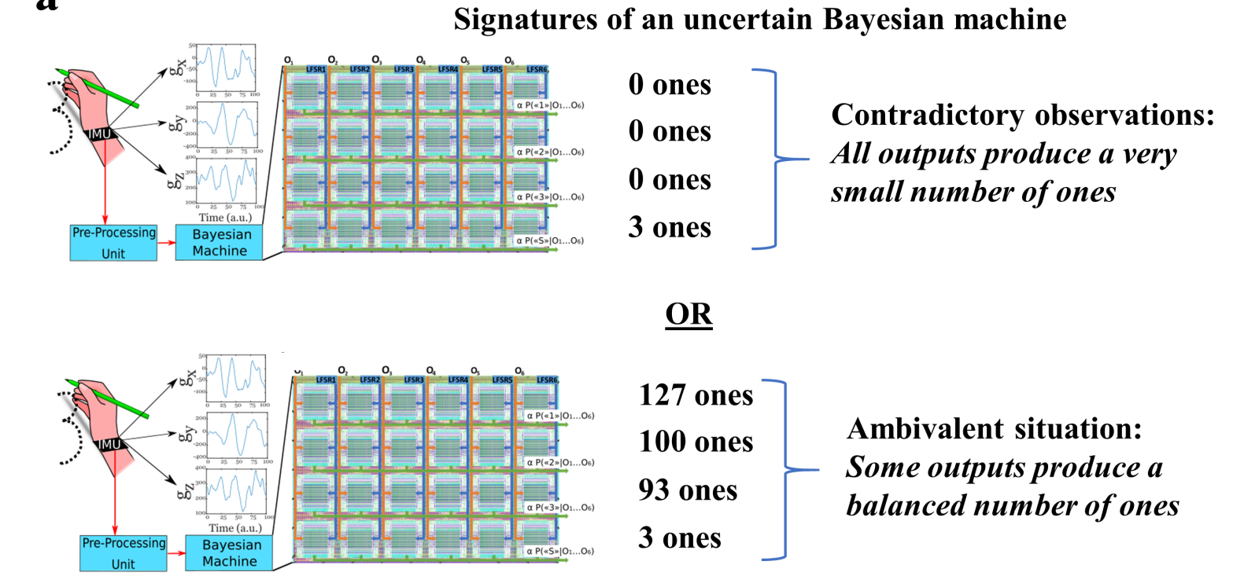
Uncertainty Evaluation
EPISTEMIC UNCERTAINTY
ALEATORIC UNCERTAINTY
Harabi, Hirtzlin, Turck et al, Nature Electronics 6, 53 (2023)

Slide 22
The Multifaceted Impact of Memristors on Neuromorphic Systems
Analog Memristors
  Analog Neural Networks
Binary Memristors
  The Bayesian Machine
Stochastic Memristors
  Bayesian Neural Networks
  Bayesian Learning

Slide 23
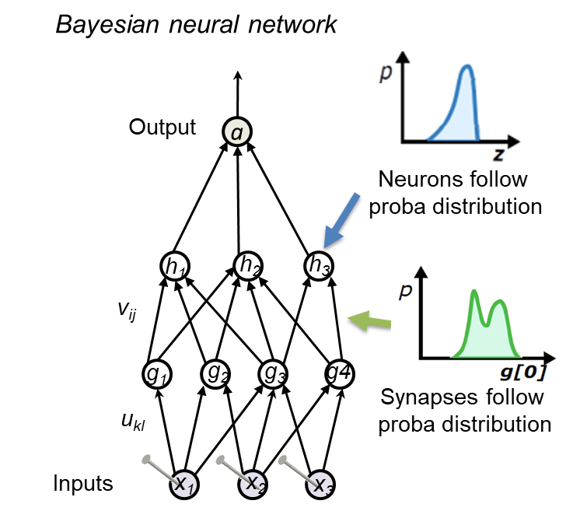
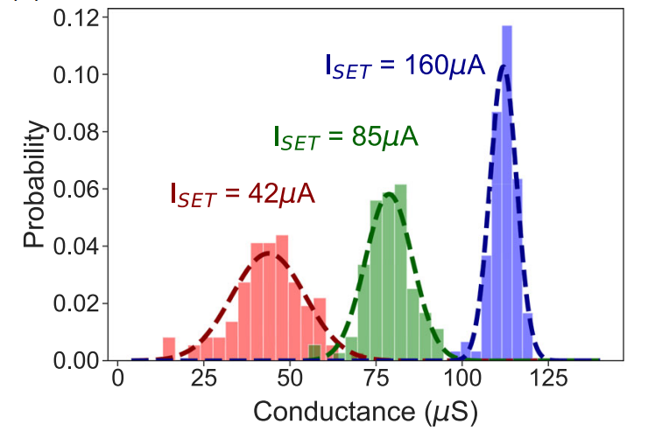
Do Not Fight Memristor Imperfections:
They Naturally Produce a Bayesian Neural Network!
In Bayesian models, everything is a random variable that follows specific probability distributions
Memristors actually act as a random variable that follow specific probability distributions!
Our concept: Bayesian models can be a “better” way to exploit memristors
Bonnet et al, preprint DOI: 10.21203/rs.3.rs-2458251/v1

Slide 24
Now Let Us Make a Bayesian Version!
We program 50 memristor arrays, and we apply the same input to them
We get 50 outputs:
Their dispersion tells about the certainty of the neural network
Programmed the same way to represent a probability distribution
Input: heartbeat to classify
…
Neural network needs to have been trained in a special way (variational inference with technological loss)
Bonnet et al, Nature Communications 14, 7530 (2023)

Slide 25
Now Let Us Make a Bayesian Version!
We program 50 memristor arrays, and we apply the same input to them
Hesitates between arrythmia type 1 and 2
Unknown data:
EPISTEMIC UNCERTAINTY
Hesitates between arrythmia type 3 and 4
Input: heartbeat to classify
…
Hesitates between arrythmia type 1 and 5
Bonnet et al, Nature Communications 14, 7530 (2023)

Slide 26
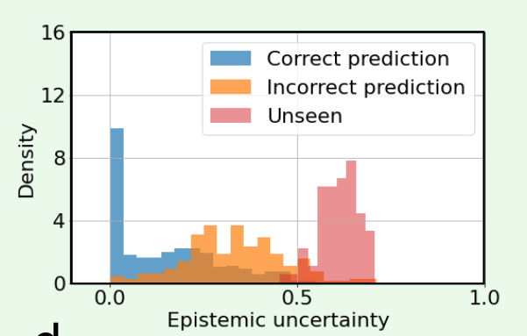
Fully Experimental Arrythmia Recogniton with Uncertainty Evaluation
79% raw accuracy (software: 80%)
Unknown types of arrythmia are easily recognized
Using 50 memristors neural networks
« Wait and Verify » Programming not needed
Bonnet et al, Nature Communications 14, 7530 (2023)
26

Slide 27
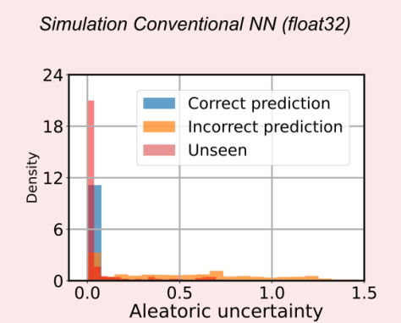
Fully Experimental Arrythmia Recogniton with Uncertainty Evaluation
79% raw accuracy (software: 80%)
Unknown types of arrythmia are easily recognized
Using 50 memristors neural networks
« Wait and Verify » Programming not needed
Bonnet et al, Nature Communications 14, 7530 (2023)
27

Slide 28
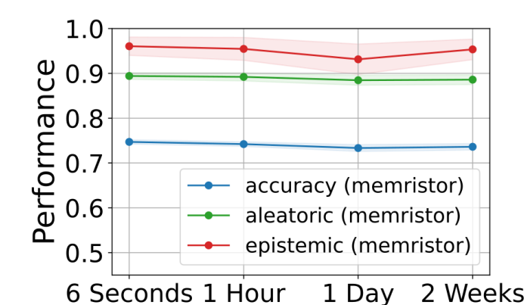
Stable Performance Over Time
Memristors are not stable, but they remain true to the probability distribution they represent!
Bonnet et al, Nature Communications 14, 7530 (2023)
28

Slide 29
The Multifaceted Impact of Memristors on Neuromorphic Systems
Analog Memristors
  Analog Neural Networks
Binary Memristors
  The Bayesian Machine
Stochastic Memristors
  Bayesian Neural Networks
  Bayesian Learning

Slide 30
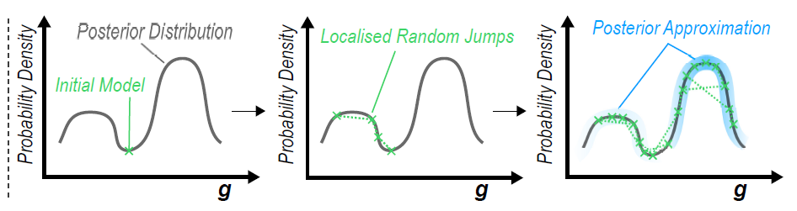
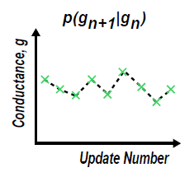
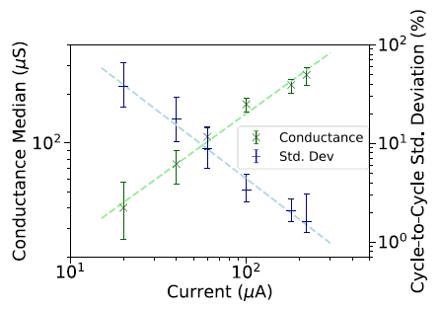
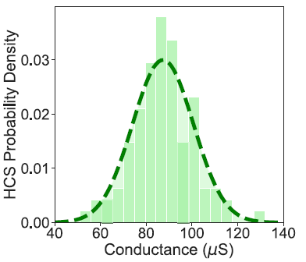

Bayesian Models Can Learn Using Metropolis-Hastings
Markov Chain Monte Carlo (MCMC)
Models Jumps
Collection of Models
Initial
Model
The jumps can be performed easily using the statistical behavior of memristors!
SET
$$μ$$
$$σ$$
RESET
Memristors are ideal for MCMC-based learning!
30
Notes:
Instead of finding ways of fighting against these intrinsic random properties using mitigation techniques like the rest of the state of the art, what we did in this thesis was look for another machine learning approch that is more suitable
In my thesis we propsed that a much more suitable learing algorithm is one called Markov chain Monte Carlo sampling
Markov chain Monte Carlo re-poses the learning problem by trying to answer the question, how likely is my model given my data. In contrast to descedning an error gradient, MCMC aims to build up a picture of what is called the posterior distribution.
Starting from an inital model, for example here, MCMC proceeds to make a series of localised random jumps on this posterior, recording information on the probability of the models as it goes along. After a whole series of these random jumps, or samples, we are left with an approximation of the posterior that we can then apply to a task.
In contrast to gradient-based learning, the ideal device in MCMC is one that behaves as a random variabl
As chance would have it, resisitve memory devices are nanoscale gaussian random variables in the high conductznce state
That is to say that each time a device undergoes a SET operation, a conductance value is sampled from its gaussian cycle-to-cycle conductane probability density
Furthermore, the mean and standard dev of these randoom variables are a function of the SET current allowed to flow through the device and therefore we can condition these random variables on SET current
In other words they are absoltely ideal for MCMC samlping algorithms

Slide 31
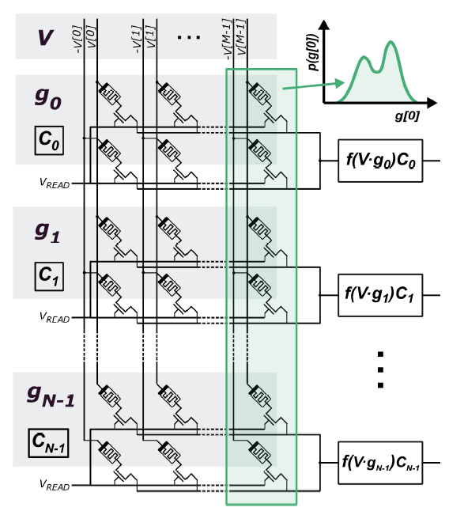


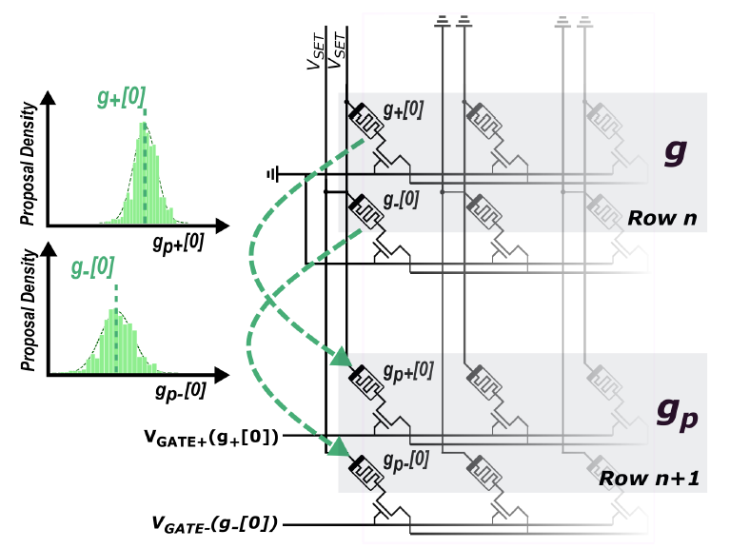
Memristor-Based MCMC in Practice
Initialise model g
Sample
Compare
ACCEPT/REJECT
From top to bottom
Learning takes place inside of the memory !
Dalgaty et al, Nature Electronics 4, p. 151, 2021
Notes:
So how can we implement Markov chain Monte Carlo in an array of resisitve memory devices ?
Given this array of devices each row is one sample and each column one parameter
Therefore, looking down a column, such as this one here, the distribution of the conductances corresponds to the distribution of each of the Bayesian model parameters.
Markov chain Monte Carlo works as follows. From an inital model, we use a random variable to propse a new model. We evaluate two quantities called the likelihood and the proir and then compare
This comparison is simply saying, what is the posterior probability of the propsed model compared to the current one
Based on this comparison we ACCEPT or REJECT this model and go round the loop again
One iteration of this loop can be performed using RRAM very efficiently by programming devices in a subsequent row in our array based on the conductances in the previous row.
This can be performed using the RRAM random variable by reading the conductance of a device in a previous row and, based on this value, programming a device in the subsequent row with a proportioanl SET current.
Doing this for each device in the row, we have generated model Gp that can then be accepted or rejected
By working down the array in this fashion from the top of the array, by the time we arrive to the bottom we have, stored in the conductance values of our array, the posterior distribution of a Bayesian model trained through Markov chain Monte
Crucially we have implemented our algorithm inside of the memory circuit memory relying simply on the application of nanosecond length pulses to nanoscale devices

Slide 32
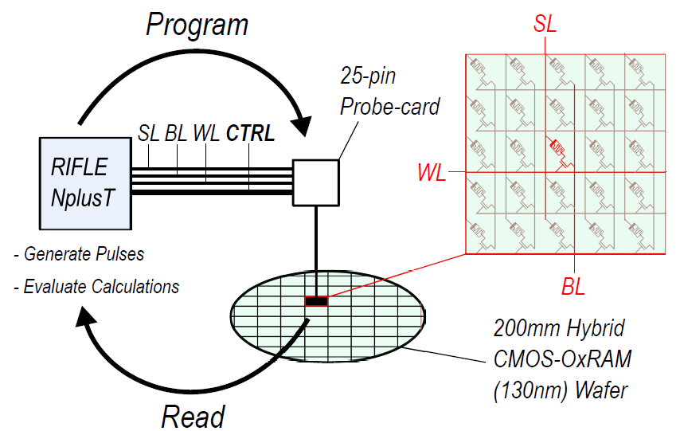
Memristor-Based MCMC in Practice
Computer-in-the-loop experiment with an array of 16,384 memristors
Mangasarian, O. L., et al (1995). Operations Research, 43(4), 570-577.
Dalgaty et al, Nature Electronics 4, p. 151, 2021
32
Notes:
We implemented our algorithm on an experimental system consisting of a computer in the loop with a fabricated RRAM array and applied it to a series of supervised learning tasks
Thank you to Niccolo for his help in developing this setup
One of the tasks we addressed was the detection of malignant breast tissue based on features extracted from images like these.

Slide 33
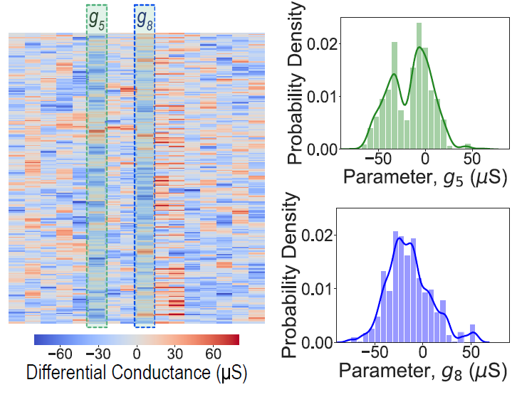
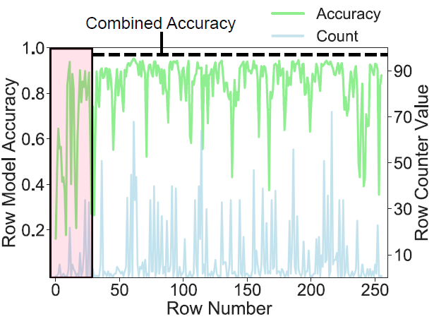
Supervised Learning with Memristor-Based MCMC
16 columns (inputs)
256 rows (samples)
The experimental system was able to detect maligant tissue with 98% accuracy
Dalgaty et al, Nature Electronics 4, p. 151, 2021
33
Notes:
We used an array of 256 rows, or samples, and 16 columns, or features.
After training finishes we are left with the posterior distribution shown as a heatmap here
Each cell of the heatmap is coloured as a function of the conductance value of the device at that location in the array
Plotted next to this heatmap we see two distributions of the conductance parameters learned in our experiment
I’d like to draw your attention in particular to the distribution in green at the right. This distribution has two modes, corresponding to two equally likely values of the parameter – something that would have been impossible to capture in a non Bayesian model
On the right hand side we plot the accuracy of each of these sampled array rows. We can see during the first 30 or so rows our algorithm gradually improves in accuracy as we converge towards the posterior distribution, and then after this it oscillates between high and medium accuracy models as it explores the posterior
After learning has finished the experimental model was able to detect unseen maligant tissue with an accuracy of 98%

Slide 34
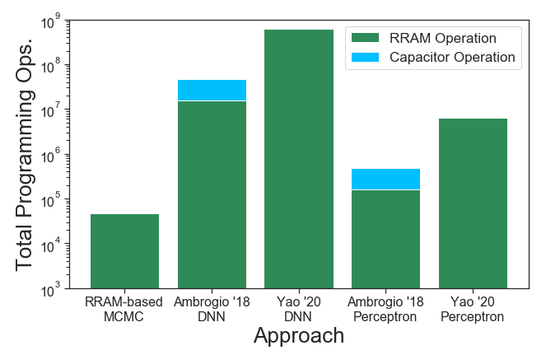
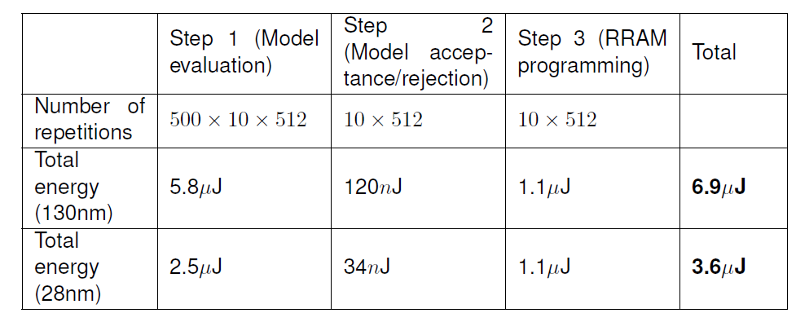
MCMC Learning Is Highly Energy-Efficient for Small Data
Memristor-based
backpropagation
Preliminary mixed-signal design results
(full model training)
Intel Xeon processor (7nm) implementation of MCMC sampling required 600mJ
Dalgaty et al, Nature Electronics 4, p. 151, 2021
Notes:
We used an array of 256 rows, or samples, and 16 columns, or features.
After training finishes we are left with the posterior distribution shown as a heatmap here
Each cell of the heatmap is coloured as a function of the conductance value of the device at that location in the array
Plotted next to this heatmap we see two distributions of the conductance parameters learned in our experiment
I’d like to draw your attention in particular to the distribution in green at the right. This distribution has two modes, corresponding to two equally likely values of the parameter – something that would have been impossible to capture in a non Bayesian model
On the right hand side we plot the accuracy of each of these sampled array rows. We can see during the first 30 or so rows our algorithm gradually improves in accuracy as we converge towards the posterior distribution, and then after this it oscillates between high and medium accuracy models as it explores the posterior
After learning has finished the experimental model was able to detect unseen maligant tissue with an accuracy of 98%

Slide 35
Conclusion
Computing like the brain with nanoelectronics devices: huge potential to reinvent electronics for cognitive-type tasks / pattern recognition
Memristors are rich devices that can be used in a variety of ways
A challenge is how to deal with memristor imperfection. Memristor models do not tell the whole story
Next steps: scaling and solving learning
Very important & creative time for micro/nano-electronics research

Slide 36







Acknowledgments
Stéphane Collin
Oleksandr Bilousov
Amadéo Michaud
Elisa Vianello
Tifenn Hirtzlin
Eduardo Esmanhotto
Djohan Bonnet
Niccolo Castellani
François Andrieu
Kamel-Eddine Harabi
Clément Turck
Tifenn Hirtzlin
Atreya Majumdar
Marie Drouhin
Jacques-Olivier Klein
Jacques Droulez
Pierre Bessière
Jean-Michel Portal
Marc Bocquet
Fadi Jebali
Jean-Pierre Walder
Eloi Muhr
Mathieu-Coumba Faye
Raphaël Laurent

Slide 37



Thank you for your attention!
NEURONIC
NANOINFER
@DamienQuerlioz
damien.querlioz@universite-paris-saclay.fr
https://sites.google.com/site/damienquerlioz/

