Slide 1
Eutectics of (Al₂O₃-YAG):Ce for Phosphor Converters of White Solid-State Lighting Driven by Laser Diodes
Oleh Vovk
ICMCB, Bordeaux
Institute for Single Crystals, Kharkiv

Slide 2
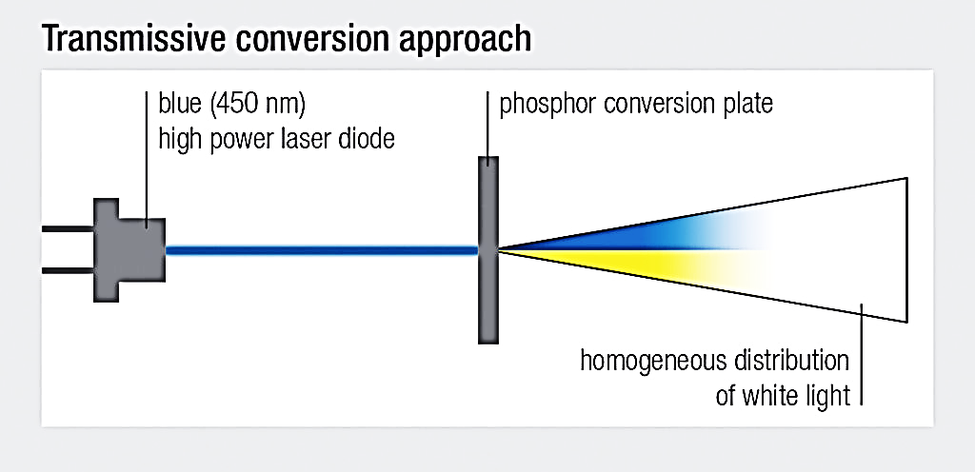
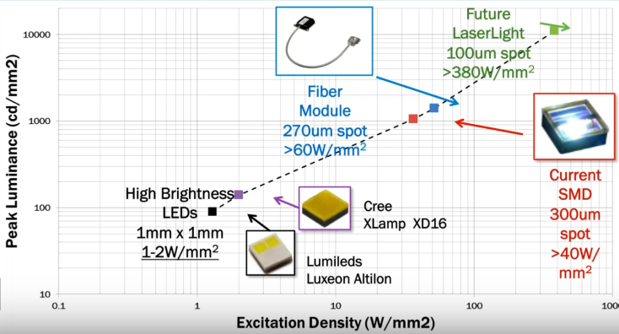
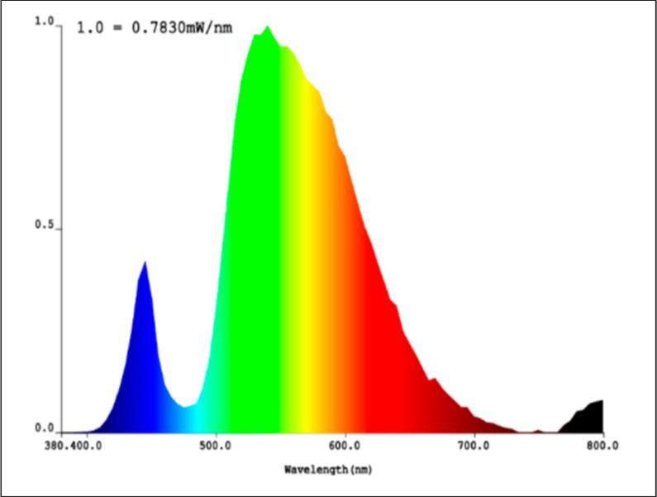
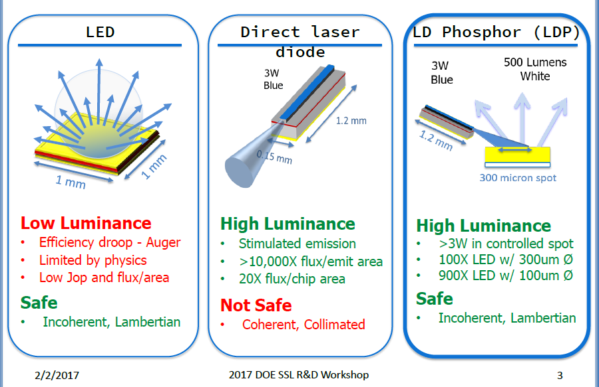
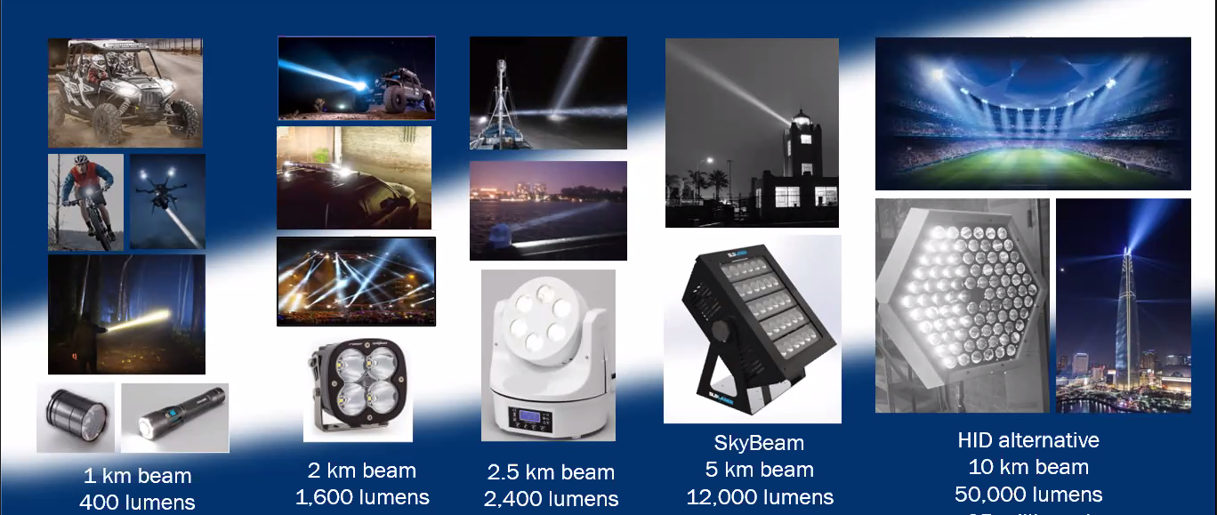
Motivation. Development of LD WSSL

Slide 3
Selected Rules for Laser Phosphors
Small luminescence saturation
Small thermal saturation
High quantum efficiency
Small Stokes shift
Low thermal quenching
High thermal conductivity
Effective heat dissipation
Small optical saturation
Short decay time
Uniform light distribution and high extraction efficiency
Suitable light scattering
Thermal and radiative resistance of the phosphors.
High chemical stability, non reacting with environment
(О₂, СO, CO₂, H₂O).
S. Li, L. Wang, N. Hirosaki, R., Laser Photonics Rev. 2018

Slide 4
Selected Rules for Laser Phosphors
Small luminescence saturation
Small thermal saturation
High quantum efficiency
Small Stokes shift
Low thermal quenching
High thermal conductivity
Effective heat dissipation
Small optical saturation
Short decay time
Uniform light distribution and high extraction efficiency
Suitable light scattering
Thermal and radiative resistance of the phosphors.
High chemical stability, non reacting with environment
(О₂, СO, CO₂, H₂O).
YAG:Ce
YAG:Ce + Al₂O₃
YAG:Ce
YAG:Ce + Al₂O₃
S. Li, L. Wang, N. Hirosaki, R., Laser Photonics Rev. 2018

Slide 5
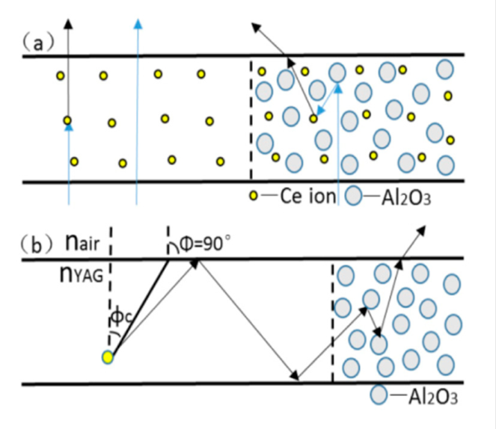
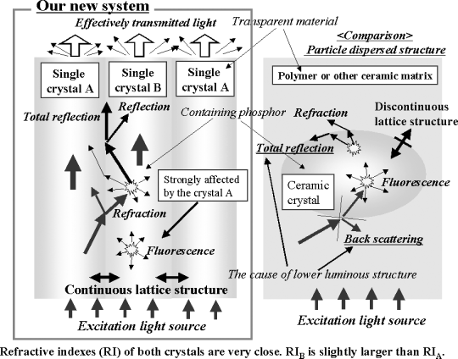
Light-harvesting model in light converter with dispersion medium of internal diffusers
The exhibition of the blue light being absorbed and converted by Ce³⁺ (a) and the light propagation (b) in single Ce:YAG matrix and in Ce:YAG matrix with Al₂O₃ particles, the critical angle φc = 33°. Y. Tang et al Optics Express, 2015
Schematic diagram of binary crystalline system for realizing incandescent, high-power white-light-emitting diodes along with comparative information regarding conventional particle-dispersed system.
Ishikawa et al, Int. J. Appl. Cer. Techn. 2006.
Estimation according our model results in rising light yield output
from 8 to 16 % for the scattering media

Slide 6
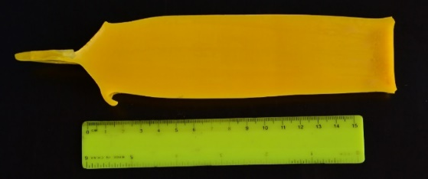
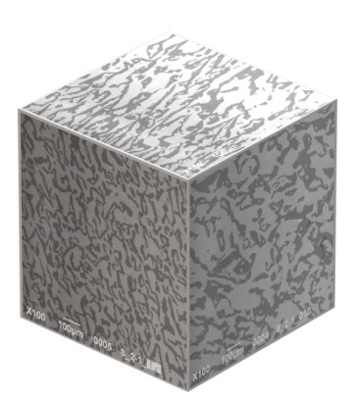
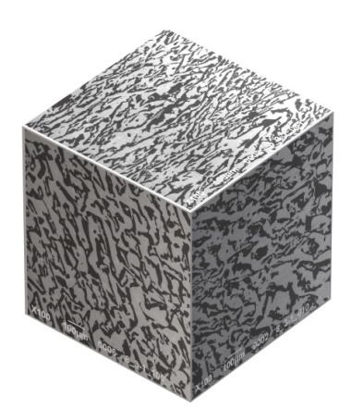
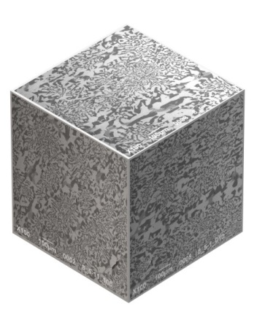
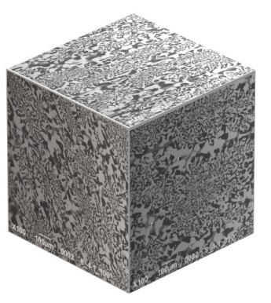
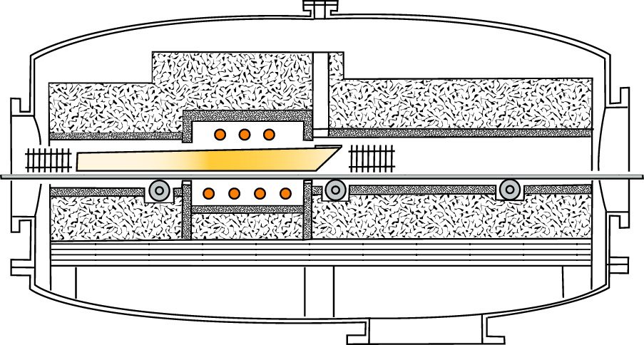
Eutectics Al₂O₃-YAG:Ce. Experimental scheme and sample morphology
Scheme of the horizontal directed crystallization (HDC) setup
Typical ingot of eutectic Al₂O₃/YAG:Ce, 1 at% Ce
z
y
x
Crystal axis
Morphology of the different ingots of the Al₂O₃-YAG:Ce eutectics
Notes:
We have synthesized and investigated the alumina yttrium aluminum garnet eutectics doped with CE as phosphor for laser lighting
Al2O3 –YAG:Ce eutectic has been synthesized by the HDC technique. The composition of eutectics was taken according well know phase diagram with correction on the Ce amount.
Description of the HDC
Desciption of the experiment
Desciption of the morphology: two phases, mutual penetration, cellular growth
Phases are corundum and YAG that proven by XRD
Typical crystal
Dependence of morphology from grown conditions rate of crystallization

Slide 7
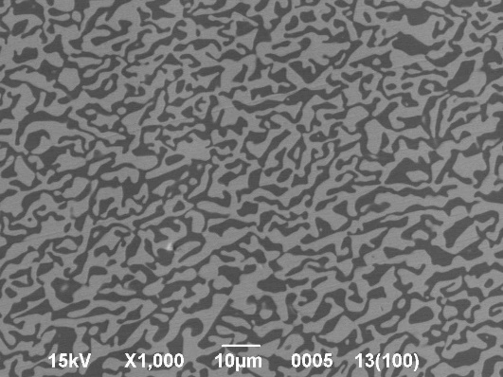
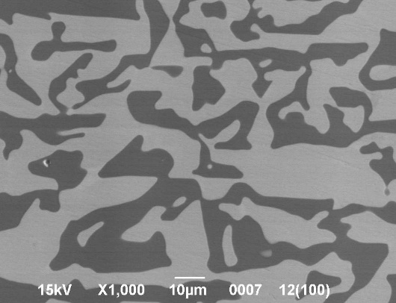
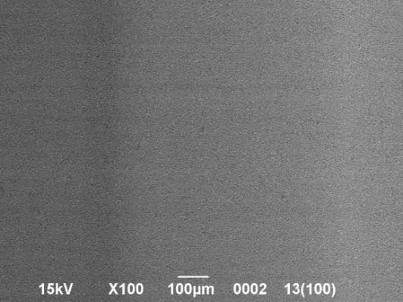
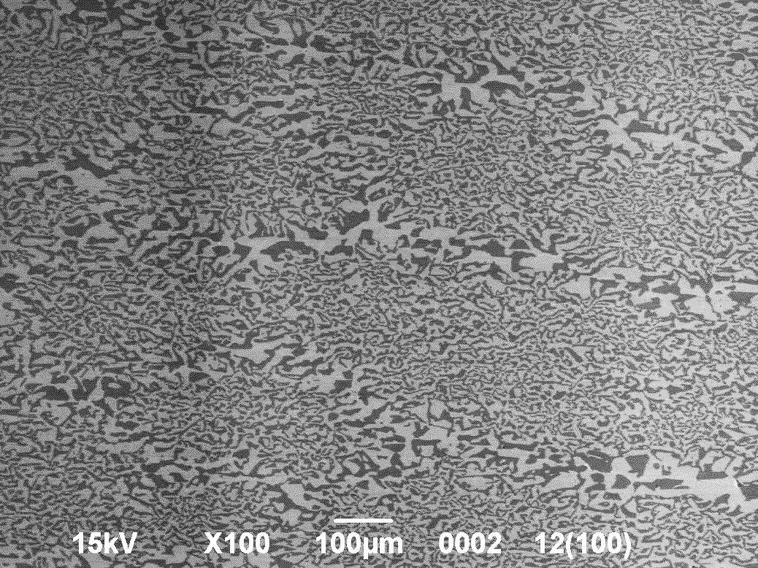
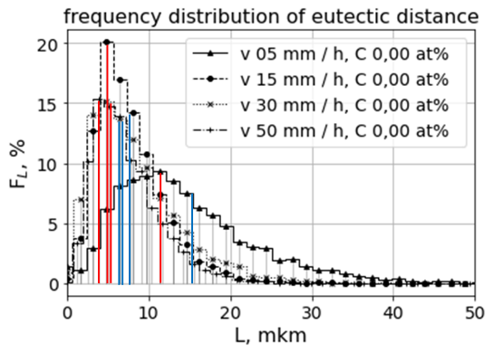
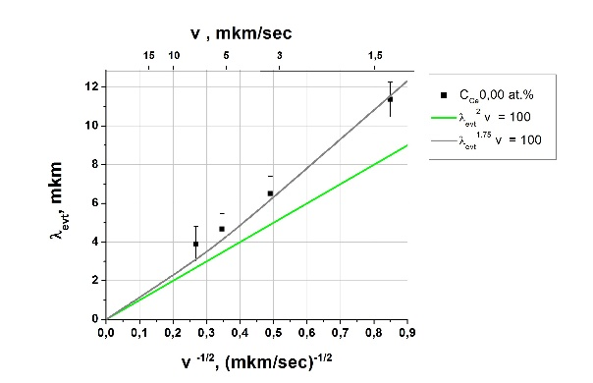
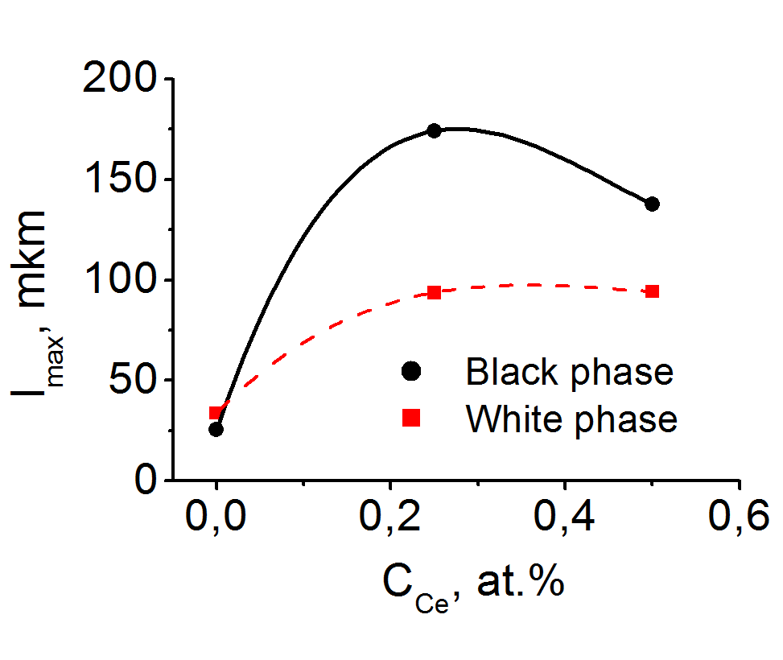
Morphology of Al₂O₃/YAG:Ce eutectics
SEM Al₂O₃/YAG:Ce, 0 at% Ce, 50 mm/h
SEM Al₂O₃/YAG:Ce, 0.25 at% Ce,15 mm/h
Dependance λ_{евт} on V:
1) theoretical, λ_{евт}²V=const,
2) experimantal, λ_{евт}^{1,75}V=const
Dependance max. length of chord on С(Се)

Slide 8
Structural perfection of the crystal boundaries. TEM and HRTEM

Slide 9
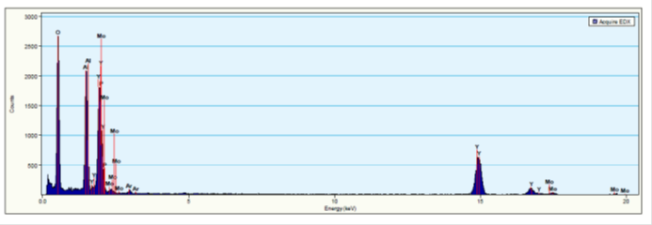
Structural perfection of the YAG crystal in eutectics. HRTEM and EDS

Slide 10
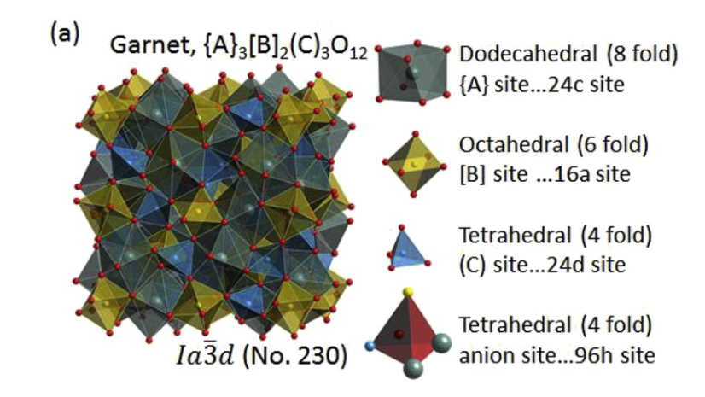
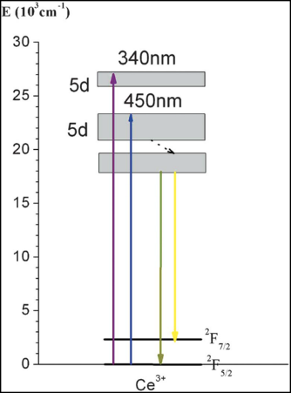
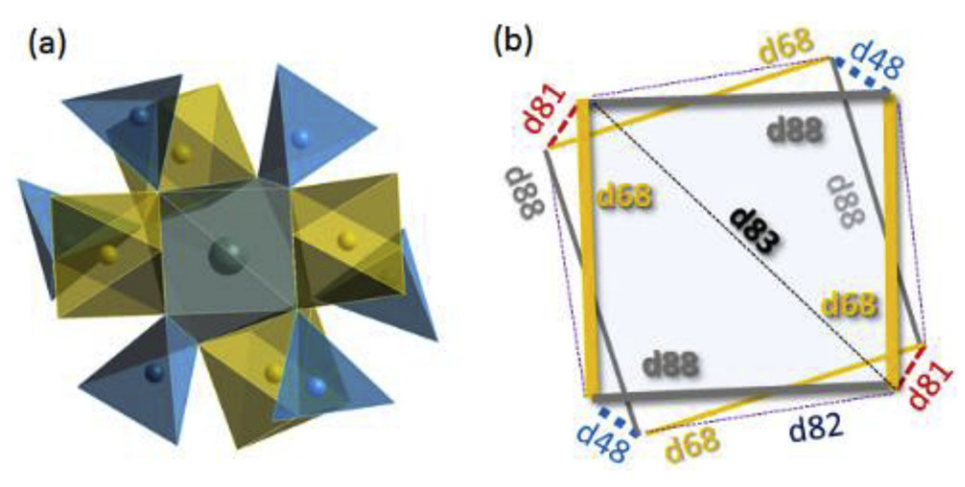
Garnet crystal structure of Y₃Al₅O₁₂
Schematic diagram of the electronic levels of Ce³⁺ in YAG
Local structure of a dodecahedral position and schematic dodecahedral framework

Slide 11
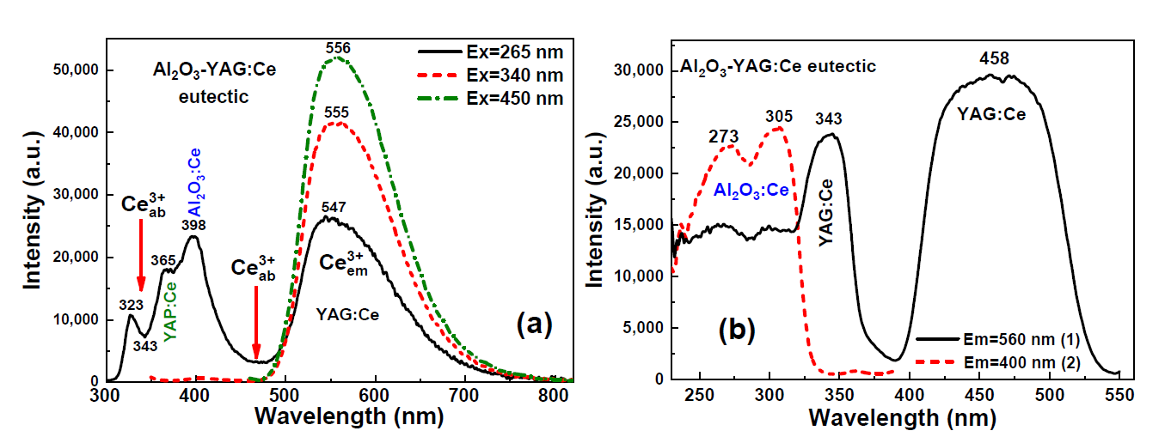
Luminescent properties, PL and PLE spectra
PL emission spectra (a) and PLE spectra (b) of (Al₂O₃-YAG):Ce eutectic (sample 4) under excitation at different wavelengths (a) and registration of Ce³⁺ luminescence in the garnet ((b), curve 1) and sapphire phase ((b), curve 2). A.Shahno Materials 2023, 16, 2701 https://doi.org/10.3390/ma16072701

Slide 12
Decay kinetics of (Al₂O₃-YAG):Ce eutectic
Decay kinetics of (Al₂O₃-YAG):Ce eutectic corresponding to the Ce³⁺ luminescence in the YAG:Ce (1) and Al₂O₃:Ce (2) phases under excitation in the respective PLE bands at 450 nm (1) and 270 nm (2). A.Shahno Materials 2023, 16, 2701 https://doi.org/10.3390/ma16072701

Slide 13
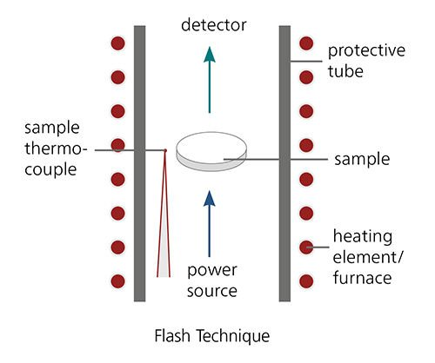
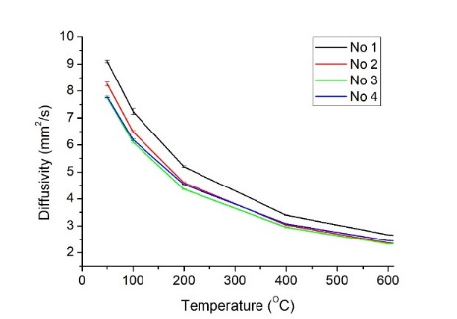
Thermal properties of the Al₂O₃-YAG:Ce eutectics. Laser Flash Analysis
Principles of the LFA
λ(T)= a(T) · ρ(T) · c_{p}(T)
a: Thermal diffusivity
ρ: Density,
c_{p}: Specific heat capacity, λ: Thermal conductivity, T: Temperature
·
Thermal diffusivity of the Al₂O₃-YAG:Ce eutectic composite
Thermal conductivity eutectic composite

Slide 14
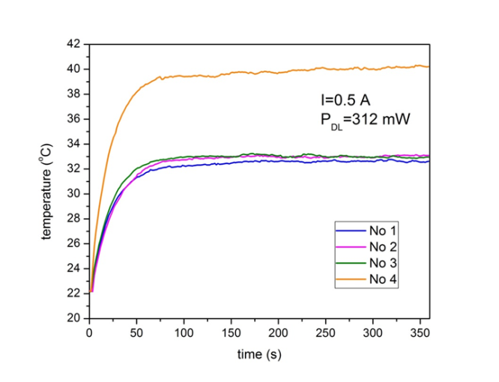
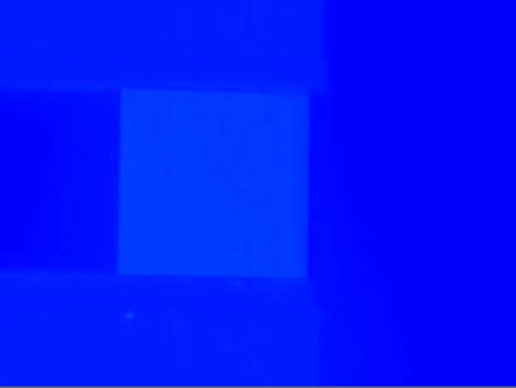
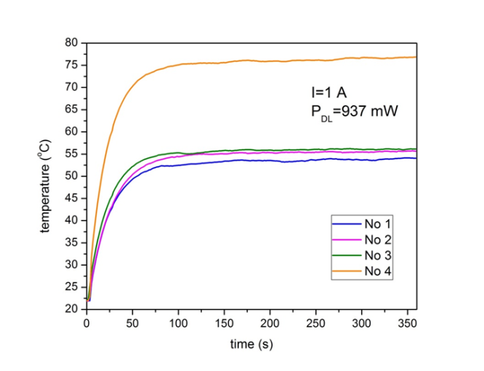
Kinetics of sample temperature under laser irradiation
2D heat distribution in sample # 1 a) and sample # 4 b) under blue diode laser excitation with optical power P=937 mW at different time intervals (after 10s, 25s, 36s, 46s, 85s and 360s) (compare Fig. 3).

Slide 15
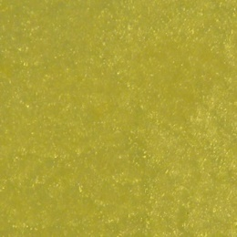
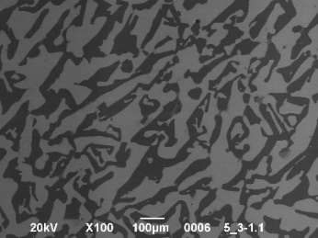
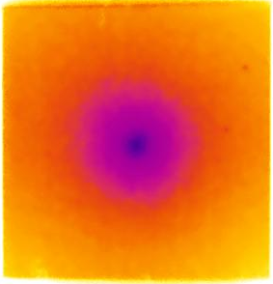
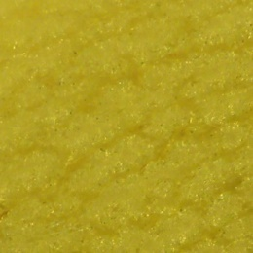
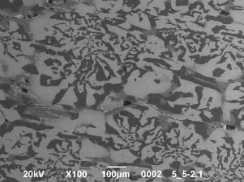
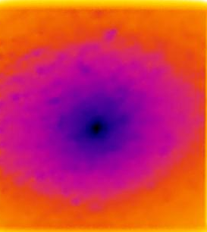
Dependence of the thermal behavior of Al₂O₃-YAG:Ce eutectics on morphology
Sample photos
SEM images
Thermal images
Kinetics of the horizontal temperature distribution

Slide 16
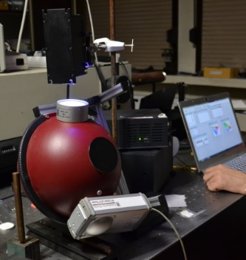
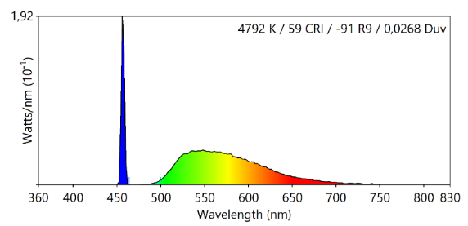
Radiometry under laser excitation at 450 nm
СІЕ diagram of Al₂O₃/YAG:Ce eutectics, without LD
sample | Efficiency, Lm/W | Efficiency, % | Sensitivity, Lm/W
# 2 | 231 | 62 | 370
# 3 | 267 | 68 | 394
# 4 | 234 | 63 | 373
# 5 | 172 | 50 | 342
СІЕ diagram of Al₂O₃/YAG:Ce eutectics

Slide 17
Conclusion
Al₂O₃-YAG:Ce eutectics meets the requirements to phosphor converter for high power White Solid State Lighting driven by Laser Diodes

Slide 18
Our colleagues who collaborate in the work
Institute of Physics NAS Ukraine, Kyiv
Institute Low Temperature and Structural Research, Polish Academy of Sciences, Wroclaw
Institute of Physics, PAS, Warsaw
Institute of Electronic Materials Technology, Warsaw
Kazimierz Wielki University in Bydgoszcz, Bydgoszcz
Universidad Autónoma de Madrid, Madrid

Slide 19
Thank for attention

