Slide 1
Effect of electronic reservoir on phase transitions in strongly correlated systems
Soumen Bag
Laboratoire de Physique des Solides (LPS), Université Paris-Saclay, France
25 th Jan, GDR Meeting, Collège de France

Slide 2
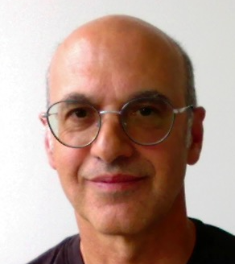
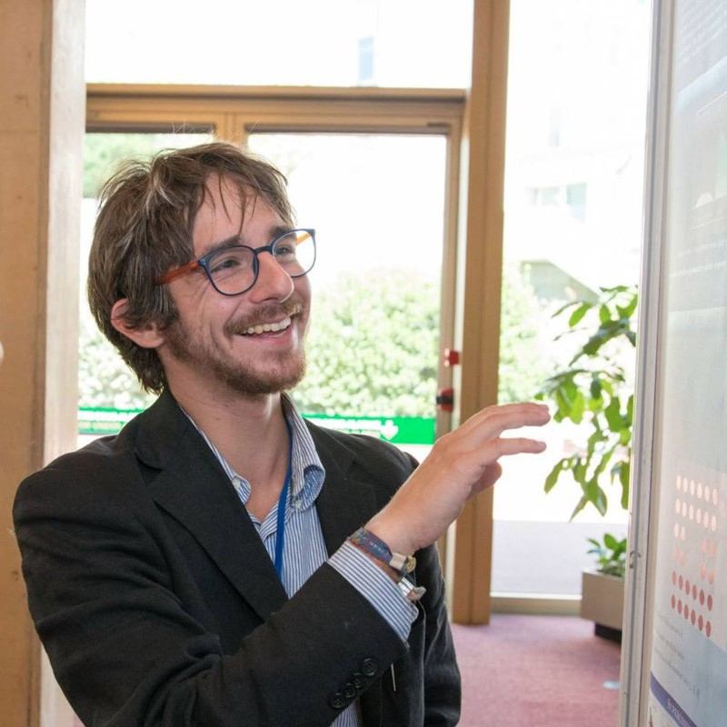
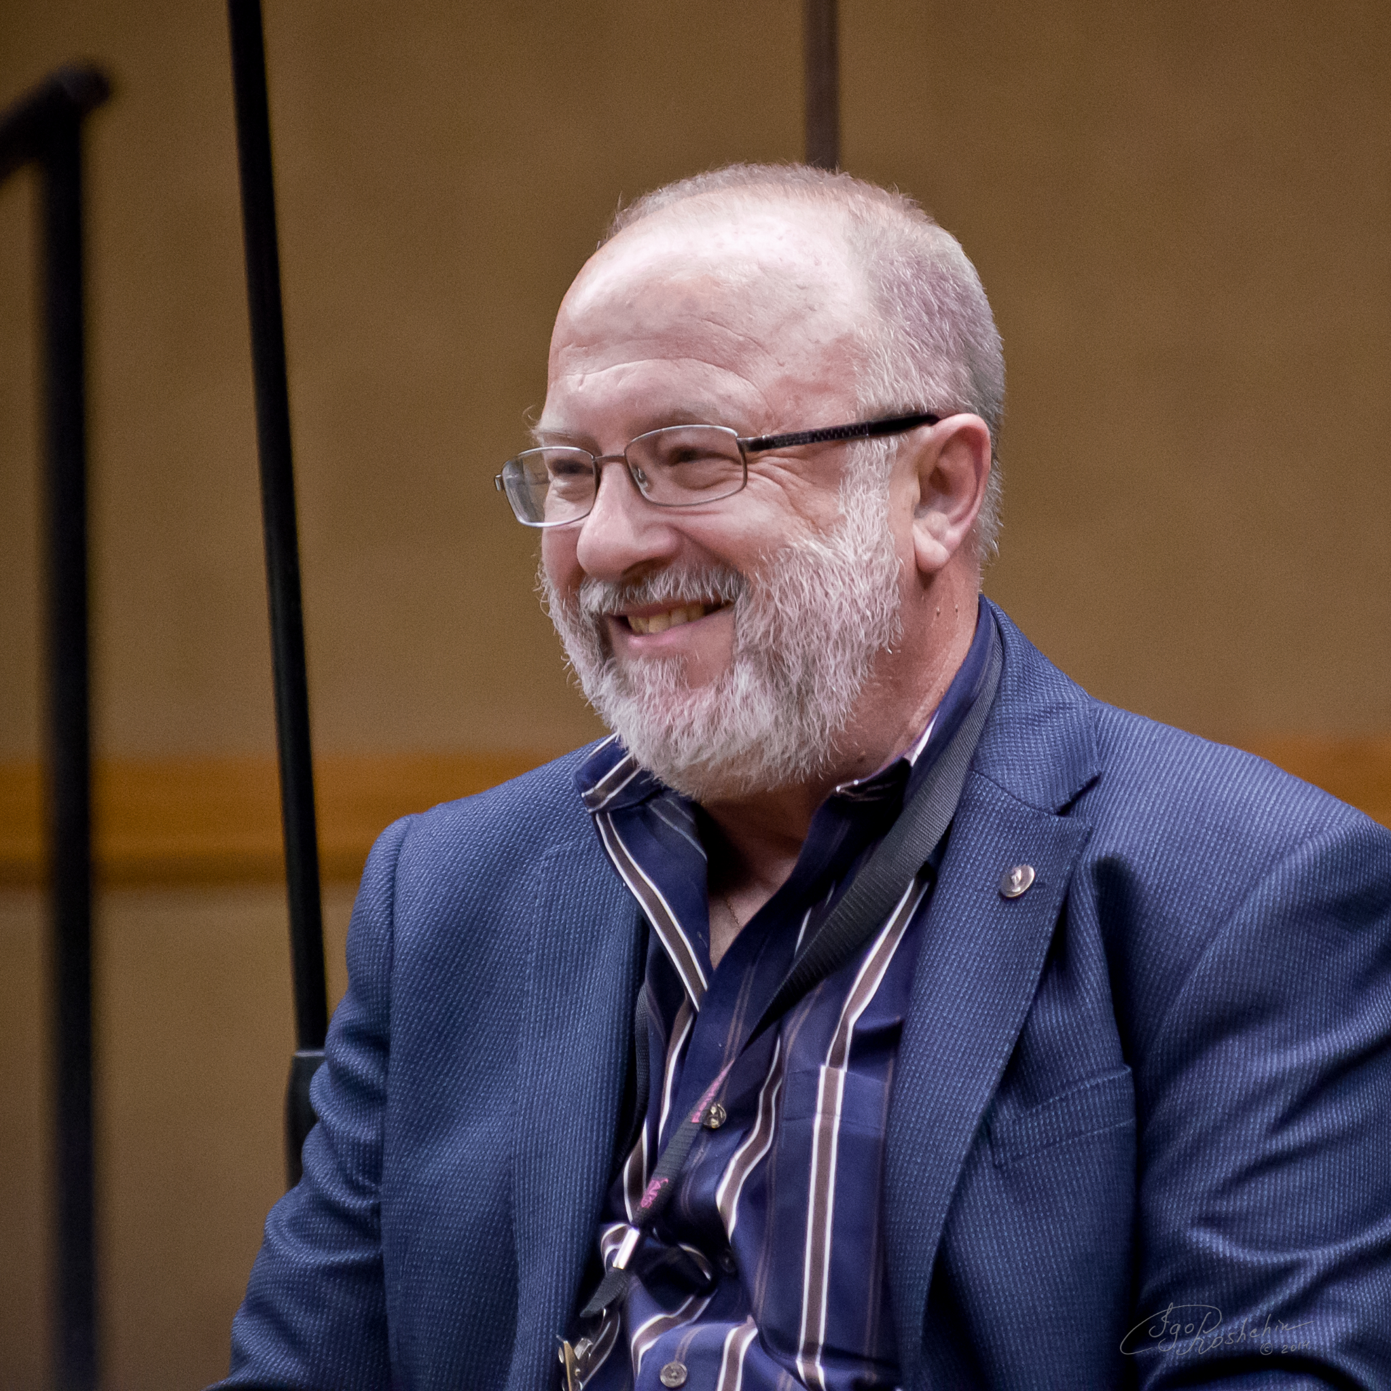
Theory
Lorenzo Fratino
Laboratoire de Physique Théorique et Modélisation
Alberto Camjayi
University of Buenos Aires
Marcello Civelli
LPS, Université Paris-Saclay
Marcelo Rozenberg
LPS, Université Paris-Saclay
Experiment
Henry Navarro
University of California, San Diego
Ivan K. Schuller
University of California, San Diego

Slide 3
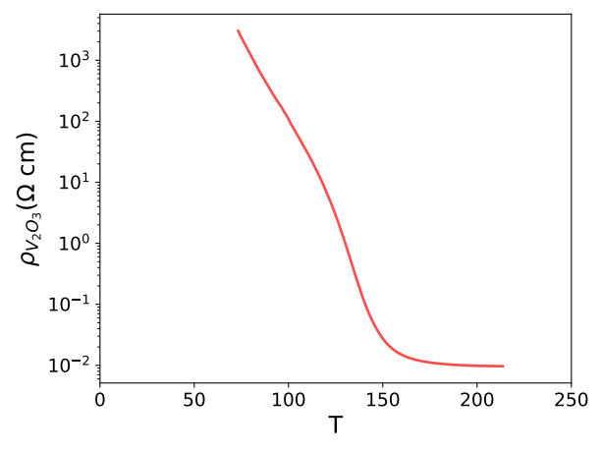
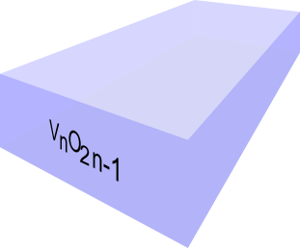
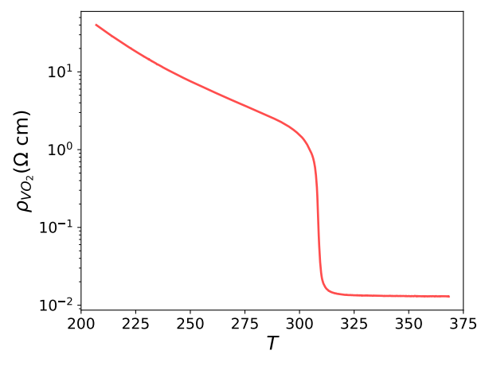
Introduction: tuning transition temperature
Large resistance change across the transition can be exploited in neuromorphic device
Insulator to Metal tansition V₂O₃
Resistance changes 6 order of magnitude.
Resistance switching phonomenon make it interesting for various application like memory storage, nuromorphic computing etc. but the problem is it has transition temperature ~150 K which is well below the room temperature. Where as its cousin VO₂ has transition temperature 310 near room temperature.
V₂O₃
Pressure and chemical doping can tune transition.
Easy way to tune the transition temperature?
It is interesting to tune the transition temperature.
Namely pressure, doping, light. Especially, the effect of light on these films is small
VO₂

Slide 4
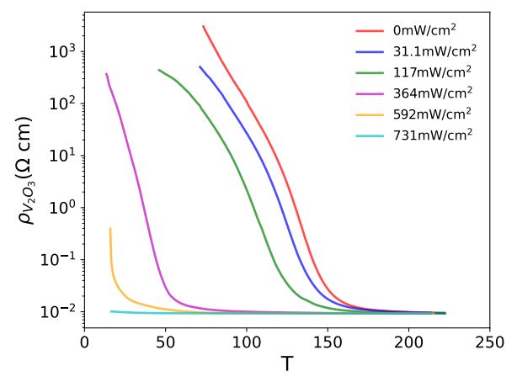
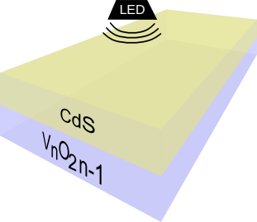
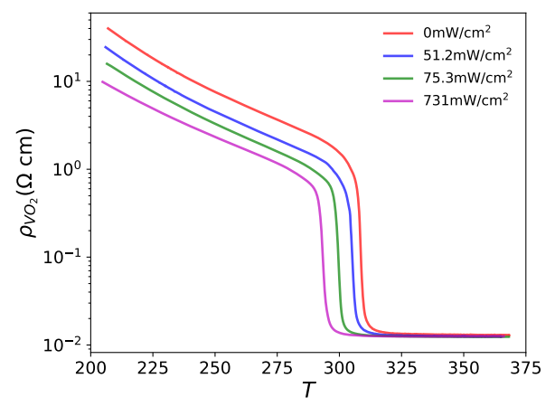
Can we control T_{IMT} using light?
Transition temperature decreases with increasing illumination intensity (P) for CdS/V₂O₃
In principle one can switch from insulating state to metallic state by light.
CdS/V₂O₃
Transition temperature suppress with increasing illumination intensity (P) for CdS/VO_{2.} But, Suppression is relatively small.
CdS/VO₂
H. Navarro Appl. Phys. Lett. 118, 141901 (2021)
Can we understand the suppression of T_{IMT}?

Slide 5
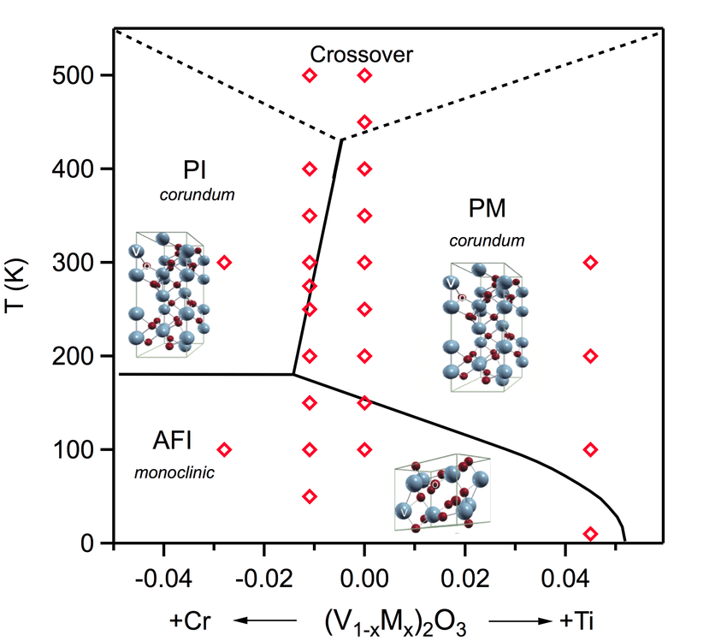
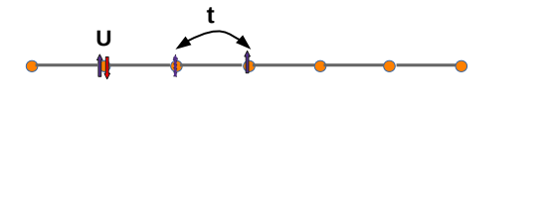
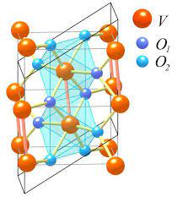
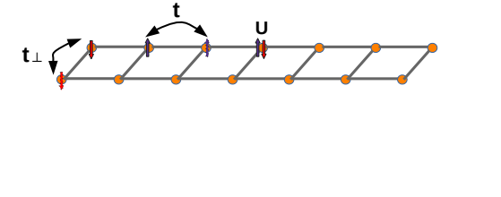
Minimal Model
Hubbard Model (HM)
V₂O₃
Dimer Hubbard Model (DHM)
VO₂
HM: J. Trastoy, M. Rozenberg, et. al. PRB, 101:245109 (2020)
DHM: O. Nájera, M. Rozenberg, et. al. PRB, 95(3):035113, 2017
arxiv.org/pdf/cond-mat/0210558.pdf
Anti-Bond(AB)
2
Bond(B)

Slide 6
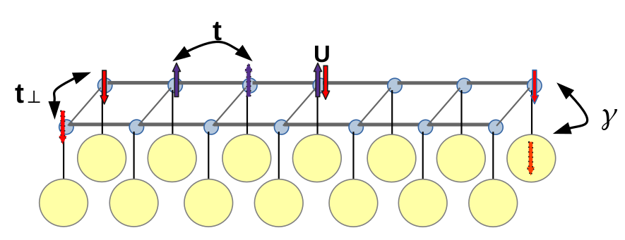
Minimal model for heterostructure model and method
Hubbard Model (HM)
CdS/V₂O₃
CdS
Dimer Hubbard Model (DHM)
We will use DMFT with HYB-CTQMC impurity solver
CdS/VO₂
Parameter of interest is:
HM: J. Trastoy PRB, 101:245109 (2020)
DHM: O. Nájera PRB, 95(3):035113, 2017
How Γ effect the system?

Slide 7
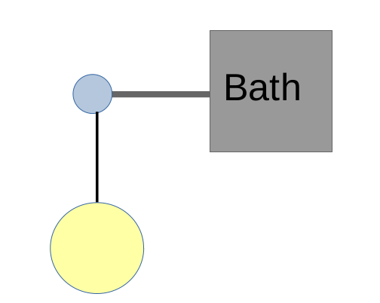
DMFT for Electronic reserver coupled HM
DMFT
Integrating out the ‘a’ fermion lead to an effective addition hybridization to the ‘c’ fermions:
Where
, Where Γ = γ²/D
A. Georges, M.R. et.al. DMFT RMP, 1996
P. werner et.al. HYB-CTQMC, PRL, 2006
We solve impurity model using Hybridization expansion Continuous Time Quantum Monte Carlo (HYB-CTQMC) as impurity solver.

Slide 8
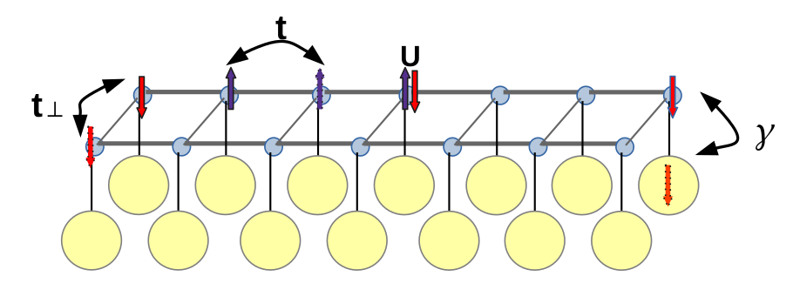
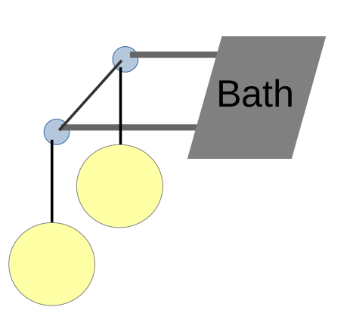
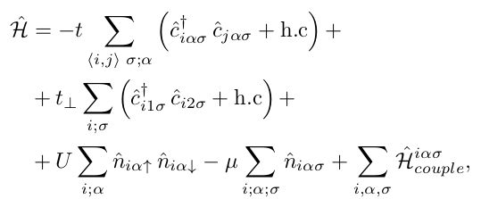
DMFT for Electronic reserver coupled DHM
DMFT
Where
We solve impurity model using Hybridization expansion Continuous Time Quantum Monte Carlo (HYB-CTQMC) as impurity solver.

Slide 9
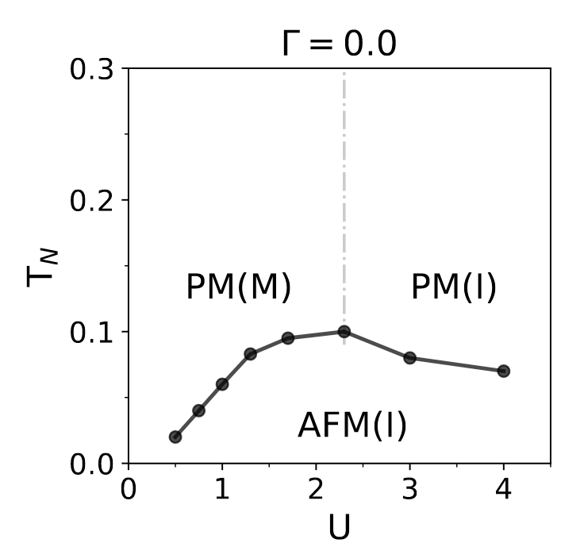
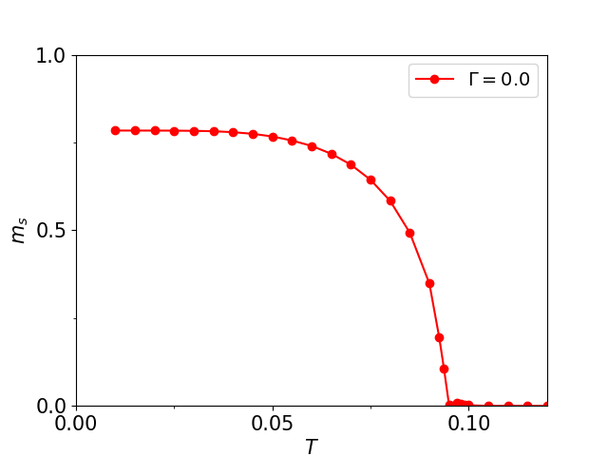
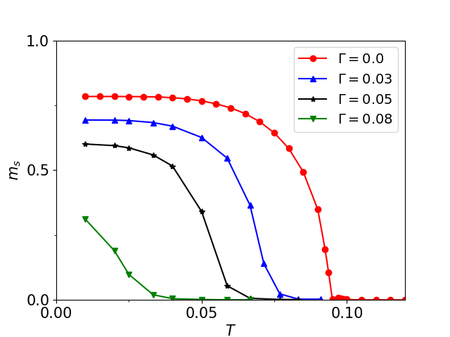
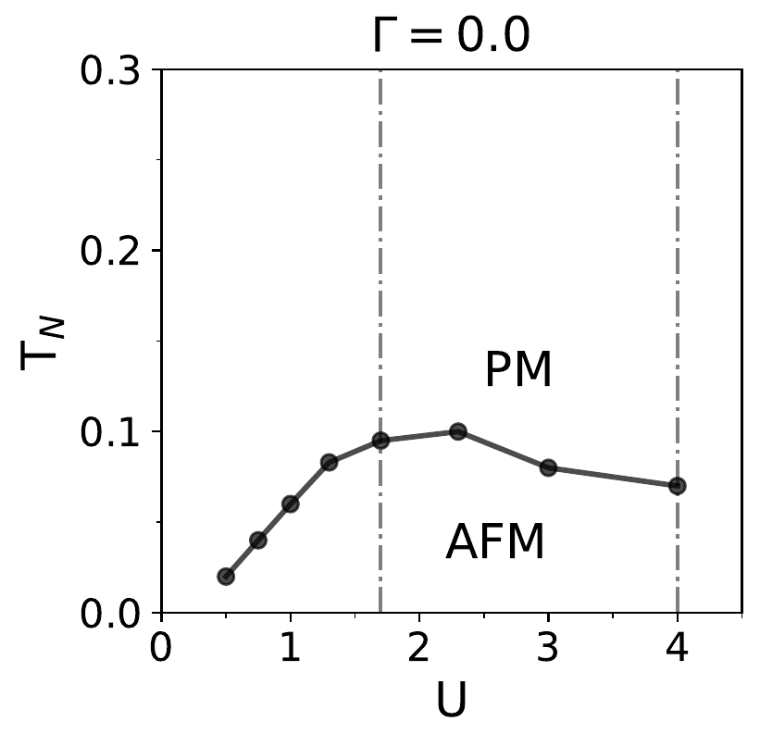
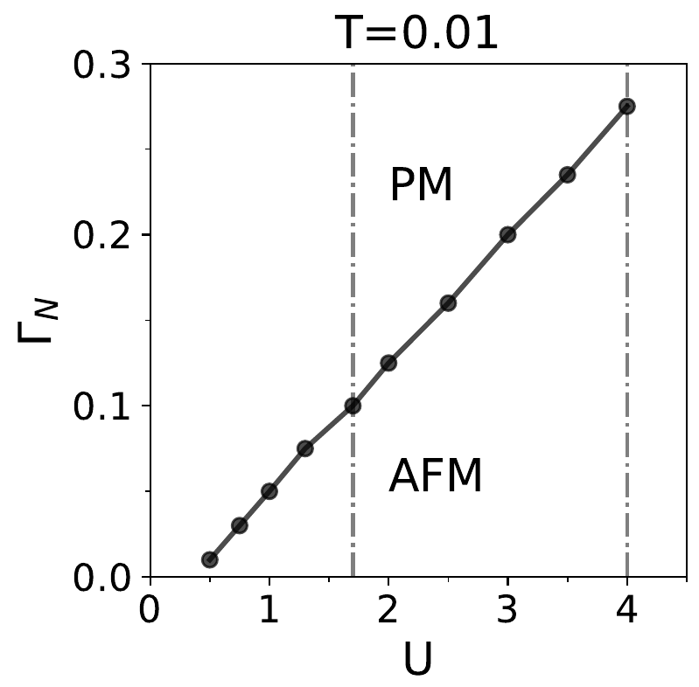
Suppression of AFM in HM
Slater
Heisenberg
PM(M): Paramagnetic (Metal), PM(I): Paramagnetic (Insulator), AFM(I): Antiferromagnet (insulator
At small U, T_{N} ~ exp(∆(U)) at large U is T_{N} ~ t²/U
ms at low temp decreases
T_{N}
T_{N} decreases with Γ.
Why T_{N} suppress?

Slide 10
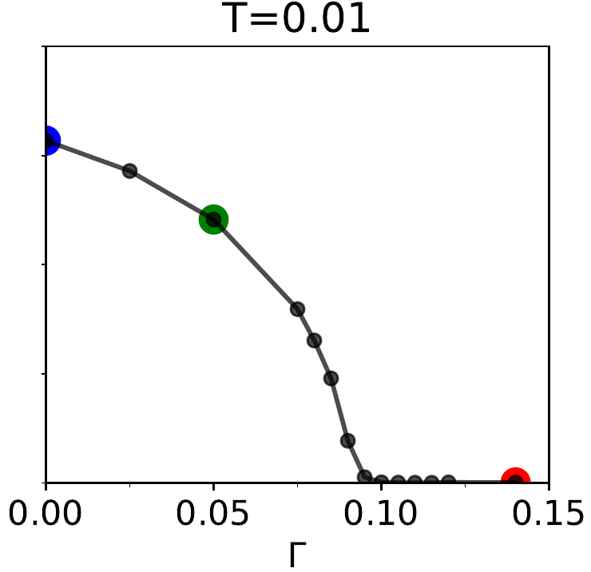
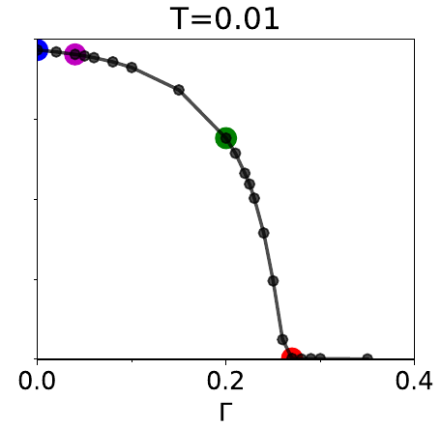
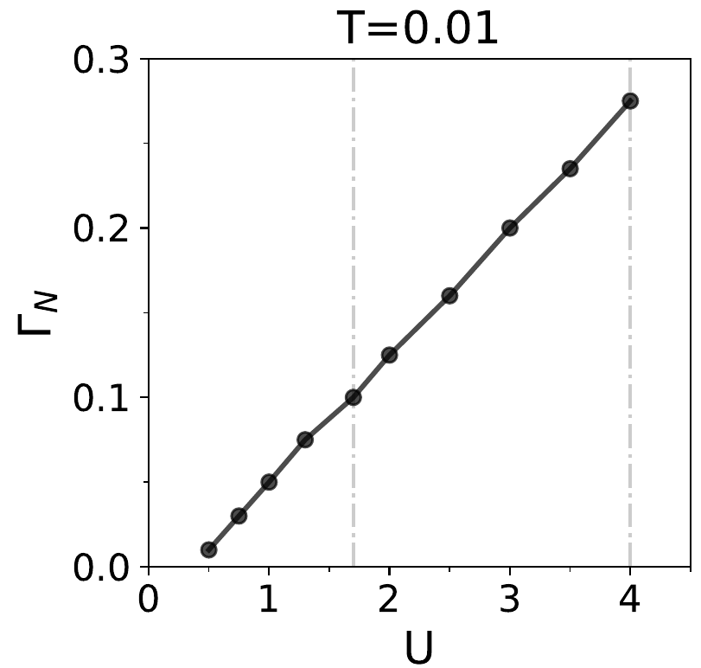
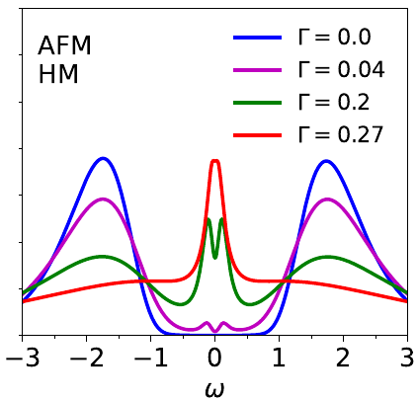
Suppression of AFM in HM
Jk
U=4.0
U=1.7
Kondo effect give rise two peak around zero frequency and responsible to AFM suppression!

Slide 11
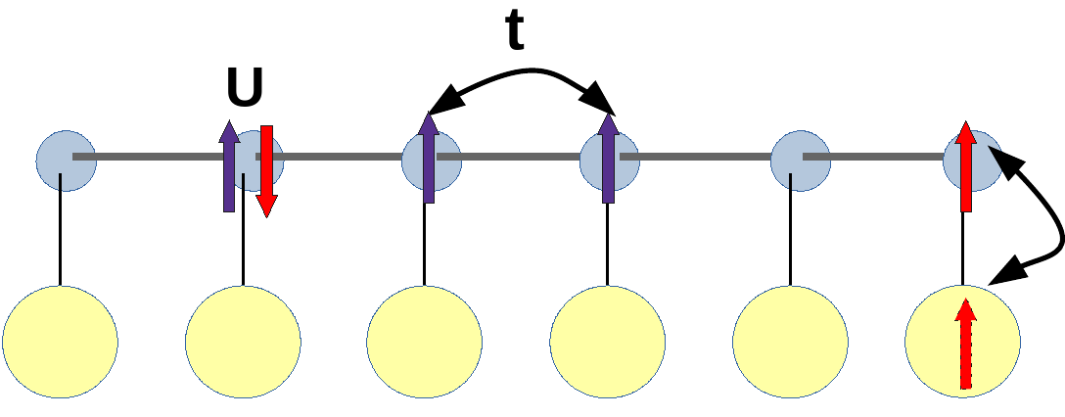
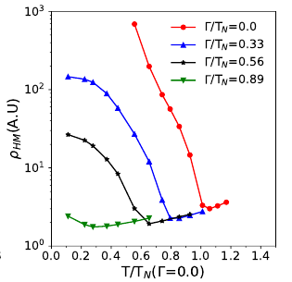
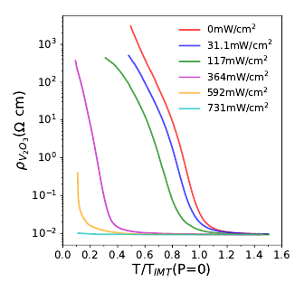
Experiment and theory for suppression of T_{IMT} in CdS/V₂O₃
Experiment
Theory
Γ
U=1.7
CdS/V₂O₃
suppression of Transition temperature T_{IMT} observed in CdS/V₂O₃
For HM-AFM coupled with metallic bath, Transition temperature suppresses with increasing Γ.

Slide 12
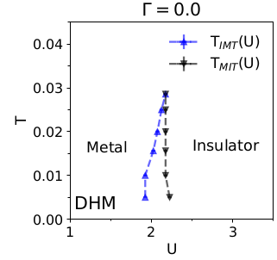
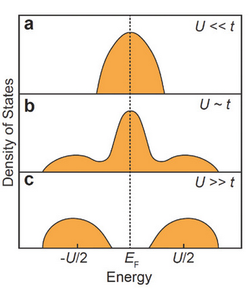
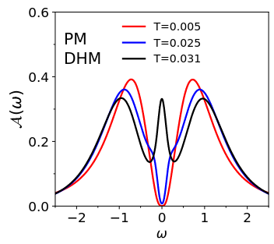
IMT in DHM
metal
Insulator
What happen to the transition as a function of Γ?
O. Nájera, M. Rozenberg, et. al.PRB, 95(3):035113, (2017)
L. Fratino, S. Bag, M. Rozenberg, et. al., PRB 105,125140 (2022)

Slide 13
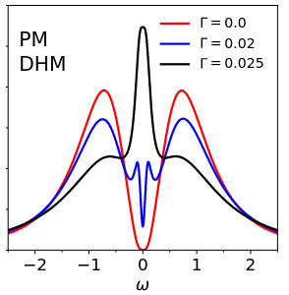
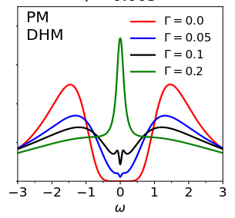
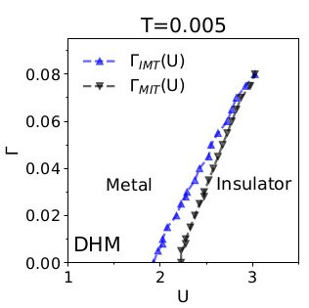
Effect of Γ on the the Mott phase of DHM
U=2.2
U=4.0
Anti-Bond(AB)
Bond(B)
AB and B form kondo singlet with reservoir’s electron

Slide 14
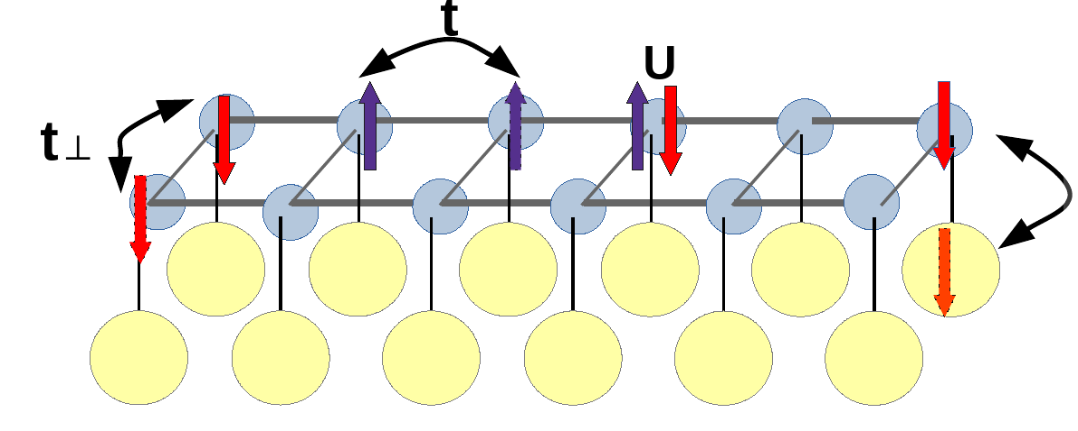
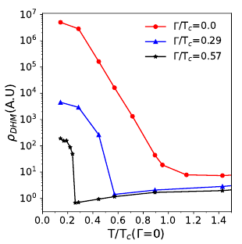
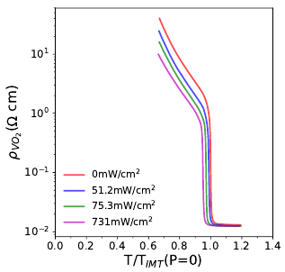
Experiment and theory for suppression of T_{IMT} in CdS/VO₂
Experiment
Theory
Γ
suppression of Transition temperature T_{IMT} observed in CdS/VO₂
For DHM coupled with electronic reervoir, Transition temperature suppresses with increasing Γ.

Slide 15
conclusion
Hubbard model coupled with a electronic reservoir could capture the suppression of IMT observed in CdS/V₂O₃ by light.
Dimer Hubbard model coupled with electronic reservoir capture the suppression of IMT observed in CdS/VO₂ by light. But it overestimate the transition
The coupling to the lattice structure of the electronic degrees of freedom of VO2,which is absent in our simplified model
Thanks for your attention!

